Slide 1
Opioid Agonist Therapy 101: An Introduction to Clinical Practice Workshop
The Comprehensive Patient Assessment
Talia Carter, OT Reg(MB), MOT, CPSM Prescribing Practices Coordinator
created with Dr. Morag Fisher, MBChB, CCSAM, Lecturer Dept. Family Medicine

Slide 2
Disclosure of Commercial Support
This program has received financial support from The College of Physicians and Surgeons of Manitoba in the form of funding for payment of presenters and organizers.
This program has received in-kind support from The College of Physicians and Surgeons of Manitoba in the form of logistical support.
Potential for conflict(s) of interest:
None identified

Slide 3
Faculty/Presenter Disclosure
Faculty: Talia Carter
Relationships with commercial interests:
None for either

Slide 4
Learning Objectives
Upon completion of this session, you should be able to perform a comprehensive assessment of an individual with Opioid Use Disorder including:
Understanding the science & art of history taking in addictions medicine
Taking a sensitive social history
Taking a history of substance use & recovery
Assessing comorbid medical conditions & impact on treatment
Conducting a focused physical examination
Discussing treatment options

Slide 5
The Comprehensive Assessment
Opening
Social History
Addiction History
Substance Hx
Behavioural Hx
Treatment History
Medical History
Physical Health
Mental Health
Medication Review
Physical Exam
Lab Tests
Wrap Up & Plan

Slide 6
Opening The Interview
Frames the Interaction & Expectations
Gets you both on the same page for the work ahead

Slide 7
Opening The Interview
Greeting & Welcoming
Briefly review why you think they have come today
Doctor’s referral, community agency referral, self-referral, walk-in
Briefly review why they have come
Motivating factors? Referring doctor’s idea? Withdrawal, illness, loss? Child & family services or criminal justice pressure?
Outline interview plan
“We have about 30 minutes today. I’m going to ask you a bunch of questions, about your life, substances you’ve used, and about your health. Some questions might feel difficult or sensitive, but bare with me – the more I learn about you, the better we can work together on a treatment plan that makes sense for you”

Slide 8
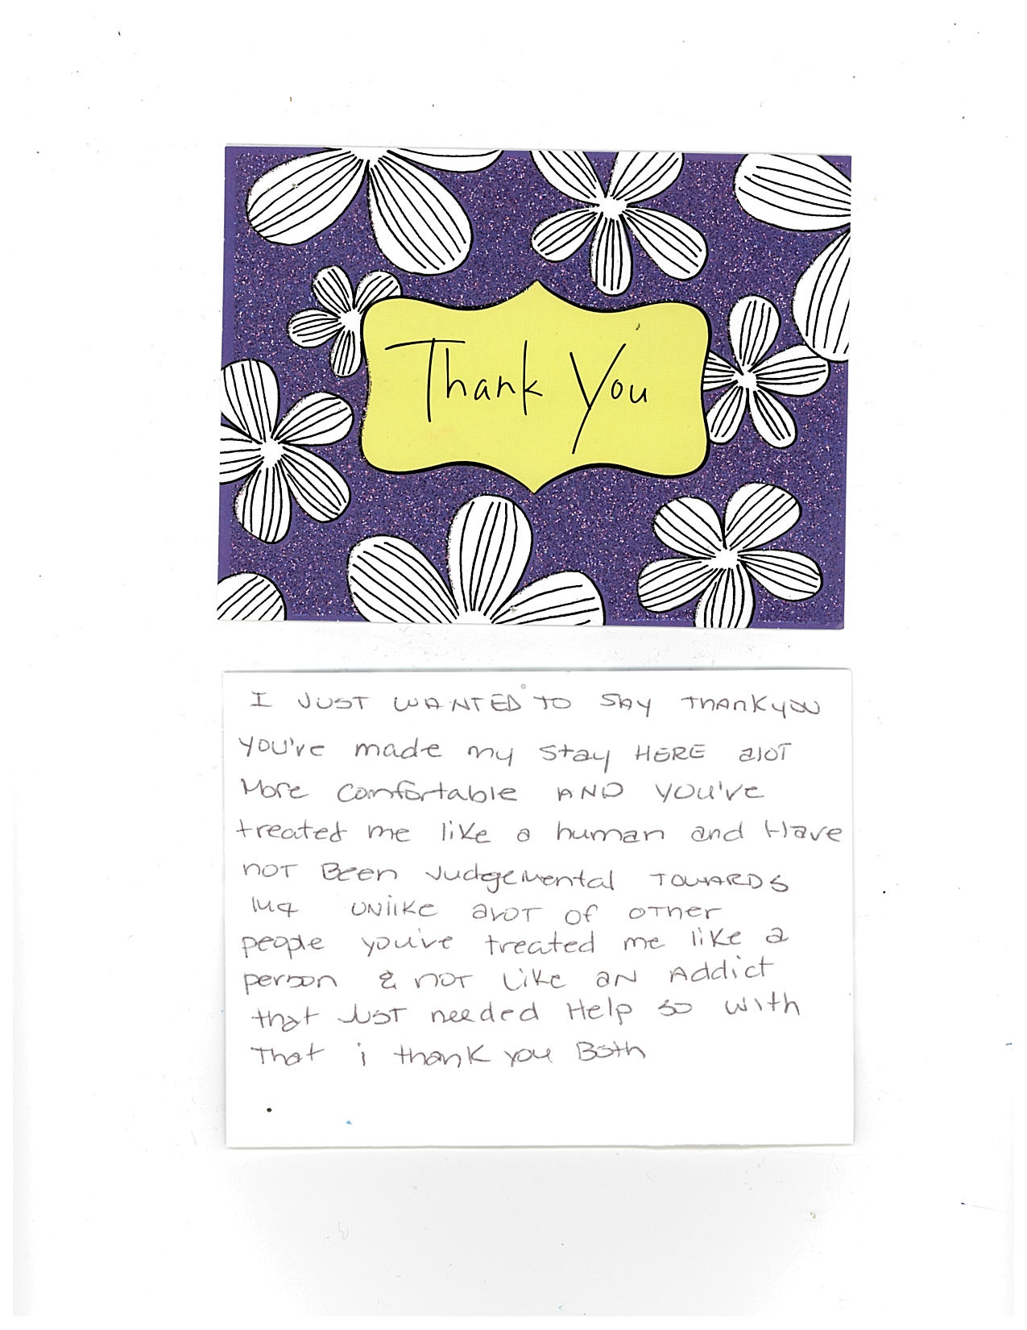
SCIENCE
& ART
of
Addiction Medicine
Notes:
Thank you note for 2 nurses on B2. Although inpatient example, this is what you want to cultivate in an interview.
Objective “ 3) Appreciate the value of sensitivity, understanding and commitment in the delivery of addictions medicine in clinical or pharmacy practice.”
This is the ART in the science of addiction medicine (of clinical interactions in general!)

Slide 9
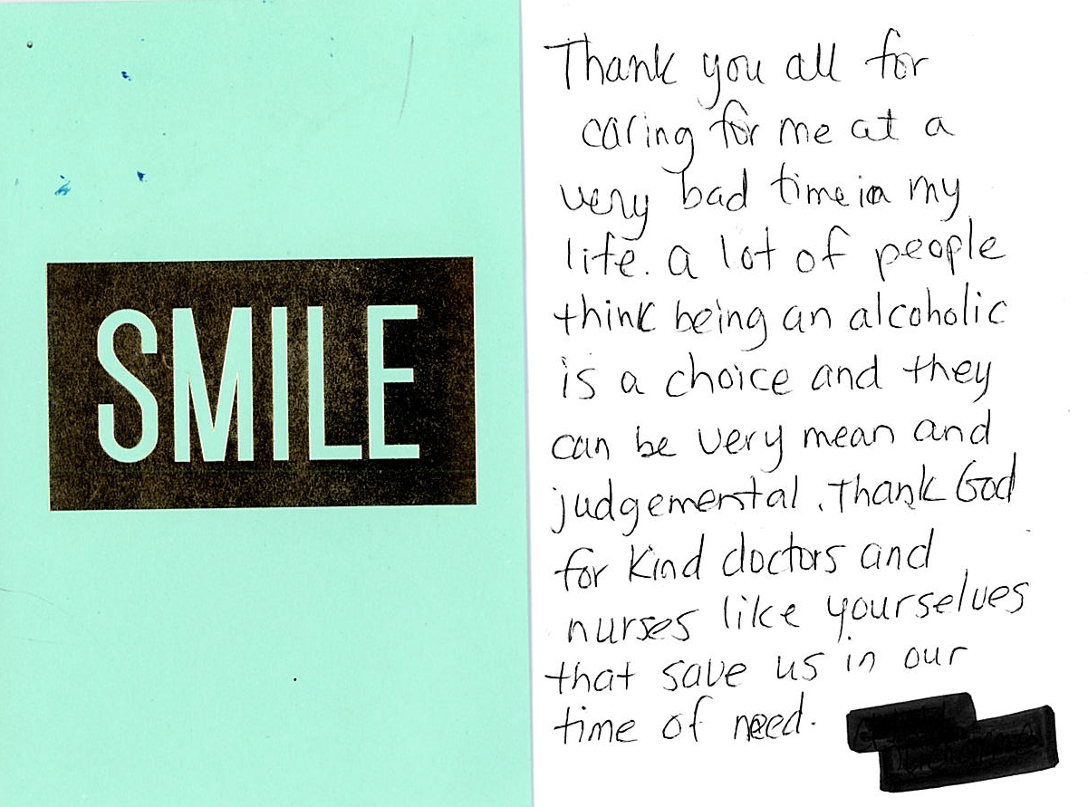
Workshop Objective…
“Appreciate
the value of sensitivity, understanding
and commitment
in the delivery
of addictions medicine in clinical or pharmacy practice.”

Slide 10
“What unites people? Armies? Gold? Flags? Stories. There’s nothing more powerful than a good story.” Tyrion Lannister - Game of Thrones

Slide 11
Social Hx – Their Story
What do you ask?
What’s important to know?

Slide 12
Social Hx – Their Story
Age
Housing (where, with who, stable, safe?)
Family & Relationships (who’s in their life? sober vs. users, safe, aware of problem, children in custody or care?)
Education (level, literacy)
Work (past, current, employer aware, LOA)
Finances (income source, untraditional means, debt)

Slide 13
Social Hx – Their Story
Illicit activity (dealing, stealing, prostitution, gang association)
Legal issues (charges, court dates, warrants, DUIs, incarceration, CFS involvement)
Supports (friends, family, (para)professionals)
Stressors (typically manifest in above)
Childhood & Teens (family dynamics, family addiction, abuse/trauma experience… depth dictated by patient)

Slide 14
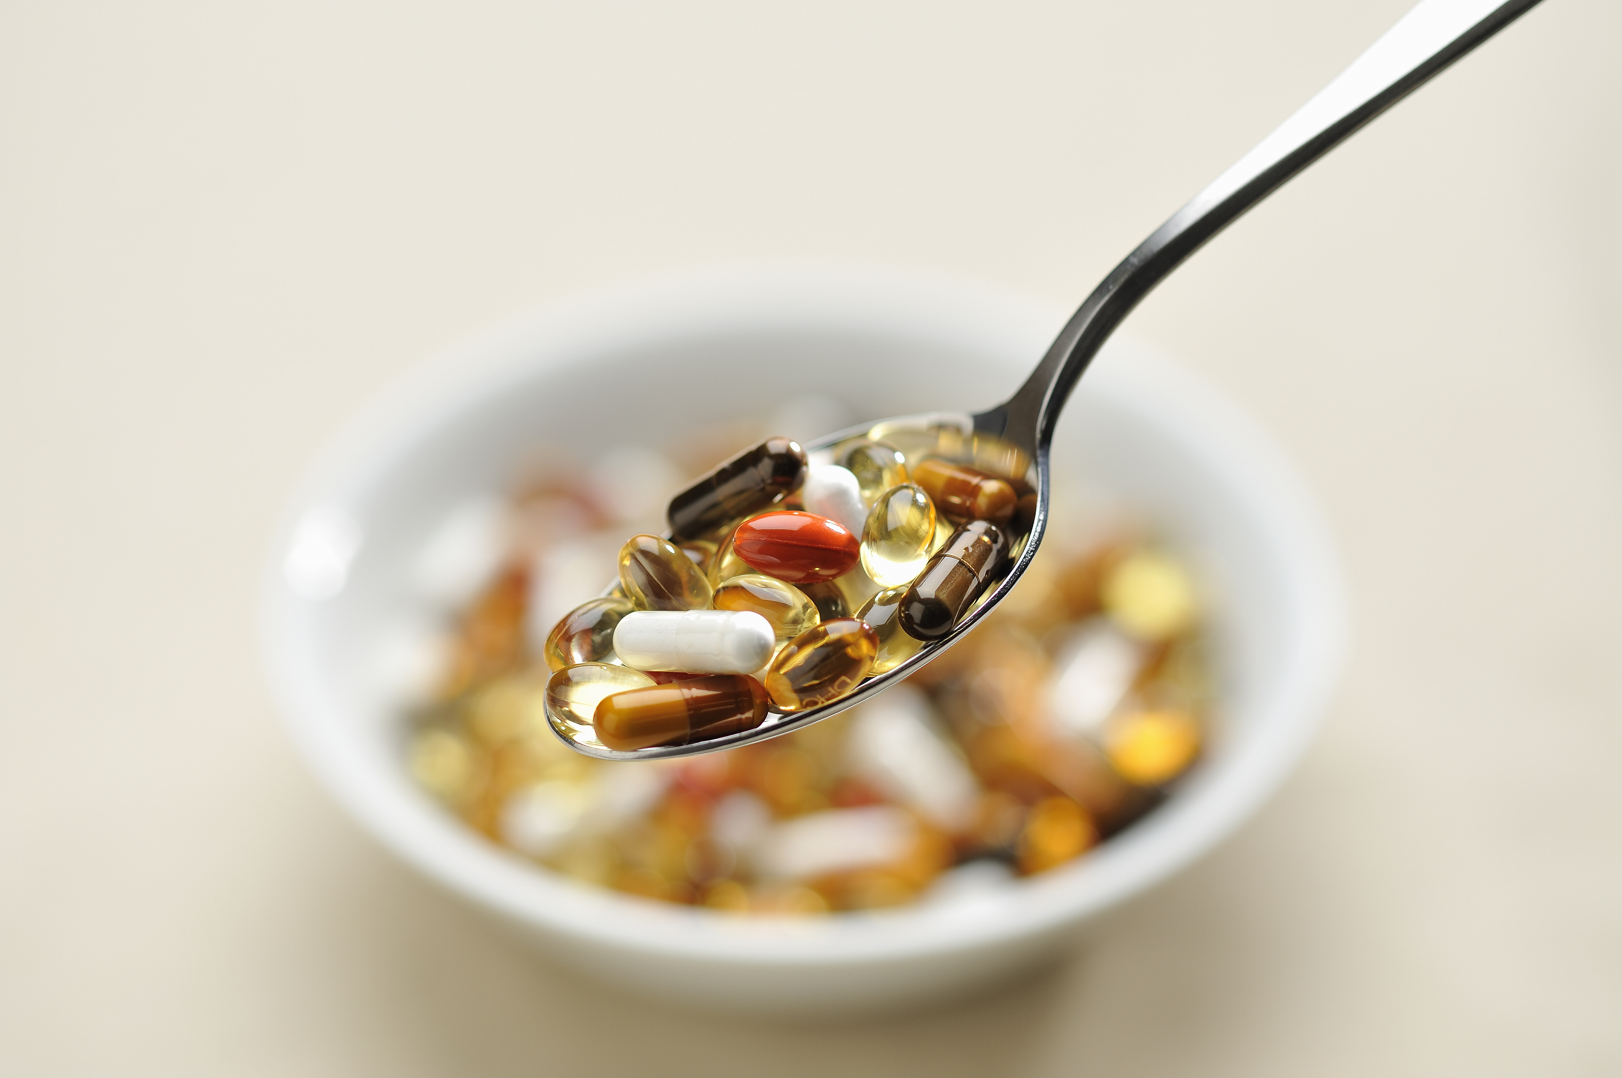
Substance Hx Categories
Opioids
Benzodiazepines
Alcohol
Stimulants
Hallucinogens
Cannabis
Solvents
OTC
Nicotine
Other
prescribed, illicit
prescribed, illicit
type, seizure Hx, DT risk, DUIs, drunk tank
cocaine/crack, methamphetamine/amphetamines methylphenidate/Ritalin, MDMA, ecstasy
acid/LSD, mushrooms, phencyclidine (PCP)
illicit, legal, edibles, smoked
dimenhydrinate/Gravol, diphenhydramine, cough syrups, sleep aides
cigarettes, vaping
steroids, gabapentin, baclofen, quetiapine, caffeine

Slide 15
The Substance Hx
What do you ask?
What’s important to know?

Slide 16
The Substance Hx
Age first use
Route (oral, chew, insufflation, intravenous )
Pattern (sporadic, intermittent, binge, weekly, daily)
If binge, how long does it last? If daily, how many times a day?
Amount (g, oz, mLs, or points, rocks, or $$ spent)
Overdose experiences? Naloxone Kit & teaching?
Access (prescribed, illicit, regular source, ‘street’ purchase)

Slide 17
The Substance Hx
Periods of abstinence (duration, most recent, supports, relapses)
Last use (relevant to withdrawal/intoxication/tolerance, discrepancies in pattern report, interpretation of UDS results)
Withdrawal Symptoms (time before symptom onset, severity, symptom duration, time before need to use, seizure risks)
Life Consequences (loss/damage to relationships, occupations, finances, health, freedom, etc.)

Slide 18
Remember Polysubstance is the Norm…
Stimulants ↑
Cocaine/Crack
Crystal meth
Amphetamines
Ecstasy/MDMA
Ritalin
Caffeine
Depressant/soothers ↓
Opioids
Alcohol
Benzodiazepines
Zopiclone
Barbituates
Hallucinogens
Acid
Mushrooms
PCP (phencyclidine)
Ecstasy/MDMA
DMT (dimethyltryptamine)
Ketamine
Cannabis

Slide 19
Quetiapine 25
Zopiclone 7.5
Diazepam 10
Temazepam 30
Crack cocaine
Alprazolam 1 mg
Shady 80
Morphine SR 200

Slide 20
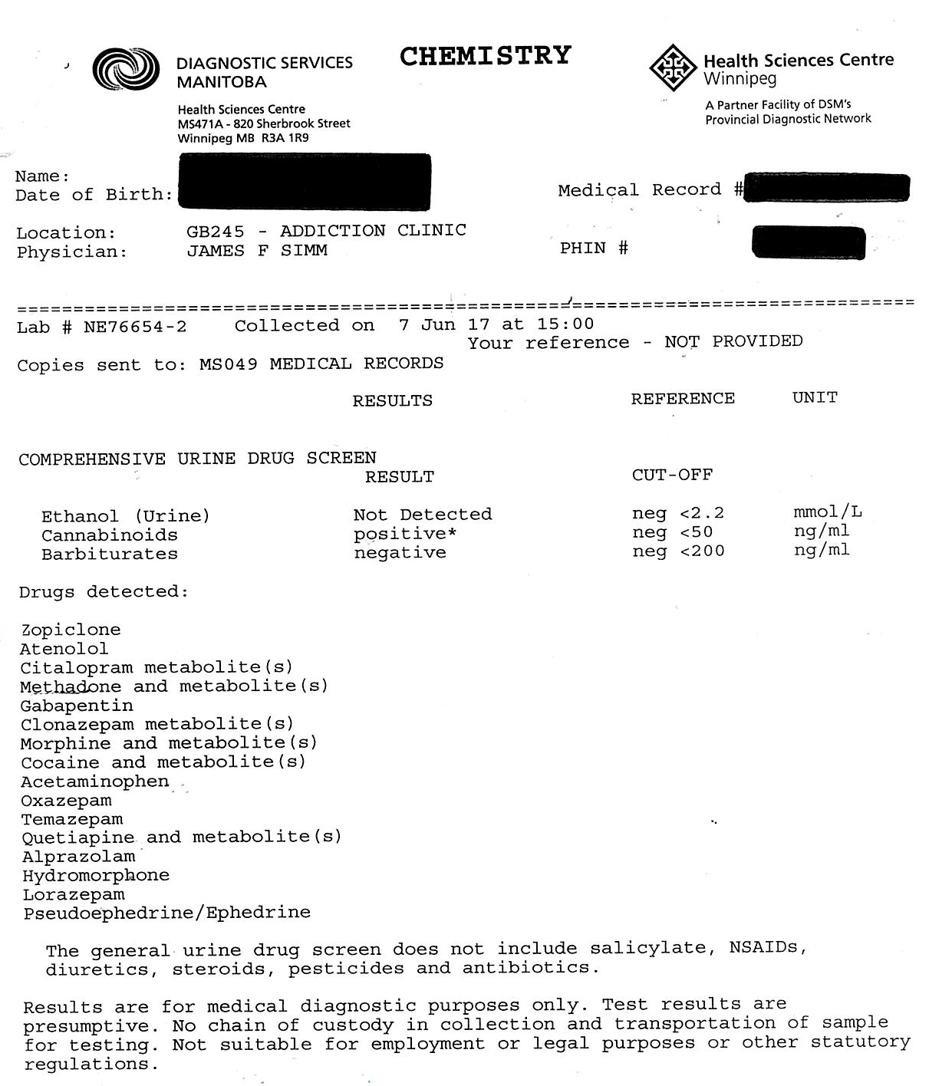
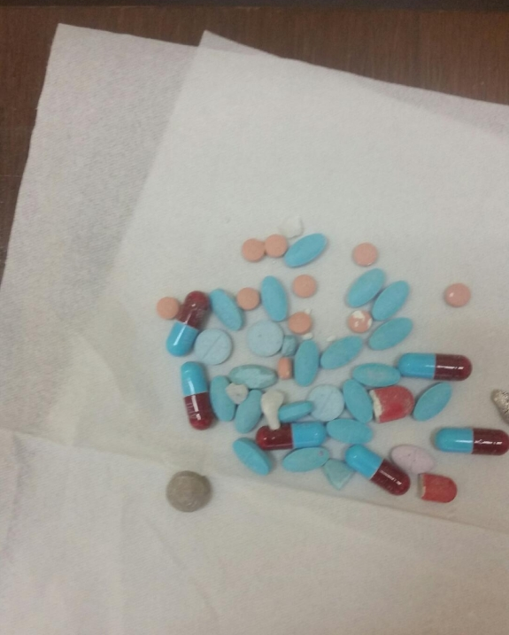

Slide 21
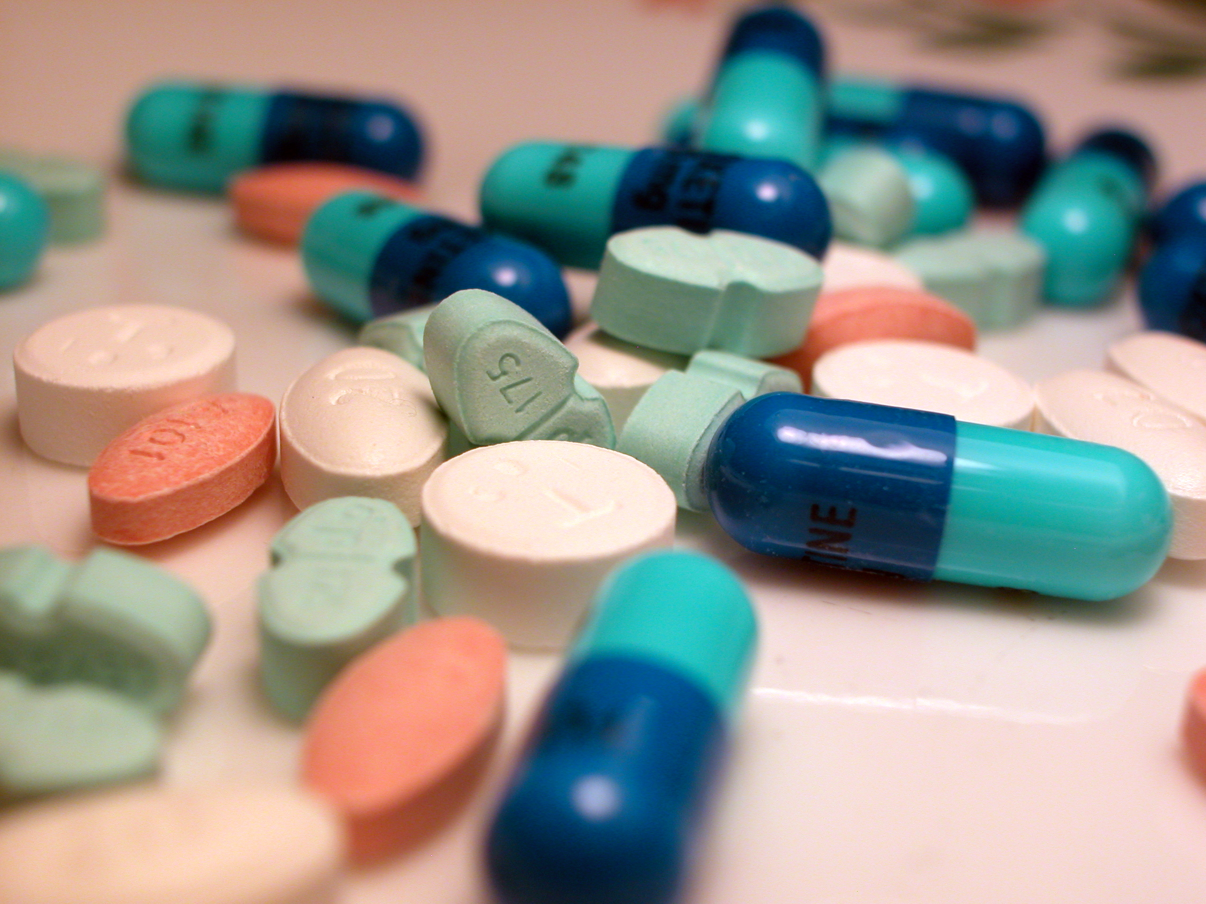
Build your Slang library…
learn Names & Trends

Slide 22
3s
Coke
gram
snow
Restorilz
Powder
8 Ball
Dime bag
pams
point
Xanies
Jib
Blow
bumps
peaches
bang
purples
ish
rips
Xanie Bars
crack
Crystal
rail
Parachute
hoot
rock
popping
80s
Green beans
Speedball
Louis Vuitton
Oxys
SuzyQs
Reds
Smack
Gabbys
Addys
Purple H
Greys
Hydros
30s
e
M
Down
Dillies
X
tar
Percs
Molly
China white
1s
Red Rocket
Notes:
Lower Potency Opioid Formulations
Codeine Tylenol 3, T2, or T1 – now Rx!
Abuse range ~10-50 T3 per day Cold water extraction
Acetaminophen toxicity (↑ risk if used as backup)
Oral, snorting less, rarely injected
T&Rs Talwin (Pentazocine) & Ritalin (methylphenidate)
Injected, ‘Talc Lung’, was more common in prairies
“Set” reported as 2x50 mg “T” & 20 mg “R” (2016)
Percocet/Oxycocet/Endocet 5 mg oxycodone
Abuse range ~10-50 Percs per day
Oral, chewed, or snorted
Potent Opioid Formulations
Oxycodone OxyContin, OxyNeo
Abuse range 80-600 mg
Long-acting, but when chew, snort or inject, becomes high-dose, rapid acting drug (all Contins)
Morphine Morphine IR, MS Contin
Abuse range 60 - ?800 mg “greys” (100 mg), “reds” (200 mg)
Oral or IV, less common snorting
Hydromorphone Dilaudid, HM Contin
Abuse range 6 - ?120 mg HMC 6’s, 30’s
Oral or IV, less common snorting
Fentanyl
Abuse range 50-200 μg patch
Chew or IV use (vinegar extraction)
Illicit Variations
Fentanyl powder
?Range grams, points ↑ OD risk! Fake Oxy80’s (Shadies)
Snort or inject
Carfentanyl
Inject or oral, ‘blotters’
↑ OD risk!
Heroin
?Range grams, points
Diverted methadone (or buprenorphine/naloxone )
It happens ↑ OD risk
100 mg IV pentazocine (talwin) = ~17 (16.7) mg IV morphine (~ 34 mg oral)
http://opioidcalculator.practicalpainmanagement.com/
PPM (practical pain management Opioid Calculator site “The free Opioid Calculator (the "Calculator") provided by VH Media LLC (the "Company"), and all information contained therein, is solely for use by trained medical professionals who are experienced in the calculation of doses of opioids based on currently published conversion factors and are competent to understand the risks, benefits and alternatives to various opioid pain medicines and determine which medicine and dosage, if any, will be safe and effective for any particular patient ("Trained Medical Professionals"). If you are not a Trained Medical Professional, do not use the Calculator. The opioid calculator was developed as an informational tool only to aid the Trained Medical Professional. Data obtained from the use of the Calculator is not meant for direct clinical application. Clinical application of any data obtained by use of the Calculator is the sole responsibility of the user only. The Company (nor any author of the Calculator) does not guarantee the accuracy or completeness of the Calculator, and the suggested doses are not a substitute for clinical judgment. All calculations must be confirmed before use.”)

Slide 23
When is the last time you snorted cocaine or smoked crack? How often do you smoke cannabis? How much Hydromorph do you use in a day?
How you ask...
vs. Do you use cocaine?
Do you use crack?
Do you use cannabis?
Do you use opioids?

Slide 24
Behavioural Addiction
Got to ASK…
Gambling
Disordered Eating
Sex, pornography
Videogames
Social Media
Notes:
Know yourself… does this make you uncomfortable? Will you be able to ask these questions? Or the other questions? What will you want to avoid as a clinician?

Slide 25
Addiction Treatment Hx
Past experience with treatment What substance?
Residential or Community
When, format, likes/dislikes, problems, successes, completion
Abstinence during or after
Past experience with OAT
When, duration, likes/dislikes, abstinence from illicit use
Process & reason for cessation
Current treatment agency involvement
Past or current self-help groups

Slide 26
Medical Hx
PMHx
Current conditions
Chronic HIV, Hep C, diabetes, hypertension, cardiac issues, cirrhosis, COPD
Acute Pain, IE, PE, septicemia, cellulitis, osteomyelitis
Doctors involved, hospitalizations, surgeries
Chronic Pain?
Origin, mechanism, severity, impact on function, psychosocial contributors
Non-opioid management or alternative therapies trialed
Allergies

Slide 27
Medical Hx - Mental Health
Past psychiatric issues
Current conditions
Predating substance use or precipitated by use/withdrawal cycle
Stability Managed or unmanageable, impact on function
Acuity Suicide risk (ideation, plan, past attempts, self-harm)
Previous treatments or hospitalizations
Doctors involved, past or current psychiatrist

Slide 28
Medical Hx - Pregnancy
Childbearing age? Take a menstrual history & ask about potential for pregnancy
If any doubt send a pregnancy test
OAT should be initiated ASAP in pregnancy for the wellbeing of mom & baby
So important – talk tomorrow!

Slide 29
Medical Hx – Medications
Recent Medications
DPIN review
Link meds to problem list
Attention to Sedatives & Polypharmacy
So important – own talk!

Slide 30
Examination
Focus Physical Exam
Vitals Heart rate, BP, RR, Temp as applicable
Examine lung & heart function as applicable
Examine skin surface for injection marks, abscesses, cellulitis
Observe Signs & Symptoms of withdrawal or intoxication
Pain Conditions?
Visual/physical exam of tenderness, ROM, functional mobility, observe for pain-related behaviours
Focused MSE as applicable
Affect, mood, thought process, SI, evidence of psychosis, personality traits, cooperation, engagement, readiness

Slide 31
Examination – Lab Tests
Urine drug screen Comprehensive vs Street
Does it match History given?
Are opioids present ? Are other drugs/meds present?
HIV, Hepatitis B&C, other STBBIs, pregnancy
CBC, LFTs, RFTs, Glucose
ECG?
All ideal, but does not have to delay OAT start if indicated

Slide 33
Discussing Treatment & Plan
Dx: Opioid Use Disorder?
May need to sort out addiction from chronic pain & mental health d/o
Problem List
What else can/needs to be addressed for quality care?
Do they want treatment?
Willing & Able to participate in treatment? Readiness to change ?
Educate about OAT vs Abstinence-based treatment
Buprenorphine/naloxone typically first line, methadone still useful for some
Can they safely start treatment in community?
In-hospital start provides closer supervision, stable dose achieved more quickly… may be indicated for some
Pregnancy, comorbid conditions, polysubstance/sedatives, rural commute

Slide 34
Interview Tips – Balanced Questions
Open-ended Questions
Do not have 1-2 word answers
More freedom to express thoughts
Less structured
“What’s it like where you are living?”
“Why do you think you first started using pain killers?”
“Tell me about your opioid use, what’s it like?”
“What other drugs have you experimented with?”
Closed-ended Questions
Can get specifics
Can tie-up loose ends
More structure
“Do you live alone?”
“How old where you when you first tried Oxy?”
“Do you use opioids every day?”
“Have you tried Fentanyl?”
“Do you inject?”

Slide 35
Balance Questions & Paraphrasing/Reflecting
Paraphrasing Content
Summarize, Synthesize, or Clarify what you hear
Lets them know you hear them
Makes sure you are getting it right
“So you started school, really struggled with anxiety, then had to drop out.”
“You tried Percs, felt more confident, then all that worry you talked about was, like, gone.”
“Can you explain what you mean when you say ‘freaked out’?”
Reflect Feelings
Can be very validating, helps to normalize
Lets them know you understand them
Makes sure you are getting it right!
“So every time you had a test, you felt doomed to fail”
“That must have been a relief, at first.”
“You must have felt so nervous, afraid even.”
“A lot of people feel that way under pressure.”

Slide 36
Take Home Message
It’s a long road…
The Art is the ability to connect with the patient
RECOVERY is the Big Picture OAT & Therapeutic Roles are key parts
There is NO MAGIC PILL
Therapeutic Relationships can be healing

