Slide 1
All about Butts
CME Jan 10, 2019
NB: All pictures taken from Sabiston’s Textbook of Surgery, Ch. 53

Slide 2
Conflict of Interest
None to declare

Slide 3
Objectives
Anal Foreign Objects
Hemorrhoids
Anal Abscesses
Anal Fissures
Anal Fistulas
Pilonidal Disease

Slide 4
Anal Foreign Objects
Objective of care —> Remove with minimal damage
Please call a surgeon!
Usually need conscious sedation at minimum
Relax sphincter muscles
Position patient in lithotomy

Slide 5
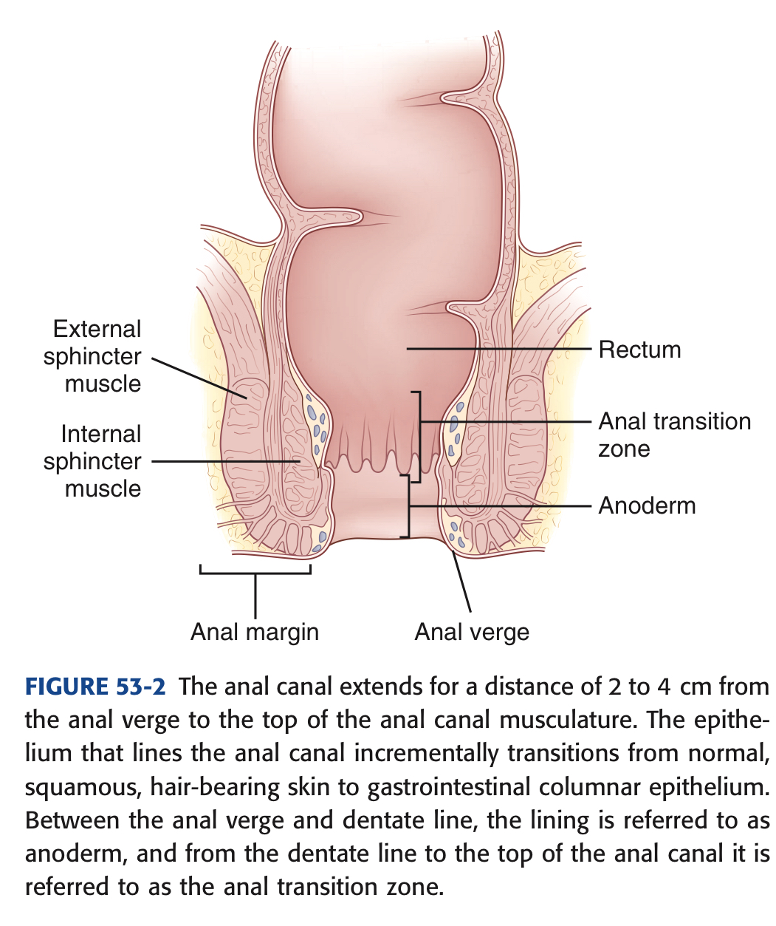
Anal Canal Anatomy
Sabistons

Slide 6
Anal Care Health Principles
Applies to just about every condition we are talking about today
If you remember nothing else - remember #1 a string and #2 these anal care principles!
In order of importance
Fibre
Fibre
Water
Hot/Cold
Clean and dry
Cotton
Endoscopy

Slide 7
Fibre
20-30 gm fibre EVERY DAY
Insoluble fibre
Don’t stop fruits/vegetables
Eg. Psyllium or Inulin fibre
Ensure able to drink enough fluids if taking fibre
Does not matter if having a BM every day
Fibre is the great equalizer

Slide 8
Water
Fluids per day - 8-10 glasses
Caffeine - bad news for anal and bowel health
Sweeteners and sugar are bad news for bowel health

Slide 9
Hot or Cold
Hot/warm water irrigation
Works better than sitz bath
Handheld shower head or squirt bottle with fresh warm water
Best for spasms/pain from fissures
Cold
For thrombosed hemorrhoids
Frozen condom —> think labour floor

Slide 10
Clean and Dry
In the words of Dr. Jen Gunter OBGYNE “this is a self cleaning oven”
Water ONLY for cleaning
No baby wipes, no soap, no shower gel
If don’t have time to shower after sweat inducing activity, wipe with wet cloth, dry and change your underwear
Especially important in summer with increased sweating

Slide 11
Cotton
Use 100% cotton underwear
Not just the gusset
Large panty-liners can be just as bad
Feminine population - using feminine pads for urine protection
“Granny panties”

Slide 12
Endoscopy
Blood per rectum >40yo
Everyone gets offered a scope
If clear reason for bleeding in office, scope does not need to be urgent or even semi-urgent
If no clear reason for bleeding, then semi-urgent scope may be warranted (good history to determine urgency)
Blood per rectum <40yo
Positive family history - offer scope
If clear reason for bleeding, likely does not need scope, but I offer to most people 30 and older
If clears up with fibre a lot of patients watch and wait
If no clear reason for bleeding, then scope offered - again does not need to be semi-urgent unless history suggests red flags

Slide 13
Hemorrhoids
3 normal anal cushions
Left later, Right anterior, Right posterior
When they enlarge or cause symptoms they are called hemorrhoids
Classified by: internal vs. external
External are below the dentate line, more commonly cause problems with keeping clean
Covered with anoderm
Once hemorrhoids themselves “go away” patient is left with skin tags
Relatively easily removed with local anesthetic and vicryl or monocryl suture

Slide 14
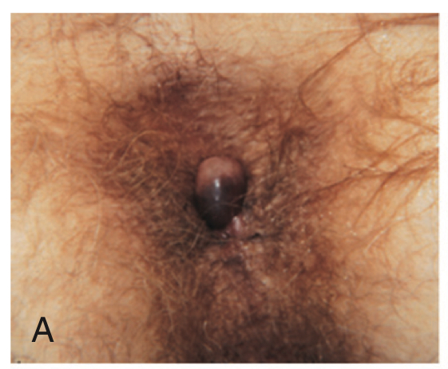
External Hemorrhoids - thrombosed
If unsure don’t do anything
Usually only one tiny area, not a third of the way around
Can give analgesics, ice and wait
Can inject with local anesthetic and lance hemorrhoid, push out clot
Less commonly done or taught

Slide 15
Internal Hemorrhoids
Grades:
Small, nonprolapsed hemorrhoids
Moderate size, prolapse but spontaneously reduce
Moderate-large, prolapse, require manual reduction
Large - prolapse, unable to reduce
Management depends on symptoms and grade

Slide 16
Internal Hemorrhoids
Grade 1/2
Fibre, fibre, and fibre and water
75-80% will be fixed with proper fibre intake
How much?
20-30 gm/day
Consistently use for 8 weeks to see lasting improvement
Bleeding Grade 1/2
If not improved with fibre
Banding
Cannot use: bleeding diathesis, anticoagulated

Slide 17
Internal Hemorrhoids Gr 3/4
Grade 3/4
Fibre!
Banding - maybe successful for grade 3, but unlikely
Hemorrhoidectomy
Surgically remove

Slide 18
Internal Hemorrhoids Gr 3/4
Grade 4
Prolapsed, difficult to reduce
Try to reduce
Minimal sedation, or at least pain control
Lots of muco
Gently bring hemorrhoids together and push above sphincter
It hurts, but feels MUCH better when reduced
Admit to hospital for ice, pain meds, start Metamucil BID

Slide 19
Peri-Anal Abscesses
Usually just bad luck
Except - Crohn’s disease (Watering can anus) and Hydraadenitis suppurativa
Start in cryptoglandular
Need appropriate incision and drainage
Typically in the OR, saddle block & sedation
Important to do good digital rectal exam under anesthesia (EUA) to rule out deep internal abscess
Crucial incision over abscess, break down internal loculations and pack the abscess for 24 hours
Packing can be removed POD 1, usually does not need to be re-packed. (Ischiorectal abscesses often need daily packing)

Slide 20
Peri-anal abscess
Approx. 20-25% will develop fistula post drainage (by 7 weeks)
Abscess in the intersphincteric space is the acute phase, a fistula represents the chronic phase

Slide 21
Anal Fistulas
Tract from internal anal canal to external anal skin
Can go through both sphincters or just one
Can travel up and through levator ani muscles - Type 3 and 4 go above levator muscle

Slide 22
Anal Fistula
Management
Surgical
EUA; probing and identifying where the internal and external openings are
Methylene blue, peroxide, lacrimal probes
If <25% (and maybe even 50%) of internal sphincter are involved, simple ligation of the tract can be definitive
If >25% involved, place a seton for drainage then a definitive surgical procedure in 6-8 weeks

Slide 23
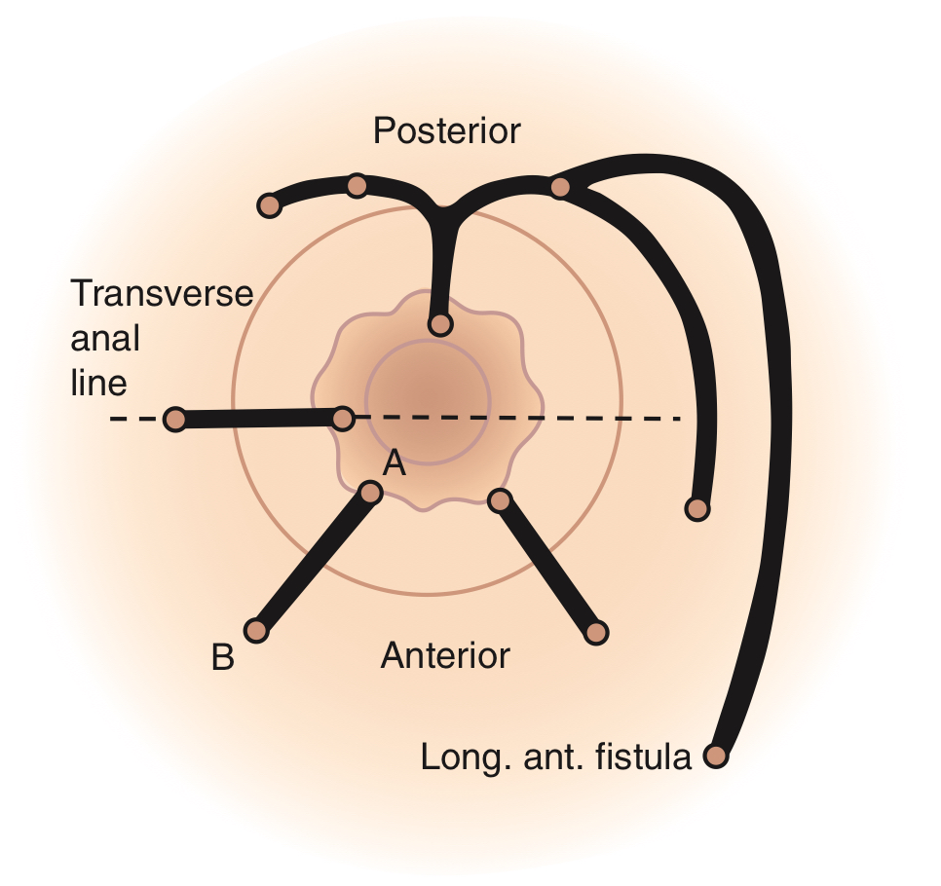
Anal fistula

Slide 24
Anal Fistulas
Other management tips
Fibre
Keep area clean/dry
Minimize surgical intervention to keep anal continence
Flatulence incontinence more common than fecal incontinence
Better to return to the OR for series of smaller procedures than a large one causing permanent damage

Slide 25
Anal Fissures
Linear ulcer (tear) in anoderm of the anal canal
Posterior is most common location
Anterior can be present in women
Other locations seen in Crohn’s, STDs, hydradenitis
Symptoms
Pain with defecation
Small amt of bleeding, occasionally dripping after BM
Diagnosis
Visual inspection of anal canal
Often cannot do DRE (nor needed)

Slide 26
Anal Fissure
Management
Fibre
Pain control - petroleum jelly
Nifedipine (diltiazam) 2% ointment in 1% xylocaine
Apply 4x day for 6-8 weeks
Up to 70% of fissures, even chronic ones, are cured with this method
Surgical - if chronic fissure, non responsive to conservative management

