Slide 1
KETO
A dietetic perspective
Aimee Cadieux, RD, CDE – Agassiz Medical Centre
Candice Comtois, RD, CDE – CW Wiebe Medical Centre
November 22, 2018

Slide 2
Disclosures
None

Slide 3
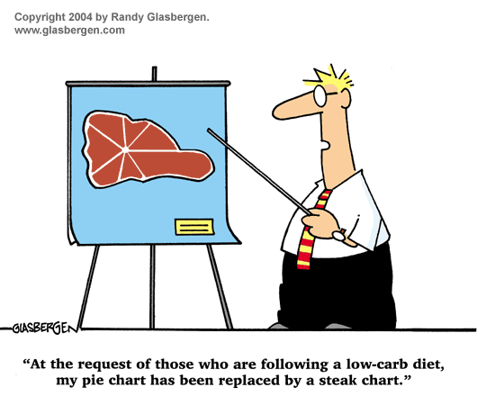

Slide 4
“I know what to do, I’m not just not doing it.”

Slide 5
Objectives
Discuss the ketogenic diet as both a therapeutic and popular health trend
Compare research outcomes of the ketogenic and low carb diets for weight loss and diabetes management with other dietary interventions
Discuss considerations for nutrition intervention

Slide 6
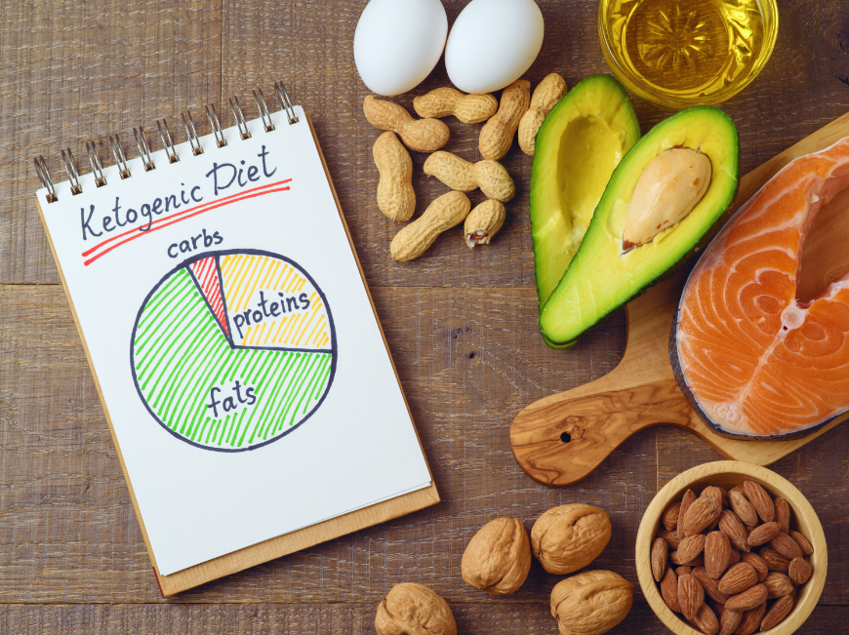
WHAT IS THE KETOGENIC DIET?

Slide 7
What is the ketogenic diet?
High fat, very low carb, adequate protein

Slide 8
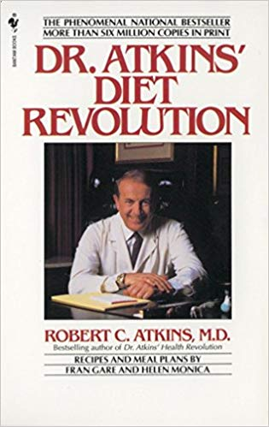
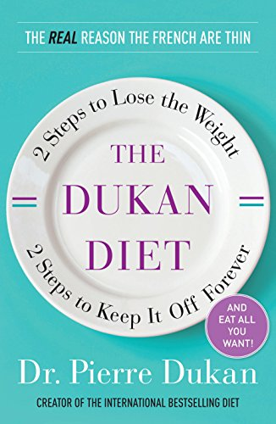
Atkins Diet
First popular ‘ketogenic’ or low carb diet
20 grams carbohydrates daily until within 10 lbs of goal weight
In 2002, introduced ‘net carbs’, subtracting fiber from carb total
Modified Atkins Diet, limits protein and emphasizes fat to help support ketosis

Slide 10
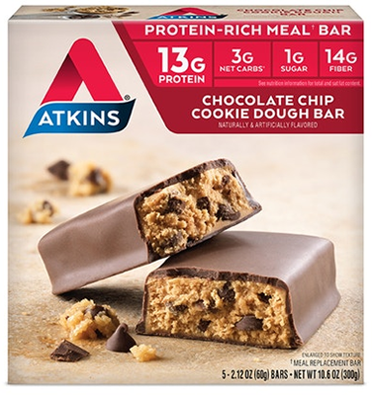
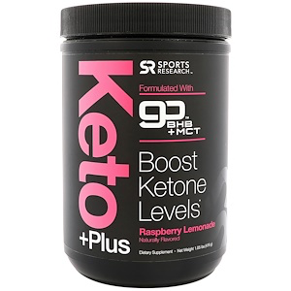
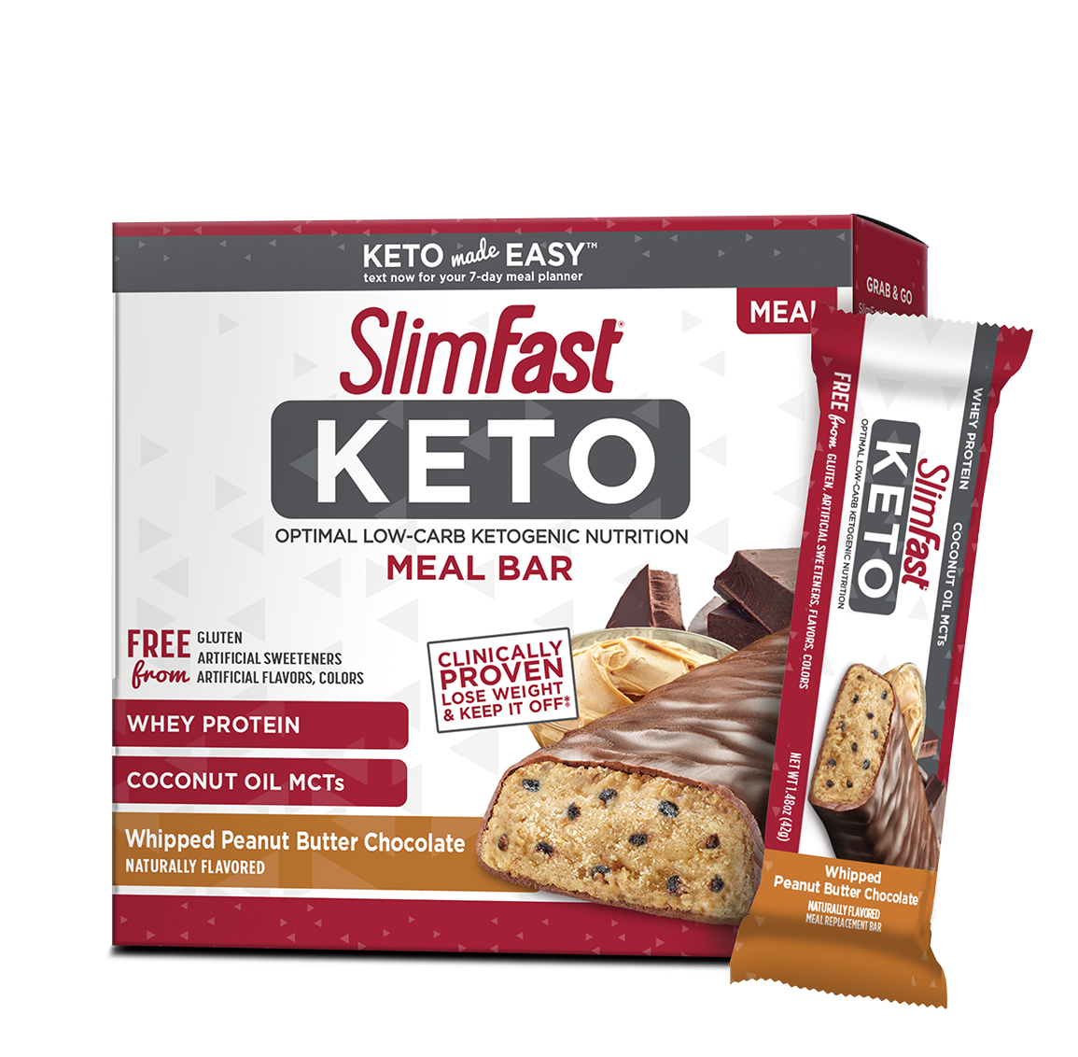
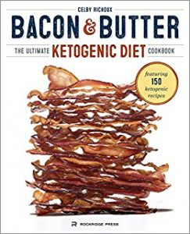

Slide 14
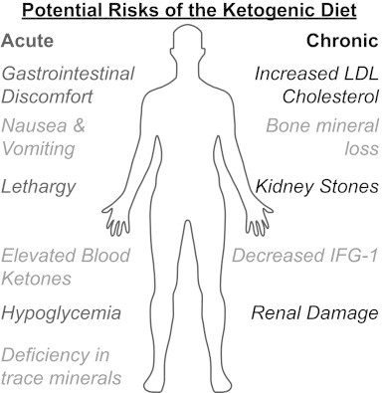

Slide 15
Keto & Weight loss

Slide 16
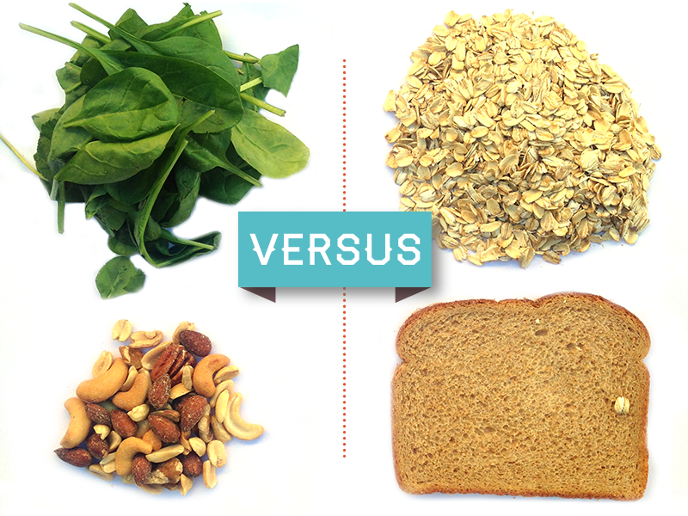
Low Carb Diet vs Low Fat Diet
British Journal of Nutrition, 2013
Systematic review, 13 RCTS
1577 participants
12-24 months
Low fat = <30% kcal from fat
Results: Low carb weight loss 0.9 kg more than low fat
Triglycerides ⬇ 0.18
Diastolic BP ⬇ 1.43
HDL-C ⬆ 0.09
LDL-C ⬆ 0.12

Slide 17
Low Carb Diet vs Low Fat Diet
British Journal of Nutrition, 2016
Systematic review, 11 RCTs
1369 participants
6-24 months
At least <20% kcal from carbs
Results: Low carb lost 2.2 kg more
TG ⬇ 0.26
HDL ⬆ 0.14
LDL ⬆ 0.16

Slide 18
DIETFITS
JAMA, 2018
Healthy low fat (HLF) vs healthy low carb (HLC)
Randomly assigned
Effect of genotype pattern and insulin secretion
12 months, 609 overweight adults
22 small group sessions
Behavior change counseling
Lowest carb or fat intake that could be maintained
Results: HLF 5.3 kg vs HLC 6.0 kg
Neither genotype nor baseline insulin secretion was associated with dietary effects on weight loss

Slide 19
Keto & diabetes

Slide 20
Virta Trial
262 participants
83 % completed program at 1 year
Ketogenic diet in Continuous Care Intervention (CCI) vs Usual Care (UC)

Slide 21
After 1 Year (Virta Trial)
HgA1c dropped 7.6% to 6.3%
Medication use dropped 57% to 30% (with exception of metformin)
Insulin use reduced by 94%
40% of those on insulin stopped
60% reduced insulin from 105.2 units to 53.8 units
Average 30 lbs wt loss (12% body wt)
Insulin resistance dropped by 55%
TG ⬇39%, LDL ⬆10%, HDL ⬆18%, apoB unchanged

Slide 22
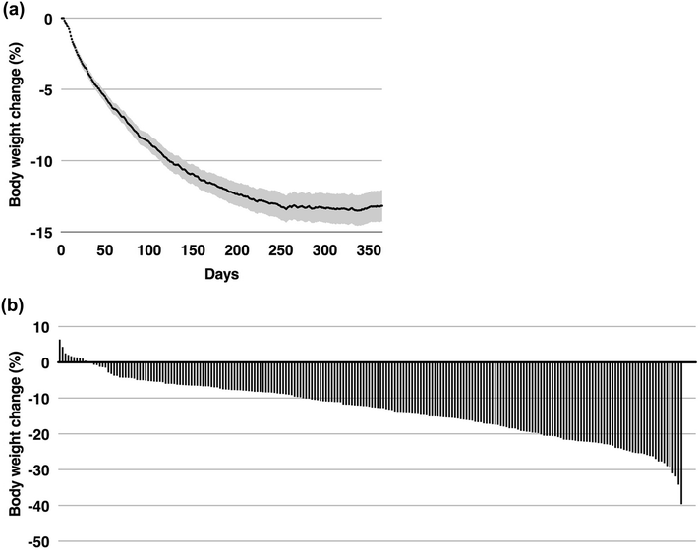

Slide 23
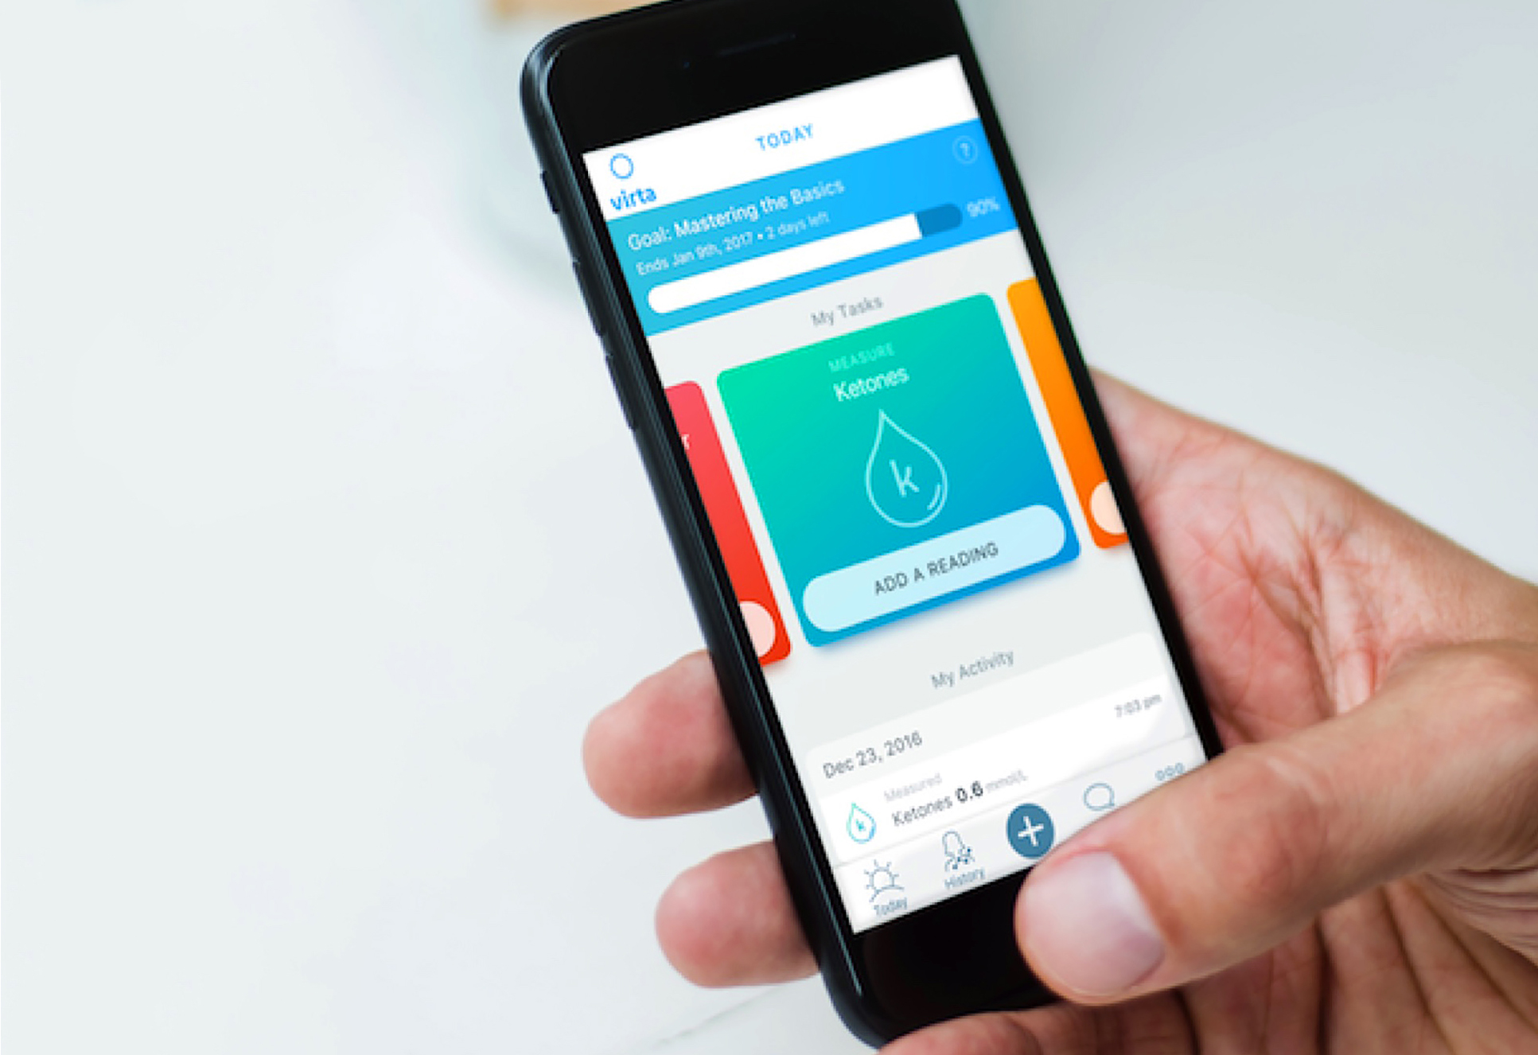
Continuous Care Intervention
Not randomized
Self-identified as motivated to change lifestyle
Intervention is INTENSE:
Cellular connected body weight scale
Glucometer, ketometer, BP cuff
Input data on website; receiving monitoring, education and communication with team

Slide 24
Continuous Care Intervention
12 weekly sessions, followed by 12 bi-weekly sessions, 6 monthly sessions
Health coaching
Individualized care plans
Biometric feedback
Peer support via online community
Telemedicine access to medical provider (physician, NP)
Reported hunger, energy, cravings and mood DAILY
Behavior change techniques:
E.g., Goal setting, self-monitoring, social support, relapse prevention, associations and repetition
Daily protein target = 1.5g/kg body weight
Source: www.weightymatters.com

Slide 25
Continuous Care Intervention
Did participants reverse diabetes??
Virta Health Website states that %reversal is defined as the % of patients with HbA1c less than 6.5% who are taking no glycemic control medication or only metformin.

Slide 26
What did we learn?
Ketogenic diet appears safe for people living with type 2 diabetes for up to 1 year with careful monitoring.
Motivated individual
+
a TON of support/resources
+
ketogenic diet
=
potential to reduce DM medication use

Slide 27
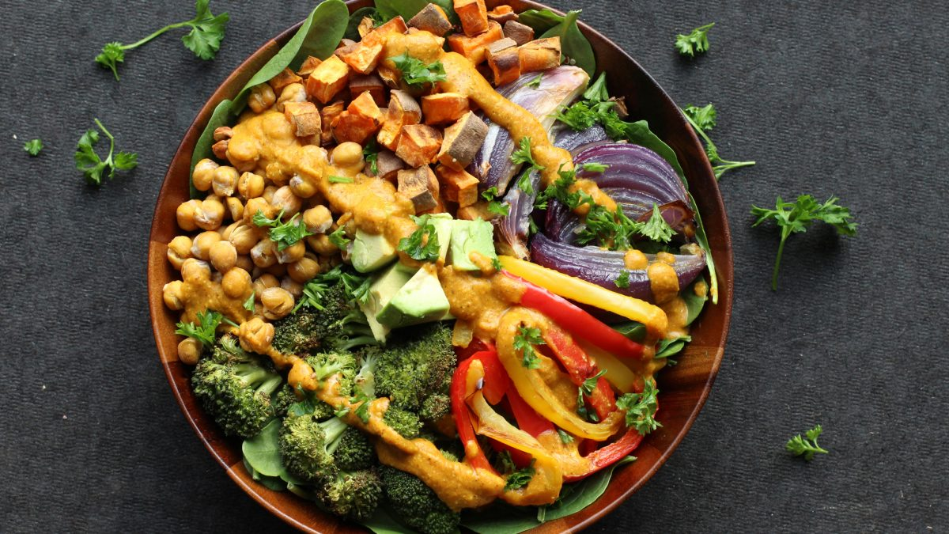
Targeting Insulin Resistance
ANY weight loss
Exercise (resistance or aerobic)
What about…..Plant-based diets?
Rotterdam Study – higher score on the plant-based dietary index was associated with:
Lowered insulin resistance
Lower prediabetes risk
Lower type 2 diabetes risk
Diet quality matters!

Slide 28
What about fasting?

Slide 29
5:2 Fasting
5 days per week = Eat normally
2 days per week = Eat only 400-600 kcal/day
Compared to reducing daily calories by the same amount
112 people with obesity, randomly assigned
Results: After 1 year, no differences in
Weight loss, waist circumference
BP, lipids, glucose, HgA1c, CRP, RMR
Only difference was fasters reported significantly more HUNGER.

Slide 30
Alternate Day Fasting
RCT, 1 year, 222 participants, 3 groups:
Alternate day fasting
Daily calorie restriction
Nothing
Results: No significant difference for weight, BP, heart rate, total chol, LDL-C, HDL-C, TG, fasting glucose, fasting insulin, CRP, homocysteine concentrations between intervention groups.
Only difference was more people dropped out of fasting group (38% vs 29%).

Slide 31
Fasting
Appears to be as effective as traditional calorie restriction…
if a person enjoys fasting and would consider maintaining the habit/practice long-term.

Slide 32
Summary
Ketogenic diets and intermittent fasting may be a useful tool for weight control.
Low carb diets appear safe up to 2 years.
Behavior change counseling is ESSENTIAL! Use your RDs!
Further research:
Are ketogenic diets effective and/or safe in weight loss and diabetes beyond 2 years? Is it more effective for weight maintenace?
What role to ketone bodies play?
E.g. diabetes, cancer, inflammation?
Is there a benefit to following a short-term ketogenic diet?

Slide 33
References
Canadian Community Health Survery – Nutrition: Nutrient intakes from food and nutritional supplements. Statistics Canada. 2017-06-20.
Allen BG, Bhatia SK, Anderson CM et al. Ketogenic diets as adjuvant cancer therapy: history and potential mechanism. Redox Biology 2; 2014; 963-970.
Bueno MB, de Melo, IS, de Oliveira SL, et al. Very-low-carbohydrate ketogenic v low-fat diet for long-term weight loss: a meta-analysis of randomised controlled trials. Br J Nutr. 2013; 110(7): 1178-87.
Mansoor N, Vinknes KJ, Veierod MB, et al. Br J Nutr. 2016; 115(3); 466-79.

Slide 34
References
Hallberg SJ, McKenzie AL, Williams PT et al. Effectiveness and safety of a novel care model of the management of type 2 diabetes and 1 year: an open-label, non-randomised, controlled study. Diabetes Ther; 2018; 9:583-612.
Chen Z, Zuurmond MB, van der Schaft N, et al. Plant versus animal based diets and insulin resistance, prediabetes and type 2 diabetes: the Rotterdam Study. Eur J Epidemiol, 2018; 33(9):883-893.
Sundfor TM, Suendsen M, Tonstad M. Effect of intermittent versus continuous energy restriction on weight loss, maintenance and cardiometabolic risk: A randomized 1-year trial. 2018; 28(7); 698-706.
Trepanowski JF, Kroeger CM, Barnosky A. Effect of alternate-day fasting on weight loss, weight maintenance and cardioprotective among metabolically healthy obese adults. JAMA Intern Med, 2017; 177(7); 930-938.

