Slide 1
The Highlights of Nutrition
CME
Jan 10, 2019
K+ replacement – Dustin
TPN – Melissa
Tube Feeds - Elizabeth

Slide 2
Conflict of Interest
None to declare

Slide 3
Objectives – Tube Feeds
Malnutrition/Starvation
Enteral nutrition (EN) vs. Parenteral Nutrition (PN or TPN)
Types of Tube Feeds
Pyloric
Nasogastric
PEG
Post pyloric
Small bowel feeding tube (SBFT)
Jejunal feeding tube
Indications for type of Tube Feeds
Risks/Complications of Tube Feeds
Practical Considerations for Tubes
Indications for TPN
Risks/Complications of TPN

Slide 4
Malnutrition
Malnutrition driven by one of :
1. Starvation – nutrient intake does not meet body’s needs
2. Metabolic dysfunction – body fails to metabolize available nutrients in a way that effectively meets their needs
Consequences of prolonged malnutrition
GI barrier dysfunction
Respiratory insufficiency
Skeletal muscle wasting
Decreased myocardial mass
Renal atrophy
Diastolic cardiac dysfunction
Poor wound healing
Immunesuppression – i.e. worsening infections

Slide 5
Types of nutrition
When considering what type of nutrition is best, ask yourself: “what is the end goal for nutrition for my patient and how long will it take me to get there?”
“Normal” – oral diet
Don’t forget supplements if needed:
Multivitamin, Iron*, Zinc
Ensure/Boost
Don’t forget special diets:
High or Low Fibre
High Protein
Enteral Feeds
Use the GI tract when it is available and safe to do so
* please, to save your patient do not give iron when NPO, CF or when GI tract is unhappy

Slide 6
Enteral Feeds
*occassionally this is unknown, eg. Severe pancreatitis, or recovery after major surgery
Contraindications:
Intractable vomiting/diarrhea
Paralytic ileus
High output enterocutaneous fistula
GI obstruction, GI ischemia
Diffuse peritonitis
Severe shock, GI hemorrhage, GI malabsorption
Short gut, i.e. <100 cm of small bowel left
Inability to gain access
Need for enteral nutrition <7 days*

Slide 7
Parenteral Nutrition
Supply all nutrition needed through intravenous access
Unless rare circumstances this should be through central line access
Eg. PICC or Internal Jugular/Subclavian
Not typically through port
Contraindications
Inadequate access/wrong preparation
There are peripheral preparations, that are used very short term and very rarely
Need for nutrition <7 days, and typically should be needed for 14 days+

Slide 8
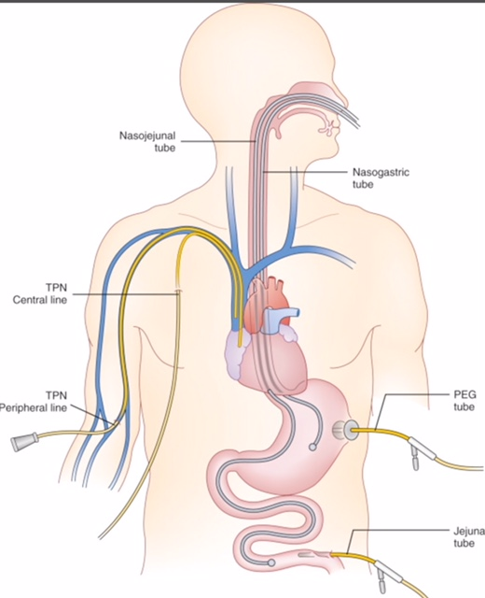
Routes for Nutrition
Pyloric Feeding Routes
Post Pyloric Feeding Routes

Slide 9
Enteral Feeds – i.e. Tube Feeds
Indications
Poor oral intake
Stroke
Muscular Troubles
Trauma
ICU admission for other causes, eg. Pneumonia etc.
Other diseases with normal functioning oral-pharyngeal phase
Pancreatitis (pyloric or post pyloric)
Post or pre surgery for nutritional support

Slide 10
Enteral Feeds – pyloric vs. post pyloric
Pyloric
Use nasogastric tube, small bowel feeding tube in the stomach, PEG tube
Easy to place (PEG tube surgical procedure with endoscopy)
Easy to order and increase dose as tolerated
Can transition to bolus feeds
Post pyloric
Uses small bowel feeding tube or jejunal feeding tube
Needs to be put in by MD and advanced by radiology
Feeds run continuously; cannot go up to bolus feeds
Jejunal feeding tube – placed through open or laparoscopic surgical procedure
Either tube – needs radiographic confirmation prior to use!

Slide 11
Indications/Benefits of EN
Two categories of patients
Critically Ill
ICU admissions
Start as soon as proper fluid resuscitation is complete
Window to start is hours for massive burn victims, up to 3 days for critically ill patients for other causes
Improves outcomes by: decreasing infection rates, overall complications decreased, less organ failure, and shorter hospital stay
Non-critically ill
If patient unable to eat for >7 days
Goldman-Cecil Internal Medicine 25th ED.

Slide 12
Risks/Complications of TF
Aspiration
Esophagitis
Pneumonia
Epistaxis, Nasal Necrosis, Sinusitis
Diarrhea
Dislodgement
Keep head of bed >35 degrees anytime a tube goes through lower esophageal sphincter

Slide 13
Practical Considerations for tubes

Slide 14
Parenteral Nutrition
Indications
Severe small bowel obstruction
Enteritis
Enterocutaneous fistulas – high output
Short bowel syndrome
Complications
Associated with line placement:
Hemothorax/pneumothorax, line infection, hematoma
Overfeeding – increased carbs leads to increased respiratory quotients, increased CO2 elimination and difficulty weaning from ventilator
More studies showing increased safety of TPN
“What is my nutritional end goal and how long will it take me to get there?”

Slide 15
When to wean
TPN – when tolerating 75% of calories through enteral route
EN – when tolerating 75% of calories through oral route*
*depending on type of tube this can easier to tolerate

Slide 16
Placement/Use/Removal PEG

