Slide 1
Friday afternoon with IUCDs
Alaa Awadalla
Feb1, 2019

Slide 2
Conflict. I have no conflict of interest to declare and I have not received any grants from pharmaceutical companies

Slide 3
Objectives:
Get familiar with types of IUCDs available, pricing, indications and potential issues.
Spend time of Patient councelling prior to the IUCD use.
Insertion and trouble shooting.
Post IUCD insertion follow up.

Slide 4
History of IUCDs

Slide 5
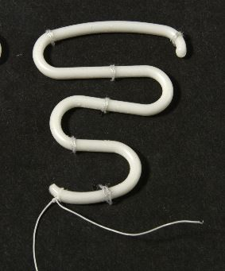
Lippus Loop

Slide 6
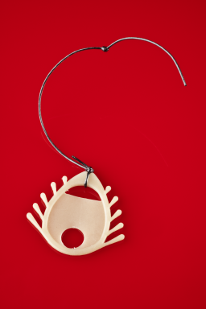
Dalkon Sheath

Slide 7
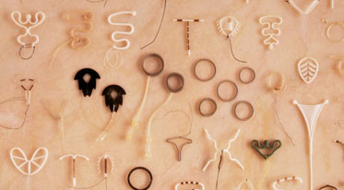
Choose what you want

Slide 8
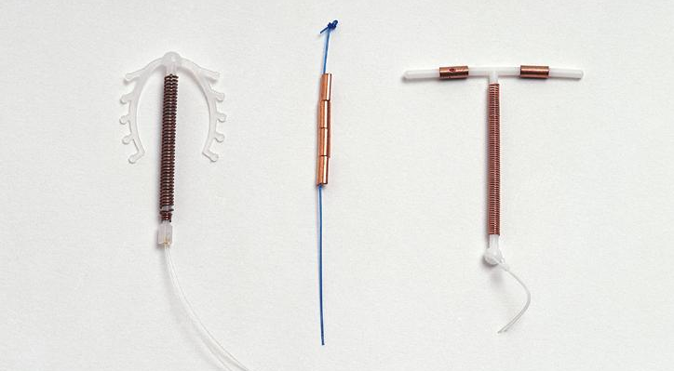

Slide 9
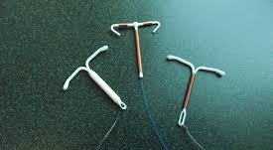
Which to choose

Slide 10
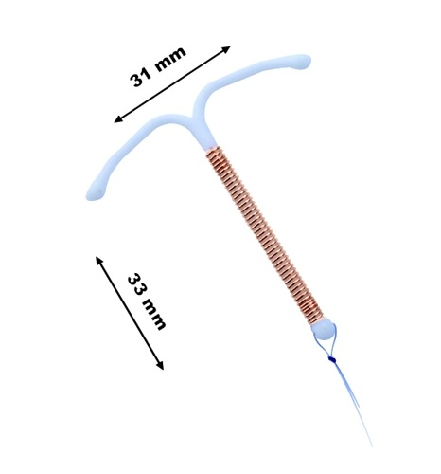
copper

Slide 11
What is available

Slide 12
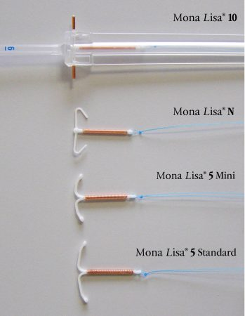
Copper Mona Lisa

Slide 13
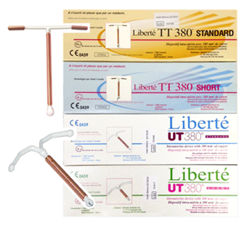
Copper librete

Slide 14
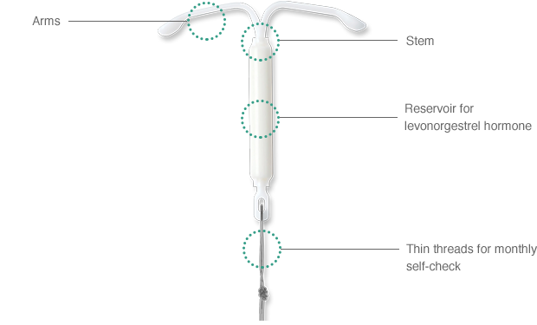
Mirena

Slide 15
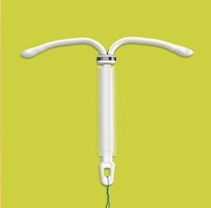
kyleena

Slide 16
Why Copper
Does not want hormones.
Likes to see her peiods
My friend like it.

Slide 17
What patients need to know about Copper IUCD
How it works?
Possible heavy periods
Failure of 1:100 or even higher

Slide 18
Mirena, kyleena and jaydess
Why Hormonal?
Less periods
More effective
Which one to use??

Slide 19
What patients need to know about hormonal IUCDs
Possible Hormonal side effects
Bleeding issues
Lack of periods
Pregnancy with IUCD.

Slide 20
Other uses for IUCD
Post coital conraception
Menorrhagia
Endometrial hyperplasia

Slide 21
Insertion of IUCD
Sterilization of instruments. Do you have an Autoclave, do you know if it is working or not.
Do we need swabs before IUCDs
Is your patient pregnant

Slide 22
Nullipara and IUCDs
Pain issues.
Possible LA.
Pre IUCD analgesia.
May have to take it our if Vasovagal attack does not resolve.

Slide 23
Discussion and let us work.

Slide 24
Any easy questions?
Thanks for letting me share the topic with you.

