Slide 1
GROUP COGNITIVE BEHAVIOURAL THERAPY (CBT) FOR SUBSTANCE USE DISORDERS
FACILITATOR TRAINING
Rick Hawe, MD, FRCPC
Assistant Professor, University of Manitoba

Slide 2
Disclosures
No financial disclosures relevant to this presentation

Slide 3
Background & Intro
Introduction….
Why Group Therapy……?

Slide 4
Workshop Overview
Group Therapy Overview – Theory, Practice, Experience
Theories of Addiction (The “Science”)
CBT Basics – Theory, Practice, Experience
Cognitive Conceptualization of Addiction
Patient Assessments and Stages of Change
Let’s Get Started … (Fundamentals, Structure, Format)
Modules / CBT skills
Challenges
Further Reading (Reference List)
Wrap-up

Slide 5
Group Therapy Overview
Introduction (What…., Why…., How…)
Is group therapy enough?
Benefits / Challenges
Role of the Therapist

Slide 6
Group Therapy Overview Group Process
Instillation of Hope | Dev. Of Socializing Techs
Imparting Information | Interpersonal Learning
Universality | Cohesiveness
Altruism | Existential Factors
Corrective Emotional Experience | Catharsis
Imitative Behavior
Theory and Practice of Group Psychotherapy – Yalom and Leszcz

Slide 7
Group Therapy Overview Group Process – Summing it up
Discovering and accepting previously unknown or unacceptable parts of myself
Being able to say what was bothering me rather than holding it in
Other members honestly telling me what they thought of me
Learning how to express my feelings
The group’s teaching me about the type of impression I make on others
Theory and Practice of Group Psychotherapy – Yalom and Leszcz

Slide 8
Group Therapy Overview Group Process – Summing it up continued
Expressing negative and /or positive feelings towards another member
Learning that I must take ultimate responsibility for the way I live my life no matter how much guidance and support I get from others
Learning how I come across to others
Seeing that others could reveal embarrassing things and take other risks and benefit from it helped me do the same
Feeling more trustful of groups and of other people
Theory and Practice of Group Psychotherapy – Yalom and Leszcz

Slide 9
Group Therapy Overview Common Misconceptions
Group therapy is unpredictable
Group therapy not as effective
Being in a group with other individuals with problems is detrimental
This Photo by Unknown Author is licensed under CC BY

Slide 10
Group Therapy Overview Process in Action
https://www.youtube.com/watch?v=9_IEOG02gwY

Slide 11
Group Therapy Overview Process in Action
Workshop Exercise

Slide 12
Group Therapy Overview Common Problems
Perceived goal incompatibility
High turnover or drop out (30-60%)
Group therapy, unlike individual therapy does not offer immediate comfort
Sub-grouping, extra group socializing, scapegoating, etc.

Slide 13
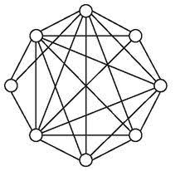
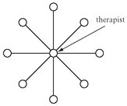
Group Therapy Overview Role of the Therapist
Consistent, positive relationship between therapist and patient (concern, acceptance, genuineness, empathy)!
Within the above framework leaders clarify the goals, focus the group, manage time and be active and efficient.
Ground Rules
Culture Building (group members are agents of change)
Content Expertise
Lead by Example Modeling (curiosity, empathy, support)
Engage the group (open ended, directive)
Moderate interactions (if needed)
Transfer of learning

Slide 14
Group Therapy Overview
Q & A

Slide 15
Definition of Addiction
“Addiction is a treatable, chronic medical disease involving complex interactions among brain circuits, genetics, the environment, and an individual’s life experiences. People with addiction use substances or engage in behaviors that become compulsive and often continue despite harmful consequences. Prevention efforts and treatment approaches for addiction are generally as successful as those for other chronic diseases”.

Slide 16
Definition of Addiction
Addiction is a treatable, chronic medical disease involving complex interactions among brain circuits, genetics, the environment, and an individual’s life experiences.
People with addiction use substances or engage in behaviors that become compulsive and often continue despite harmful consequences.
Prevention efforts and treatment approaches for addiction are generally as successful as those for other chronic diseases.

Slide 17
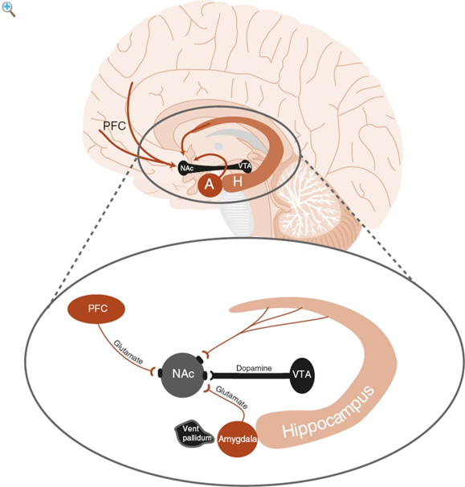
Science
Reward pathways:
Historically guide our choices
All our joys funnel into same network
Mesolimbic DA system (NAc, VTA)
PFC – goal directed behavior
Hippocampus
Amygdala
Hardwired happiness “set point”
The Neuroscience of Clinical Psychiatry – Higgins & George

Slide 18
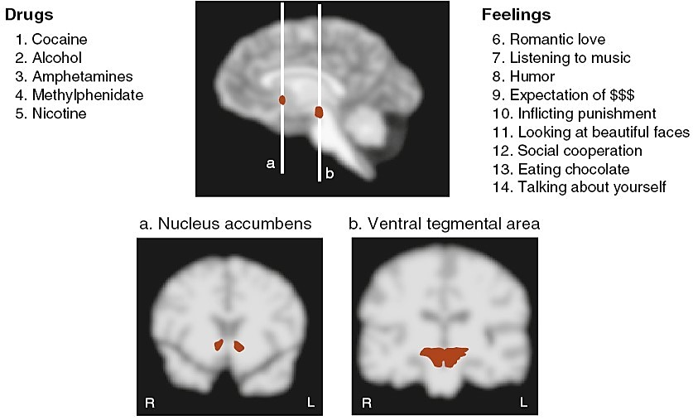
Science
The Neuroscience of Clinical Psychiatry – Higgins & George

Slide 19
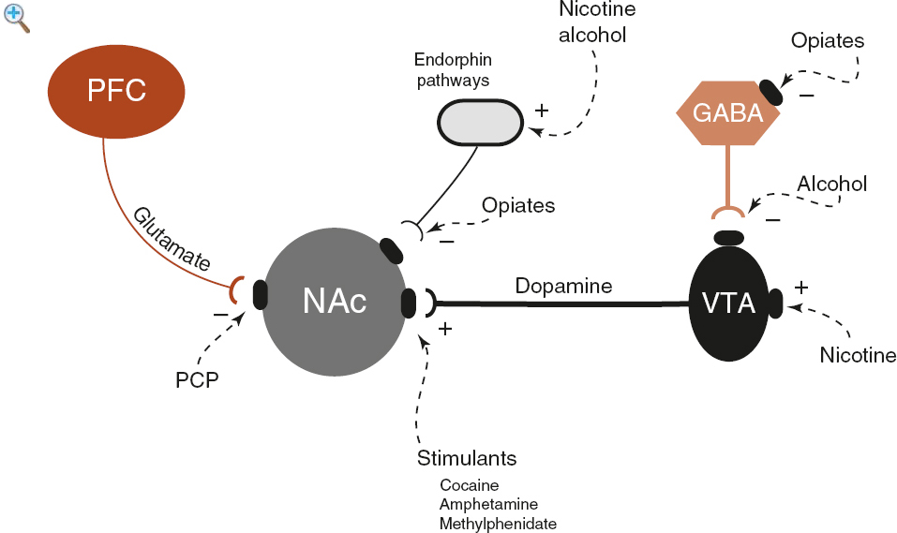
Science
Reward Pathways
Some drugs act directly
Some act via inhibitory suppression
The Neuroscience of Clinical Psychiatry – Higgins & George

Slide 20
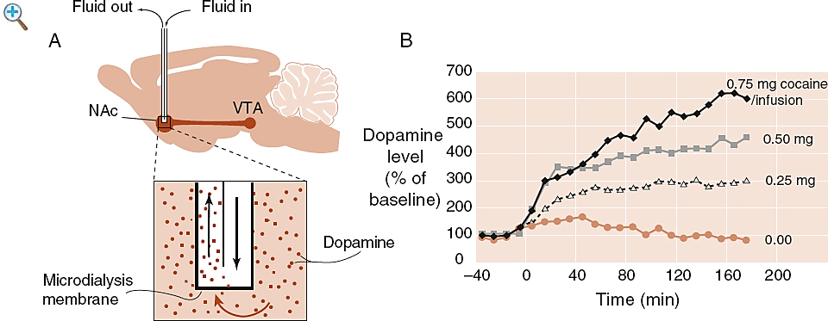
Science
The Neuroscience of Clinical Psychiatry – Higgins & George

Slide 21
Dopamine Activation with Substance Use
1100
Accumbens
AMPHETAMINE
Accumbens
COCAINE
1000
400
900
800
DA
300
DA
700
DOPAC
DOPAC
600
HVA
HVA
% of Basal Release
% of Basal Release
500
200
400
300
200
100
100
0
0
0
1
2
3
4
5 hr
0
1
2
3
4
5 hr
Time After Amphetamine
Time After Cocaine
250
NICOTINE
MORPHINE
250
Accumbens
Dose (mg/kg)
200
Accumbens
200
0.5
Caudate
1.0
150
2.5
% of Basal Release
150
10
% of Basal Release
100
100
0
0
0
1
2
3 hr
0
1
2
3
4
5hr
Time After Nicotine
Di Chiara G, Imperato A. Proc Natl Acad Sci USA 1988;85:5274-5278
Time After Morphine

Slide 22
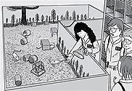
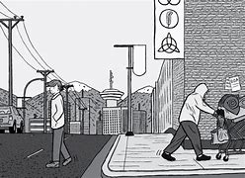
Science
Rat Park
Dissenting views - animal research studies.
Chez Soi – housing first initiative

Slide 23
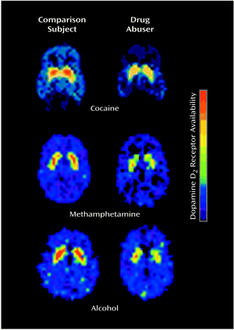
Science
Cravings and the PFC
Decreased DA activity
Goldstein RZ & Volkow ND. Am J Psychiatry 2002

Slide 24
Science
How deep-brain stimulation treats disorders: “It’s given me my life back”

Slide 25
Science - MCQ
Based on what we have reviewed about neuroscience, in which brain structure did Dr. Plummer have the electrodes placed?
A) Corpus callosum
B) Prefrontal Cortex (PFC)
C) Nucleus Accumbens (NAc)
D) Amygdala

Slide 26
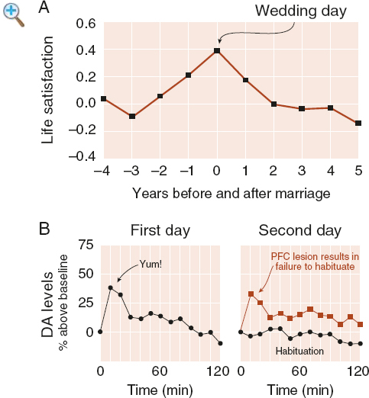
Science
Habituation
Down regulation of DA receptors
“Chasing the Dragon”
The Neuroscience of Clinical Psychiatry – Higgins & George

Slide 27
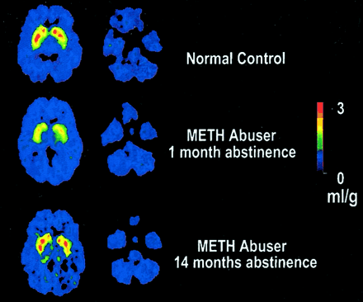
Science
DA pathways
Volkow ND et al. J Neuroscience 2001;21:9414-8

Slide 28
Science
Level of understanding remarkable:
Structural understanding
Brain and behavior understanding
Disappointments:
Translation from bench to bedside (clinical practice)

Slide 29
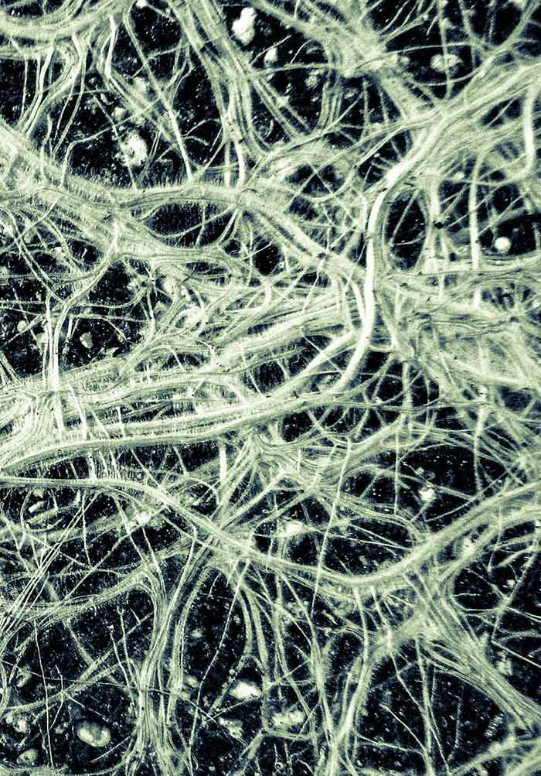
Science
Neuroplasticity
CBT implications

Slide 30
Science
Q & A

Slide 31
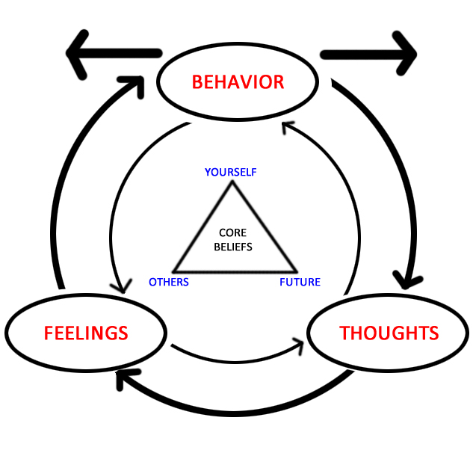
CBT Basics
Aaron Beck – University of Pennsylvania
Beck’s Triad (Depression)
Negative view of self, negative view of others, negative view of future
Thoughts, Feelings, Behaviors
Adaptation for various psychiatric disorders
Adaptation for substance use disorders

Slide 32
CBT Basics
Principles of CBT
Formulation (evolving)
Therapeutic alliance
Collaboration and active participation
Goal oriented and problem focused
Emphasis on the present
Educative (teach patient to become own therapist)
Time limited
Structured sessions
Identify and evaluate dysfunctional thoughts and beliefs
Variety of techs to change thinking, mood and behavior
Cognitive Therapy: Basics and Beyond, Judith Beck

Slide 33
CBT Basics
Cognitive Conceptualization
Automatic thoughts
Attitudes, rules, assumptions
Core beliefs
Results
Feelings / Behaviors
Automatic Thoughts
Intermediate Beliefs
Core Beliefs
Cognitive Therapy: Basics and Beyond, Judith Beck

Slide 34
CBT Basics – T/F Question
Cognitive Behavioral Therapy is focused on the present and ignores the past.
True or False?

Slide 35
CBT Basics
Structure of sessions
Mood check
Bridging from previous session (may include some feedback)
Setting the agenda
Review of homework
Items on the agenda (i.e., Thought Record)
Summary and Feedback
Cognitive Therapy: Basics and Beyond, Judith Beck

Slide 36
CBT Basics
Key Techniques (Agenda Items):
Thought Records (automatic thoughts, biases, core beliefs)
Drilling down
Disputing (automatic thoughts, intermediate beliefs, core beliefs)
Other methods: (cognitive continuum, rational-emotional role play, using “others” as a reference point)
Working with Core Beliefs
Problem Solving
Pros / cons
Behavioral Experiments
Behavioral Activation
Activity monitoring and scheduling
Relaxation / Guided Imagery
Graded Exposure
Role Playing
Homework
Cognitive Therapy: Basics and Beyond, Judith Beck

Slide 37
Adaptations of CBT to Group Format
Evolution
Increased efficiency of CBT
Group Process (noise)
CBT: Impaired Information Processing
Automatic thoughts
Core beliefs
Commonalities
Techniques in CBT Basics all lend themselves exceptionally well to group therapy
Process of group becomes reparative in itself (more effective ?)

Slide 38
CBT Basics
Q & A

Slide 39
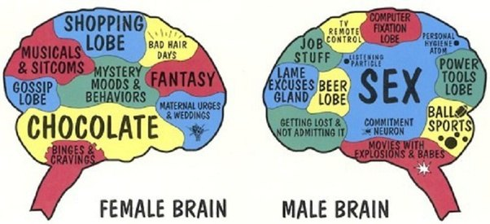
Addiction is Addiction is Addiction…..
Remarkable differences in addictive behavior
Remarkable differences in brain receptor chemistry
Remarkable differences in reasons for addiction

Slide 40
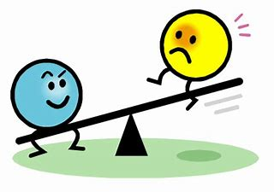
Cognitive Model of Addiction
Addiction
Self Efficacy
Coping Strategies
Simplistic View = Balance vs Imbalance
Self Efficacy – how well one can execute courses of action required to deal with prospective situations.
Coping Strategies – techniques we employ to deal with stress.
Group Cognitive Therapy for Addictions – Wenzel, Liese & Beck

Slide 41
Cognitive Model of Addiction
Proximal situational factors
Anticipatory expectations
Relief oriented expectations “I need a drink”
Facilitating thoughts / Instrumental strategies
Triggers, cues, urges
Distal background factors
Early Life Experience and “schemas”
Genetic predisposition
Psychiatric illness
Social network
Exposure
Personality traits
Proximal
Addiction
Distal
Group Cognitive Therapy for Addictions – Wenzel, Liese & Beck

Slide 42
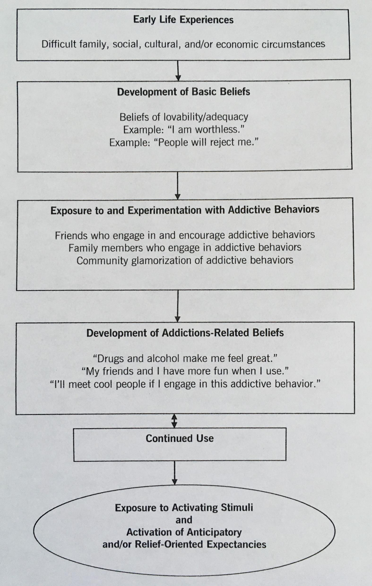
Cognitive Model of Addiction
A number of these factors are modifiable through CBT therapy.
Early life experience
Basic beliefs
Exposure to addictions
Addictions take on a life of their own
Triggers, cues, urges
Group Cognitive Therapy for Addictions – Wenzel, Liese & Beck

Slide 43
Cognitive Model of Addiction – T/F Question
Early life experience is modifiable through CBT.
True or False ?

Slide 44
Stress Vulnerability Model
Stress Vulnerability Model
Psychiatric disorders
Alcohol and Drug Abuse
Coping Skills
Social Support
Meaningful Activities
Medication
Biological Vulnerability
Stress
Symptom Sensitivity Relapse
Integrated Treatment for Dual Disorders – Mueser, Noordsy, Drake & Fox

Slide 45
Assessment
Meet 1:1
Review substance use history
Each substance
How it is used (imbibe, inhale, insulfate, inject)
When started, how much, peak use, current use
Consequences: legal, medical, personal
Treatment history (prior group Tx?)
Family history
Developmental History
“Rock bottom”
“Triggers”
Support System
Motivation (Ask)
Introduce them to CBT model

Slide 46
Assessment
Behind the scenes (3rd eye - detective)
Suitability for group (insight, cognition, severe personality pathology)
Do they need medical management first
True motivation
Psychological schemas (mistrust, failure, please others, rejection fear, self sabotage)
Potential pitfalls / predicting behavior in group (interpersonal relational style, risk of dropping out, help – rejection)
Filing away key aspects of history
Fodor for group cohesiveness, etc.
Draw quieter individuals in
Denial
Formulation / Conceptualization

Slide 47
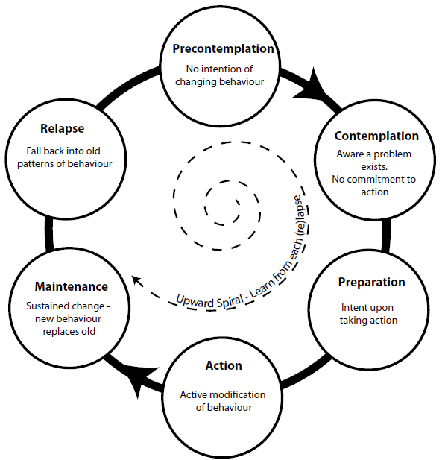
Stages of Change
Pre-contemplation (unaware, unmotivated, denial)
Contemplation (aware, low motivation, “may need a boost”)
Preparation (aware, motivated, ready for change)
Action (actively working on change, attending Tx)
Maintenance (long-term, therapy and beyond)
Relapse (abstinence violation effect)
Norcross, Krebs & Prochaska, 2011

Slide 48
Stages of Change - MCQ
Which of the following techniques would not generally be considered a component of motivational interviewing ?
A) Resisting giving direct advice
B) Understanding the patients’ experiences and motivations
C) Telling patients they are not ready
D) Listening to the patients struggles
E) Empowering and exploring ambivalence

Slide 49
Preparation of clients
Enlist them as informed allies, collaborators, but provide a framework
1
Offer “guidelines” about how best to participate
2
Anticipate some of the potential frustrations, disappointments
3
Offer guidelines about duration of therapy, group makeup
4
Discuss “ground rules”
5
Discuss “risks”
6

Slide 50
Cognitive Model of Addictions / Patient Assessment / Stages of Change
Q & A

Slide 51
Let’s get started …. CBT Fundamentals
Overarching Tenants / Principles:
Therapeutic relationship
Collaboration
Alliance / Trust
Curiosity
Motivational techniques
Think about what you are thinking
Teach patients to become their own therapists.
Skills / Tools / Techniques:
Modules
Focused in real time
Shared experience

Slide 52
Let’s get started …. Structure of Group
Active, directed, structured yet flexible
Often 2 trained facilitators
Compatible with other treatment
Typically 90-120 mins
Small (5) to large (12), brief
Heterogonous makeup
Collaborative, educational, supportive
Combination of Socratic questioning and didactic teaching.
Goals: harm reduction vs. abstinence
Balance between skills development and group process
Open versus closed

Slide 53
Let’s get started …. Introductions and Ground Rules. Risks
Introductions
Modelled by therapist
Who they are, why here, addictions
Ground Rules
Come on time and every week (call)
Be supportive to each other
Be constructive
Equal time for all
Keep it practical
Do the homework
CONFIDENTIALITY
Tell us if you are unhappy
BE RESPECTFUL OF GROUP (intoxication)
Risks

Slide 54
Let’s get started …. Format of Sessions
Check in (Daily Wellness Scale)
Feedback from previous session, review of previous session’s activities and agenda items.
Review of homework
Discussion of common themes from check-in
Collaboratively agree on module or module(s) for agenda – based on check in themes
Work through module – using specific examples from members
Elicit input from all group members.
Summarize
Assign homework

Slide 55
Lets get started …. T/F Question
In Cognitive Behavioral Therapy for addictions you want a large group of people that all struggle with the same addiction.
True or False ?

Slide 56
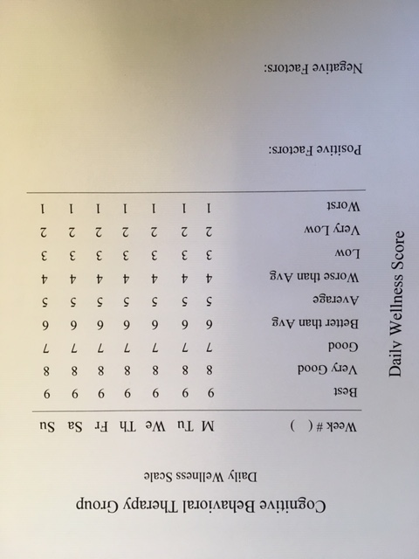
Let’s get started …. Format of Sessions (Daily wellness Scale)

Slide 57
Let’s get started …. Modules
1) Stress Vulnerability and Harmful Effects of Substances
2) Cravings
Triggers, Cues & Urges
Coping with Craving
3) Refusal Skills and Assertiveness
4) Behavioral Chain Analysis
5) Though Records
Thoughts & Feelings
Biases / Cognitive Distortions

Slide 58
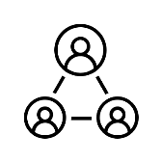
Let’s get started …. Modules
6) Relationships
Healthy Dependency
7) Rebuilding Trust
8) Goal Setting
9) All Purpose Coping Plan

Slide 59
Let’s get started….
Q & A

