Slide 1
GROUP COGNITIVE BEHAVIOURAL THERAPY (CBT) FOR SUBSTANCE USE DISORDERS
FACILITATOR TRAINING
Rick Hawe, MD, FRCPC
Assistant Professor, University of Manitoba

Slide 2
Workshop Overview
Group Therapy Overview – Theory, Practice, Experience
Theories of Addiction (The “Science”)
CBT Basics – Theory, Practice, Experience
Cognitive Conceptualization of Addiction
Patient Assessments and Stages of Change
Let’s Get Started … (Fundamentals, Structure, Format)
Modules / CBT skills
Challenges
Further Reading (Reference List)
Wrap-up

Slide 3
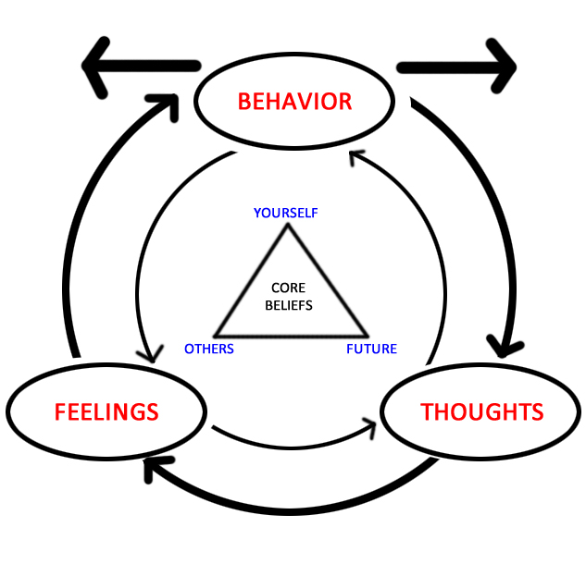
CBT Basics
Aaron Beck – University of Pennsylvania
Beck’s Triad (Depression)
Negative view of self, negative view of others, negative view of future
Thoughts, Feelings, Behaviors
Adaptation for various psychiatric disorders
Adaptation for substance use disorders

Slide 4
CBT Basics
Principles of CBT
Formulation (evolving)
Therapeutic alliance
Collaboration and active participation
Goal oriented and problem focused
Emphasis on the present
Educative (teach patient to become own therapist)
Time limited
Structured sessions
Identify and evaluate dysfunctional thoughts and beliefs
Variety of techs to change thinking, mood and behavior
Cognitive Therapy: Basics and Beyond, Judith Beck

Slide 5
CBT Basics
Cognitive Conceptualization
Automatic thoughts
Attitudes, rules, assumptions
Core beliefs
Results
Feelings / Behaviors
Automatic Thoughts
Intermediate Beliefs
Core Beliefs
Cognitive Therapy: Basics and Beyond, Judith Beck

Slide 6
CBT Basics – T/F Question
Cognitive Behavioral Therapy is focused on the present and ignores the past.
True or False?

Slide 7
CBT Basics
Structure of sessions
Mood check
Bridging from previous session (may include some feedback)
Setting the agenda
Review of homework
Items on the agenda (i.e., Thought Record)
Summary and Feedback & Assign Homework
Cognitive Therapy: Basics and Beyond, Judith Beck

Slide 8
CBT Basics
Key Techniques (Agenda Items):
Thought Records (automatic thoughts, biases, core beliefs)
Drilling down
Disputing (automatic thoughts, intermediate beliefs, core beliefs)
Other methods: (cognitive continuum, rational-emotional role play, using “others” as a reference point)
Working with Core Beliefs
Problem Solving
Pros / cons
Behavioral Experiments
Behavioral Activation
Activity monitoring and scheduling
Relaxation / Guided Imagery
Graded Exposure
Role Playing
Homework
Cognitive Therapy: Basics and Beyond, Judith Beck

Slide 9
Adaptations of CBT to Group Format
Evolution
Increased efficiency of CBT
Group Process (noise)
CBT: Impaired Information Processing
Automatic thoughts
Core beliefs
Commonalities
Techniques in CBT Basics all lend themselves exceptionally well to group therapy
Process of group becomes reparative in itself (more effective ?)

Slide 10
CBT Basics
Q & A

Slide 11
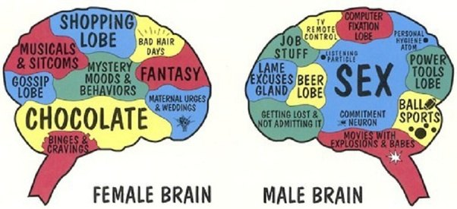
Addiction is Addiction is Addiction…..
Remarkable differences in addictive behavior
Remarkable differences in brain receptor chemistry
Remarkable differences in reasons for addiction

Slide 12
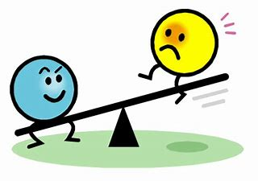
Cognitive Model of Addiction
Addiction
Self Efficacy
Coping Strategies
Simplistic View = Balance vs Imbalance
Self Efficacy – how well one can execute courses of action required to deal with prospective situations.
Coping Strategies – techniques we employ to deal with stress.
Group Cognitive Therapy for Addictions – Wenzel, Liese & Beck

Slide 13
Cognitive Model of Addiction
Proximal situational factors
Anticipatory expectations
Relief oriented expectations “I need a drink”
Facilitating thoughts / Instrumental strategies
Triggers, cues, urges
Distal background factors
Early Life Experience and “schemas”
Genetic predisposition
Psychiatric illness
Social network
Exposure
Personality traits
Proximal
Addiction
Distal
Group Cognitive Therapy for Addictions – Wenzel, Liese & Beck

Slide 14
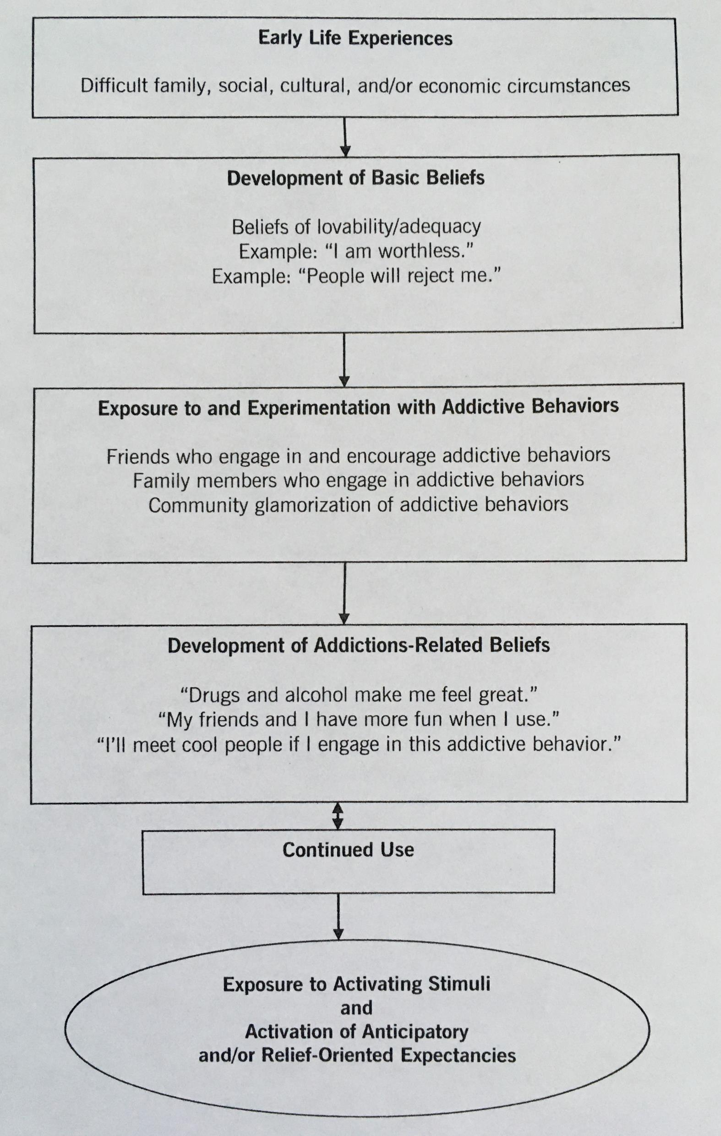
Cognitive Model of Addiction
A number of these factors are modifiable through CBT therapy.
Early life experience
Basic beliefs
Exposure to addictions
Addictions take on a life of their own
Triggers, cues, urges
Group Cognitive Therapy for Addictions – Wenzel, Liese & Beck

Slide 15
Cognitive Model of Addiction – T/F Question
Early life experience is modifiable through CBT.
True or False ?

Slide 16
Stress Vulnerability Model
Stress Vulnerability Model
Psychiatric disorders
Alcohol and Drug Abuse
Coping Skills
Social Support
Meaningful Activities
Medication
Biological Vulnerability
Stress
Symptom Sensitivity Relapse
Integrated Treatment for Dual Disorders – Mueser, Noordsy, Drake & Fox

Slide 17
Assessment
Meet 1:1
Review substance use history
Each substance
How it is used (imbibe, inhale, insulfate, inject)
When started, how much, peak use, current use
Consequences: legal, medical, personal
Treatment history (prior group Tx?)
Family history
Developmental History
“Rock bottom”
“Triggers”
Support System
Motivation (Ask)
Introduce them to CBT model

Slide 18
Assessment
Behind the scenes (3rd eye - detective)
Suitability for group (insight, cognition, psychological mindedness, severe personality pathology)
Do they need medical management first
True motivation
Psychological schemas (mistrust, failure, please others, rejection fear, self sabotage)
Potential pitfalls / predicting behavior in group (interpersonal relational style, risk of dropping out, help – rejection)
Filing away key aspects of history
Fodor for group cohesiveness, etc.
Draw quieter individuals in
Denial
Formulation / Conceptualization
Ideal Candidate

Slide 19
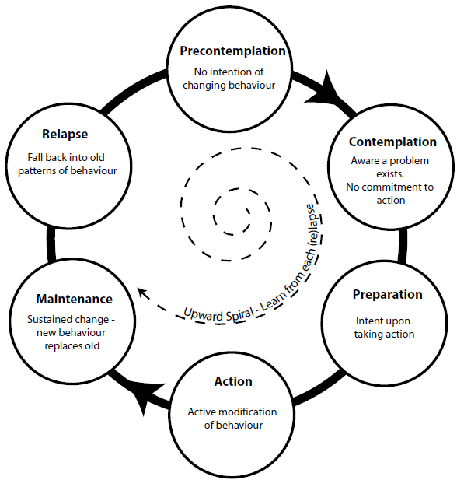
Stages of Change
Pre-contemplation (unaware, unmotivated, denial)
Contemplation (aware, low motivation, “may need a boost”)
Preparation (aware, motivated, ready for change)
Action (actively working on change, attending Tx)
Maintenance (long-term, therapy and beyond)
Relapse (abstinence violation effect)
Norcross, Krebs & Prochaska, 2011

Slide 20
Stages of Change - MCQ
Which of the following techniques would not generally be considered a component of motivational interviewing ?
A) Resisting giving direct advice
B) Understanding the patients’ experiences and motivations
C) Telling patients they are not ready
D) Listening to the patients struggles
E) Empowering and exploring ambivalence

Slide 21
Preparation of clients
Enlist them as informed allies, collaborators, but provide a framework
1
Offer “guidelines” about how best to participate
2
Anticipate some of the potential frustrations, disappointments
3
Offer guidelines about duration of therapy, group makeup
4
Discuss “ground rules”
5
Discuss “risks”
6

Slide 22
Cognitive Model of Addictions / Patient Assessment / Stages of Change
Q & A

Slide 23
Let’s get started …. CBT Fundamentals
Overarching Tenants / Principles:
Therapeutic relationship
Collaboration
Alliance / Trust
Curiosity
Motivational techniques
Think about what you are thinking
Teach patients to become their own therapists.
Skills / Tools / Techniques:
Modules
Focused in real time
Shared experience

Slide 24
Let’s get started …. Structure of Group
Active, directed, structured yet flexible
Often 2 trained facilitators
Compatible with other treatment
Typically 90-120 mins
Small (5) to large (12), brief
Heterogonous makeup
Collaborative, educational, supportive
Combination of Socratic questioning and didactic teaching.
Goals: harm reduction vs. abstinence
Balance between skills development and group process
Open versus closed

Slide 25
Let’s get started …. Introductions and Ground Rules. Risks
Introductions
Modelled by therapist
Who they are, why here, addictions
Ground Rules
Come on time and every week (call)
Be supportive to each other
Be constructive
Equal time for all
Keep it practical
Do the homework
CONFIDENTIALITY
Tell us if you are unhappy
BE RESPECTFUL OF GROUP (intoxication)
Risks

Slide 26
Let’s get started …. Format of Sessions
Check in (Daily Wellness Scale)
Feedback from previous session, review of previous session’s activities and agenda items.
Review of homework
Discussion of common themes from check-in
Collaboratively agree on module or module(s) for agenda – based on check in themes
Work through module – using specific examples from members
Elicit input from all group members.
Summarize
Assign homework

Slide 27
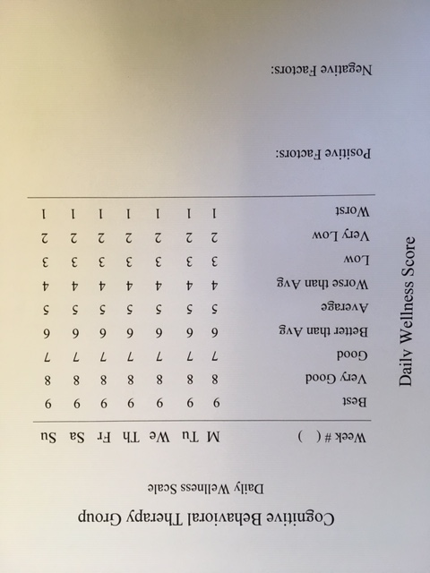
Let’s get started …. Format of Sessions (Daily wellness Scale)

Slide 28
Lets get started …. T/F Question
In Cognitive Behavioral Therapy for addictions you want a large group of people that all struggle with the same addiction.
True or False ?

Slide 29
Let’s get started …. Modules
1) Stress Vulnerability and Harmful Effects of Substances
2) Cravings
Triggers, Cues & Urges
Coping with Craving
3) Refusal Skills and Assertiveness
4) Thought Records
Thoughts & Feelings
Biases / Cognitive Distortions
5) Behavioral Chain Analysis

Slide 30
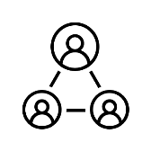
Let’s get started …. Modules
6) Relationships
Healthy Dependency
7) Rebuilding Trust
8) Goal Setting
9) All Purpose Coping Plan

Slide 31
Let’s get started….
Q & A

Slide 32
Module 1 – Effects of Substances
Stress Vulnerability Model and Harmful Effects of Substances.
Discuss the stress vulnerability model of psychiatric illness
Review examples of information available pertaining to various substances
“The Harmful Effects of ……”
AFM resource brochures – “The Basics”

Slide 33
Harmful Effects of Alcohol

Slide 35
Module 1 – Homework Exercise
Substance | Effects | Withdrawal Symptoms
Listing of substances.
Review “The Harmful Effects of ……” various substances as they pertain to them. List 2 harmful effects you did not know.
Review “The Basics” handouts and have them identify the substance, the effects they experience and potential withdrawal symptoms.

Slide 36
Module 2 : Cravings
Discuss Cravings
Physical Sensations, Cognitions, Emotions
Graphical depiction of cravings (days, months)
Triggers & Cues
Coping with Cravings

Slide 37
Module 2: Cravings MCQ
Cravings are typically time limited and last for:
A) 10-20 min
B) 5 min
C) Until you satisfy the craving
D) 2 hours

Slide 38
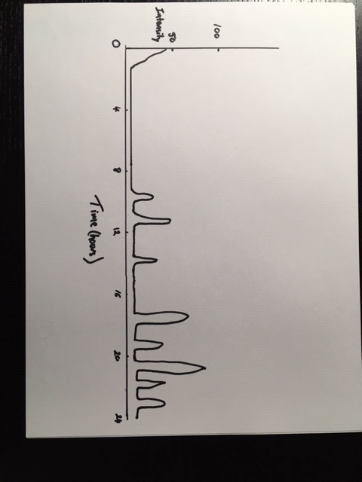
Cravings
1
2
3

Slide 39
Triggers and Cues
Distinguish Triggers and Cues for Cravings
Triggers – typically interactions with others that generate strong emotional responses.
Disagreements with partners or family members
Interactions with supervisors or co-workers
Anxiety producing interactions or situations
Cues – typically the inanimate forces in our environment (Classical Conditioning)
Day of the week, time of the day, physical environment
Smells, sights, sounds (commercials/shows, MLLC, drug paraphernalia, smelling drugs)
Events paired with use – beach, BBQ’s, sports
Paycheques, cash

Slide 40
Coping with Cravings
Cravings come and go, 10-20 min blocks
Distraction (prepare a list of activities)
Recalling the negative consequences (index cards or wallet cards, phone notes) (pictures) (“rock bottom”)
Talking through cravings with trusted individual
Utilizing self-talk
Guided imagery / mindfulness
Contingency management
Avoiding triggers / cues
Crave surfing
Substitution
Escape plan

Slide 41
Module 2 – Homework Exercises
Description of Cravings
Physical Sensations | Emotions | Cognitions
Description of Cravings
List of Triggers
Listing of Common Triggers / Cues
1
2
3
4
5

Slide 42
Module 2 – Homework Exercises
Daily Record of Craving
Date / Time | Situation, thoughts, feelings | Intensity of Craving (0-10) | Length of Craving | Coping Skills Utilized
Example: Friday, 3 pm | Argument with boss, frustrated angry | 7 | 20 min | Distraction (went for walk)
Daily Record of Cravings

Slide 43
Modules 1 & 2…. 1) Harmful effects of substances 2) Cravings, triggers, cues
Q & A

Slide 44
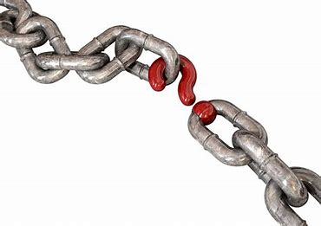
Module 3 – Refusal Skills & Assertiveness
Keys to success in managing addictions involve a number of significant changes to the ways in which individuals mange their lives
Assessing / Reducing Availability
Managing Cues
Assertiveness & Refusal Skills
Seemingly Irrelevant Decisions
Planning for high-risk situations

Slide 45
Module 3 - Homework
1) Reducing Availability of Substances
Ways to Reduce Access | Advantages | Disadvantages
Reducing availability
Refusal skills
2) Describe a recent situation in which you used refusal skills
3) Make a list of the refusal skills that work best for you.

