Slide 1
Approach to Irritable Bowel Syndrome
The Good, the Bad and the Uncertain
Dr. Karen Toews and Dr. Grace Frankel
MEDS Conference - Jan 30, 2021

Slide 2
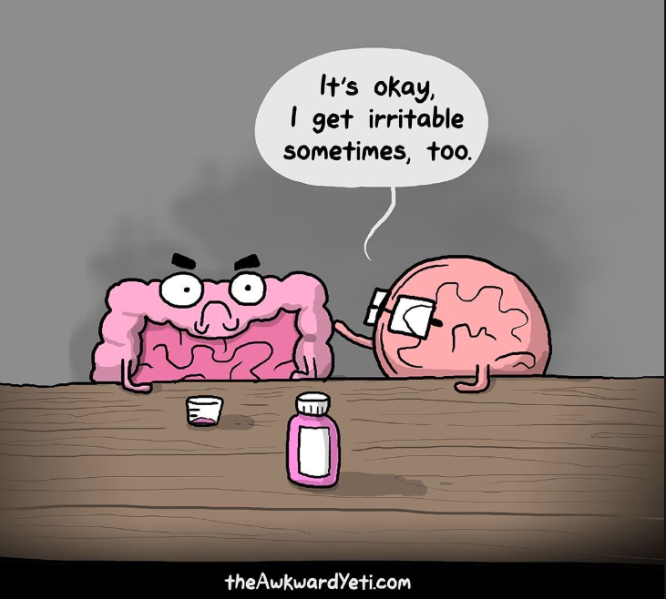
Disclosures
Dr. Karen Toews
No commercial or financial conflicts of interest to declare
Dr. Grace Frankel
No commercial or financial conflicts of interest to declare
We just like to talk about poop

Slide 3
Learning Objectives
Review the Rome diagnostic criteria for IBS and question whether IBS is a diagnosis of exclusion.
Explore the brain-gut/gut-brain hypothesis as the proposed pathophysiology of irritable bowel syndrome (IBS)
3. List the pharmacological treatments for IBS-C and IBS-D and explore relative efficacy
4. Discuss 2 herbal product options for treatment of IBS
5. Summarize 4 IBS management PEARLS for primary care

Slide 4
According to the Bristol Stool Chart, what type of poop is this?
Type 1 = severe constipation
#POOPTALK
Notes:
Let’s get started…..what kind of poop is this? Slido question

Slide 5
ROME IV Criteria
Patient has recurrent abdominal pain (≥1 day per week, on average, in the previous 3 mo), with an onset ≥6 mo before diagnosis
Abdominal pain is associated with at least two of the following three symptoms:
Pain related to defecation Change in frequency of stool Change in form (appearance) of stool
Patient has none of the following warning signs: Age ≥50 yr, no previous colon cancer screening, and presence of symptoms
Recent change in bowel habit Evidence of overt GI bleeding (i.e., melena or hematochezia) Nocturnal pain or passage of stools Unintentional weight loss Family history of colorectal cancer or inflammatory bowel disease
Palpable abdominal mass or lymphadenopathy Evidence of iron-deficiency anemia on blood testing Positive test for fecal occult blood
N Engl J Med2017;376:2566-78
Notes:
NEJM 2017
Why is this so difficult…..we have all heard about somebody who was told they had IBS and it was really cancer
Guidelines and diagnostic criteria change
“experts” order lots of tests
Patient expectations

Slide 6
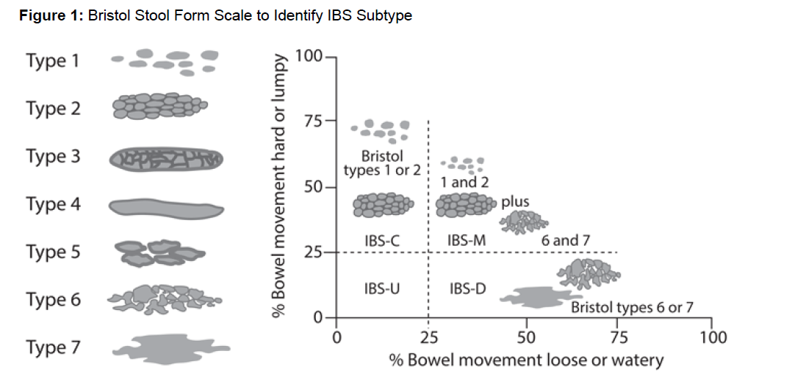
Constipated >25% and <25% diarrhea
IBS-C
A bit of everything (>25% for both)
IBS-M
Diarrhea >25% and <25% constipation
IBS-D
From Pinto-Sanchez MI. Irritable Bowel Syndrome Chapter In CTC [Accessed May 2020]
Notes:
IBS subtype can be identified based on stool consistency through the Bristol stool form scale, a validated instrument that allows reporting of stool
appearance on a scale of 1 to 7. A score of 1 corresponds with hard to pass and lumpy stool (slow GI transit) and 7 corresponds to entirely liquid stool (fast
GI transit) (see Figure 1).
The 3 main subtypes of IBS are:
IBS with predominant constipation (IBS-C)—stool type 1–2 from the Bristol stool form scale more than 25% of the time and stool type 6–7 less
than 25% of the time.
IBS with predominant diarrhea (IBS-D)—stool type 6–7 from the Bristol stool form scale more than 25% of the time and stool type 1–2 less than
25% of the time.
IBS with mixed bowel pattern (IBS-M)—stool type 1–2 from the Bristol stool form scale more than 25% of the time and stool type 6–7 more than
25% of the time.
People whose symptoms do not fit into any category are considered to have IBS unclassified (IBS-U).[9] IBS subtypes are not separate conditions and the
quantity, intensity and severity of symptoms may vary from patient to patient.[4] Therefore, the IBS subtype should ideally be re-categorized as a person’s
bowel habits change.

Slide 7
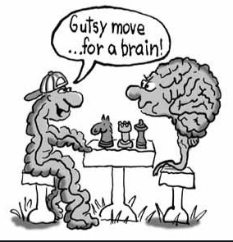
Gut-Brain or Brain-Gut
N Engl J Med 2017;376:2566-78
Notes:
The pathogenesis of IBS is multifactorial!

Slide 8
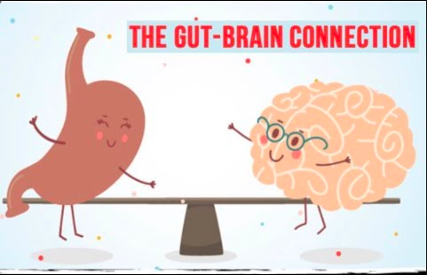
Brain-Gut or Gut-Brain
N Engl J Med 2017;376:2566-77
Notes:
Although subtyping of IBS currently guides management, each subtype probably comprises more than one disease entity
Causes thought to start in the gut: SIBO, dysregulation of gut motility, visceral hypersensitivity, inflammation, post infectious, food sensitivity (FODMAPS)

Slide 9
A Diagnosis of Exclusion?
National guidelines for IBS management state that in a patient who has symptoms meeting the Rome IV criteria, with no alarm features, the physician should make a POSITIVE diagnosis of IBS without resorting to a battery of tests.
Ordering a panel of blood tests routinely is unsupported by the evidence.
Am J Gastroenterol 2014;109
Notes:
This is from the 2017 NEJM article – US National Guidelines
Cdn guidelines recommend serologic testing to r/o celiac – conditional recommendation – low quality evidence
In patients who meet diagnostic criteria for IBS and have no alarm features, we do not routinely perform any additional testing beyond the initial evaluation. This limited diagnostic approach rules out organic disease in over 95 percent of patients - uptodate

Slide 10
Which of following diagnostic test(s) is/are important to order for a patient you suspect has IBS?
Colonoscopy
Celiac Screen
Fecal calprotectin
CBC
Food allergy testing
None of the above
#POOPTALK
Notes:
Slido question

Slide 11
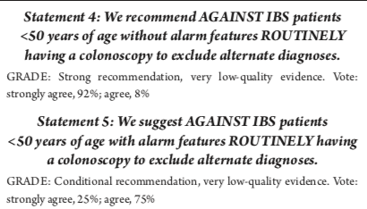
Canadian IBS Guideline 2019 Recommendations:
Data from seven case-control studies showed a greater likelihood of having positive celiac antibodies among patients with IBS compared with controls without IBS (odds ratio [OR] 2.94; 95% CI, 1.36–6.35)

Slide 12
Diagnostic algorithm
N Engl J Med 2017:376
Notes:
NEJM 2017
Cdn gastro guidelines say celiac screen only! And recommends against CRP and fecal calprotectin
Fecal calprotectin: Faecal calprotectin (or fecal calprotectin) is a biochemical measurement of the protein calprotectin in the stool. Elevated faecal calprotectin indicates the migration of neutrophils to the intestinal mucosa, which occurs during intestinal inflammation, including inflammation caused by inflammatory bowel disease. Under a specific clinical scenario, the test may eliminate the need for invasive colonoscopy or radio-labelled white cellscanning.

Slide 13
Notes:
A little different than the previous algorithm – this was starts with celiac and colonoscopy if >50 then advises Metamucil and peppermint oil and dicetel and then goes on to focus on predominant bowel habit

Slide 14
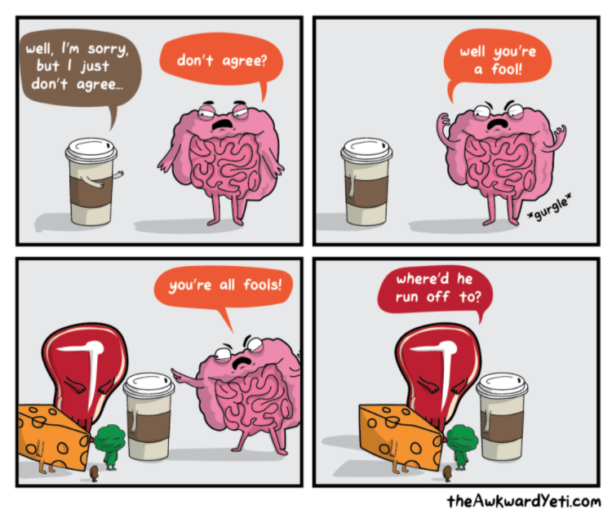
Treatment of IBS
So Many Drugs…….What Do I Pick?

Slide 15
Irritable Bowel Syndrome
Treatment
Diarrhea
Loperamide (Immodium®)
Diphenoxylate/atropine (Lomotil®
Cholestyramine (Olestyr®)
Eluxadoline (Viberzi®)
Rifaxamin (Zaxine®)
Constipation
Psyllium + Fluids
PEG
Senna/bisacodyl
Lubiprostone*
Linaclotide
Plecanatide*
Tenapanor
?Prucalopride
Abdominal Pain
Antispasmotics Dicyclomine (Bentylol®)
Hyoscine (Buscopan®
Pinaverium (Dicetel®)
Trimebutine (Modulon®)
Pain AND Diarrhea
Tricyclic antidepressants
Pain AND Constipation
SSRIs – paroxetine, fluoxetine and citalopram have been investigated for IBS
*Not available in Canada

Slide 16
Which of the following medications is a prokinetic drug for IBS-C that has a warning for increased risk of suicide/suicidal ideation?
Linaclotide
Tenapenor
Loperamide
Prucalopride
#POOPTALK

Slide 17
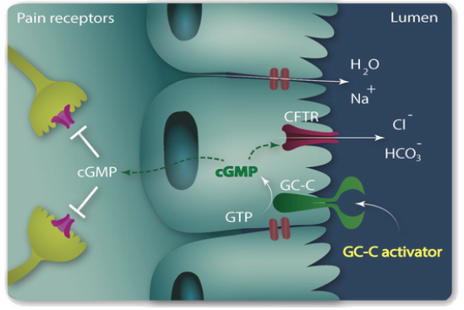
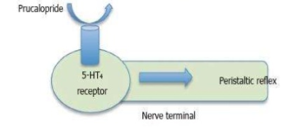
IBS-C
Linaclotide CONSTELLA & Plecanatide TRULANCE
Prucalopride RESOTRAN
Serotonin (5HT4) agonist = peristalsis in gut (prokinetic agent)
World J Gastrointest Pharmacol Ther. May 6, 2016; 7(2): 334-342
Advanced Drug Delivery Reviews. 101. 10.1016/j.addr.2016.01.010.
Guanylate Cyclase C (GC-C) agonist = chlorine and bicarb into lumen which increases intestinal fluids. cGMP may also reduce pain pathway
Notes:
Prucalopride – works on serotonin receptors, which exist in the gut. Also why SSRIs cause nausea/GI symptoms. This is why there is also a suicide/SI risk for this drug.
Linaclotide was developed when the mechanism of action of enterotoxins was studied – toxin-producing bacteria increase GC_C activity leading to increased permeability of Cl and water into the lumen leading to diarrheal symptoms. Researchers though they could use this info to engineer a drug for constipation management and voila, linaclotide (and placanitide) were born

Slide 18
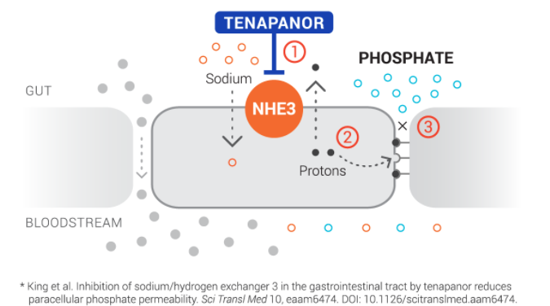
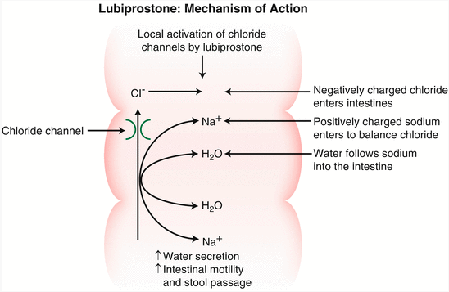
IBS-C
Tenapanor IBSRELA
Lubiprostone AMITIZA
Inhibits sodium/H+ exchanger = sodium, phosphate and water are excreted (softening stools, also to ↓phosphate in CKD)
Chloride channel activator = draws in water to soften stool
Irritable Bowel Syndrome with Constipation. In: Rose, MD, MSEd S. (eds) Constipation. Springer, New York, NY
Notes:
Tenapenor was originally created to lower phosphate in CKD – turns out diarrhea was a side effect et voila! Another drug indication = IBS-C
Linaclotide, Plenaclotide, Lubiprostone and Tenapenor are expensive stool softeners.

Slide 19
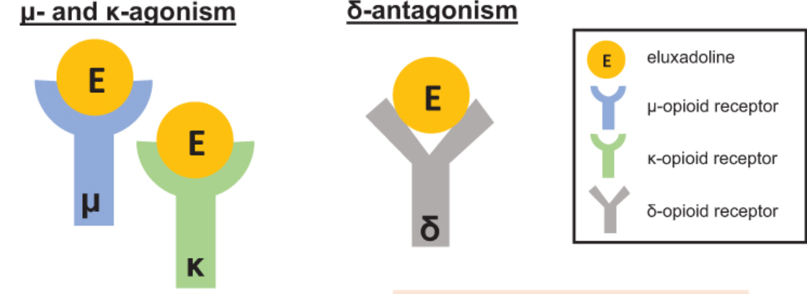
IBS-D
Eluxadoline VIBERZI
Slows gut motility (μ), reduces pain (κ)
Modulates μ-receptor activity to prevent constipation
Drug Design, Development and Therapy 2020:14 1391–1400
Notes:
Think about mechanism of opioid constipation → might as well make an agent that does the same thing but has other receptors to precent you from getting too constipated.

Slide 20
Do drugs for IBS work?
April 2020
18 RCTs (n=1127) with the majority of patients being women
Global improvement in IBS symptoms 57% TCAs vs 26% placebo (NNT=5), SSRIs 55% vs 33% (NNT=5)
Abdominal pain improvement TCAs 59% vs 28% (NNT=4), SSRIs 45% vs 26% but not significant
Side effects? Worse with TCAs (drowsiness, dry mouth) NNH=7
SSRIs 37% vs 27% not significant

Slide 21
Do drugs for IBS work?
Am J Gastroenterol. 2018 March ; 113(3): 329–338
8 linaclotide and 7 plecanatide trials included (n=10,369 patients)
For IBS-C primary outcome is decrease in pain ≥30% in past 24h with increase in CSBM ≥1 per week for half the weeks in a 12-week follow-up period
Linaclotide: OR 2.43 (1.48-3.98) NNT=6
Plecanatide: OR 1.87 (1.47-2.38) NNT=9 versus placebo
Side effects? Diarrhea linaclotide NNH=32, plecanatide NNH >100
*Note* when I crunch the numbers it’s more like NNH =18-24 linaclotide, NNH=62 plecacatide (there were a couple studies with no events)
Comparative efficacy studies sparse/small (but several SR/MA protocols underway)
Notes:
Found one comparative study with 22 patients looking at prucalopride vs tegaserod – no real difference between the two at 2 weeks (very short F/up) except for prucalopride better for abdominal pain symptoms but had more adverse effects (diarrhea). Rev Sanid Milit Mex 2018; 72 (3-4)

Slide 22
Drugs for IBS available in Canada
Drug | Indication | Dose | Cost/Coverage
Prucalopride (Resotran®) 5HT4 agonist | Chronic Idiopathic Constipation (NOT for IBS-C) | 2mg daily | Generic: $100/month (Not covered)
Linaclotide (Constella®) GC-C agonist | IBS-C | 290mcg daily 30 min prior to breakfast | $180/month (Not covered)
Tenapanor (Ibsrela®) NHE3 inhibitor | IBS-C | 50mg BID | $190/month (Not covered)
Eluxadoline (Viberzi®) Opioid receptor modulator | IBS-D | 100mg BID | $160/month (Not covered)
Rifaxamin (Zaxine®) antibiotic | IBS-D (SIBO?) | 550mg TID x 14 days | $350/14 day treatment Not Covered for SIBO/IBS (Part 3 for hepatic encephalopathy)
Hyoscine (Buscopan®) | Abdominal pain/spasm | 10mg | $22/60 tabs Covered Part 1
Pinaverium Bromide (Dicetel®) | Abdominal pain/spasm | 50-100mg TID with meals | Generic $30-60/month Covered Part 1
Diphenoxylate/atropine (Lomotil®) | Abdominal pain/spasm | 5mg initial, then 2.5mg after each loose BM | $33/60 tabs Not covered
TCAs and SSRIs | Pain with either constipation (TCAs) or diarrhea (SSRIs) | Various, lower doses than antidepressant doses | Cheap <$1/day Covered Part 1
Notes:
Prucalopride - ?suicide risk. Also has not been shown to be effective in IBS-C

Slide 23
True or False: Essential oil of peppermint (5 drops PO TID) is an effective therapy for IBS
True
False
#POOPTALK

Slide 24
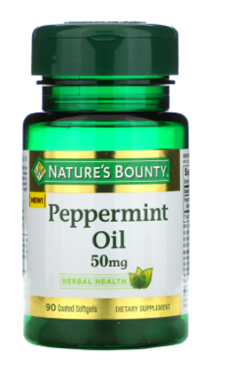
Peppermint Oil?
SR/MA 2019
7 studies (n=835); follow-up period ranged 2-12 weeks in duration
Peppermint oil (enteric coated) ?dose – who knows (usually 0.2-0.4mL in EC caps TID between meals)
Global improvement in IBS symptoms: ~60% peppermint vs 25% placebo (NNT=3)
Improvement in abdominal pain: 53.9% vs 30.3% (NNT=5)
Side effects? Heartburn, peppermint taste (limited safety data reported) – other sources estimate NNH=7 (RxFiles)
Cost? $20-$40/month
PEARL: Get ENTERIC COATED capsules! Essential oils = very irritating to the stomach!
BMC Complement Altern Med. 2019 Jan 17;19(1):21

Slide 25
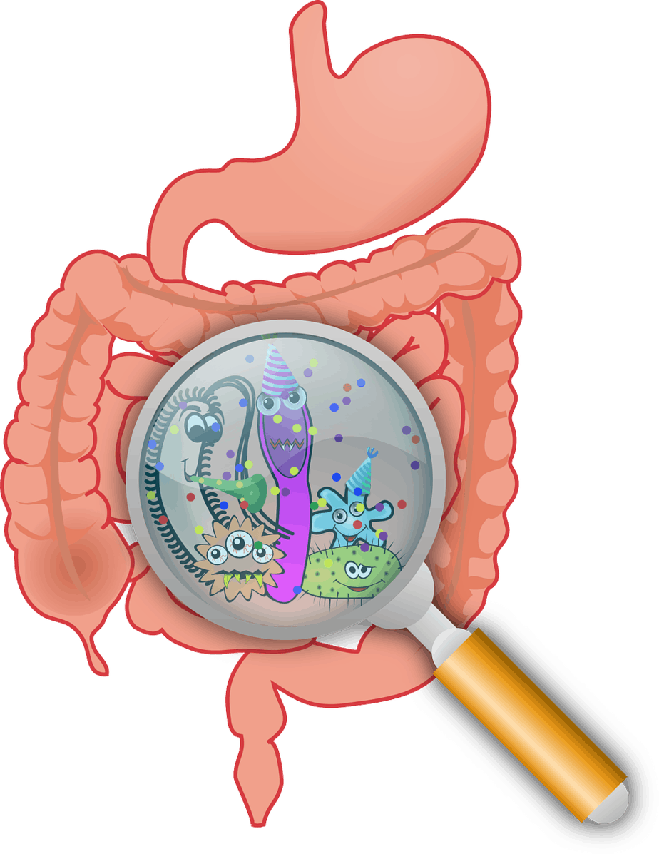
Probiotics
SR-MA 2014
43 RCTs included analyzing prebiotics, probiotics and symbiotic in IBS and CIC
Probiotics for IBS: RR 0.79 (95% CI 0.70-0.89) for global improvement in symptoms vs placebo
Most effective for abdominal pain SMD -0.25, bloating SMD -0.15 and flatulence SMD -0.23 – small effect size
Concluded that which specific strains/species are unclear due to variability between studies Note high heterogeneity I²=72%
Not enough data on pre-biotic and synbiotics
Am J Gastroenterol 2014; 109:1547–1561
Notes:
A couple of other SR-MA’s showed similar results – this SR-MA was of better quality (American journal of gastroenterology).
Eligibility for inclusion in meta-analysis
Randomized controlled trials
Adults (participants aged > 16 years)
Diagnosis of IBS or CIC based on either a clinician ’ s opinion, or meeting specifi c diagnostic criteria (Manning, Kruis score, Rome I,
II, or III), supplemented by negative investigations where trials deemed this necessary.
Compared prebiotics, probiotics, or synbiotics with placebo.
Minimum duration of therapy 7 days.
Minimum duration of follow-up 7 days.
Dichotomous assessment of response to therapy in terms of effect on global IBS symptoms or abdominal pain following therapy, or
response to therapy for CIC, or continuous data in the form of effect on IBS symptom scores at study end or effect on mean number
of stools per week for CIC (Preferably patient-reported, but if this was not available then as assessed by a physician or questionnaire
data).
Synbiotics = combo of pre and probiotics
Preiotics – stuff found in food that stimulate growth or activity of beneficial bacteria

Slide 26
4 IBS PEARLS for Primary Care
Be BRAVE! Make a POSITIVE DIAGNOSIS of IBS
Use the Brain-Gut/Gut-Brain hypothesis when counseling patients.
Most drugs for IBS have a NNT of 4-8ish but the new ones are currently expensive and not covered
Peppermint oil works! But use enteric coated capsules! Probiotics are an option too ☺

Slide 27
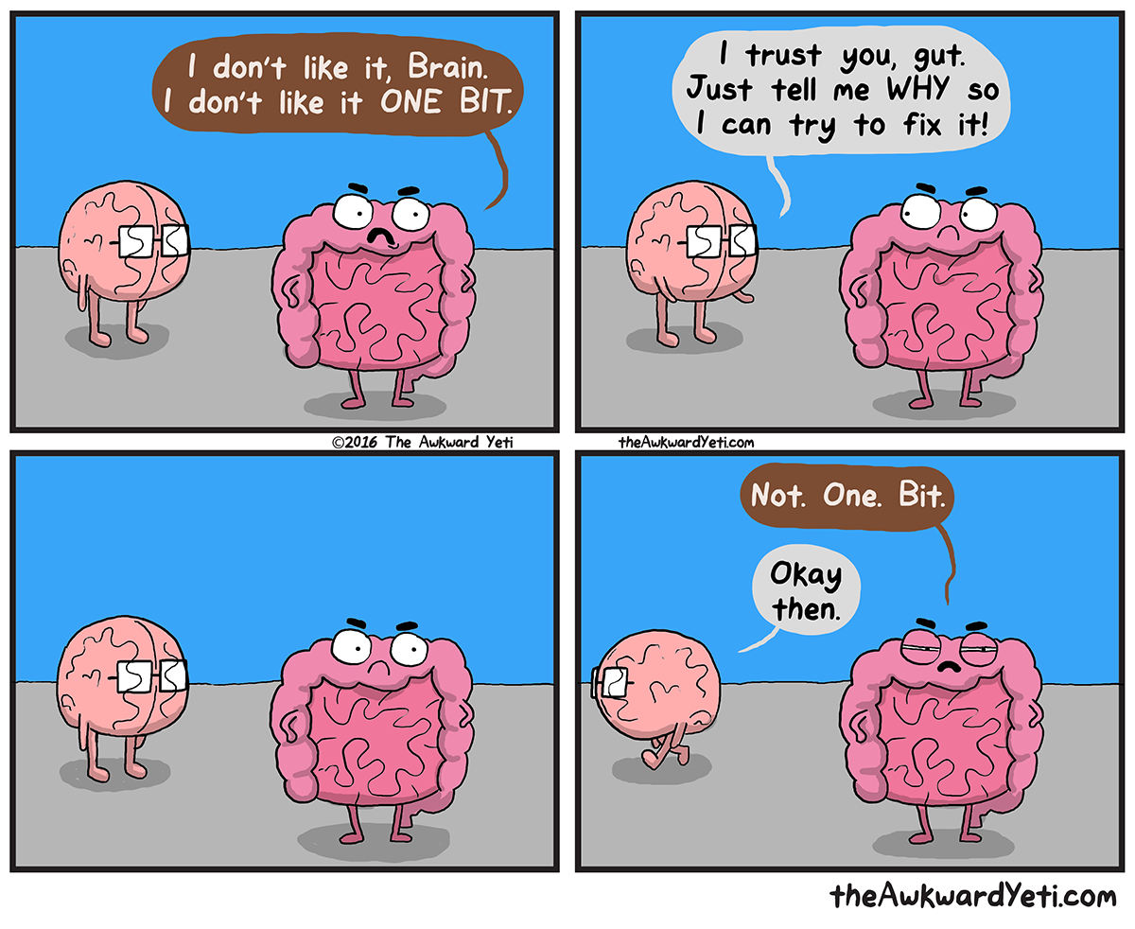
Questions?

