Slide 1
CFPC PRACTICE SAMP EXAM 2021
September 11, 2021
O. Sobowale MD CCFP
T. Cavett MD CCFP FCFP MEd

Slide 2
Disclosures:
Dr. Sobowale
Academic appointment with the Department of Family Medicine, U of M
Course director, U of M CPD, CFPC Exam Prep Course
Recurring examiner for the CFPC (SOO and SAMP) examinations
This presentation has not been endorsed by the CFPC
Dr. Cavett
Academic appointment with the Department of Family Medicine, U of M
Course Director, U of M CPD, CFPC Exam Prep Course
Paid consultant for the Medical Council of Canada
    Chair of Examination Oversight Committee
Advisor to CFPC re Virtual SOO development
No financial interest in the CFPC examination
This presentation has not been endorsed by the CFPC

Slide 3
Schedule
0830-0855 Check in – test audio and video – grab a coffee prior to the orientation
0900-1030 SAMP Orientation
1030-1045 Stretch Break
1045-1245 SAMP Exam
1245-1305 Lunch
1305-1435 Candidates mark exam
1435-1505 Group Debrief
1505-1520 Wrap up and evaluation

Slide 4
Learning Objectives
Describe the SAMP style questions
Identify important resources for prep
Practice SAMP questions

Slide 5
Overview
Exam
SAMP
SOO
Notes:
Simulated office oral
Short Answer management problem

Slide 6
Pre-COVID
Must sit full exam the first time you take it
If fail both parts, must take full exam next re-sit
If fail one part, may retake that component up to 3 times before will be required to repeat entire exam
Exam eligibility expires after 3rd failed attempt at full exam or 3 years after completing qualifying training pre-certification program
Candidates who requalify after expired eligibility will be required to start a new eligibility cycle

Slide 7
COVID modifications
For candidates writing the certification exam for the first time in 2021, the SOO component is cancelled and certification decisions will be based on successfully passing the SAMP component only.
For those who currently have a fail standing from a previous SAMP or who received a fail standing from the Oct 2020, the CFPC will only require the SAMP component of the exam to be re-taken in 2021.
For those who currently have a fail standing on the SOO component and need to repeat it for certification, the college will be offering a special administration of the SOO component in the fall of 2021

Slide 8
Exam Format
SAMPS: computer based
Prometric test centres
ProProctor if remote proctored
SOOs:
Virtual delivery (beginning in Nov ‘21)
Details TBD

Slide 9
Exam accommodation
Exam setting / remote proctored

Slide 10
105 priority topics (from 99 topics)
65 core procedures
Key Features

Slide 11
Chronic pain
Heart failure
Pain
Rash
Renal failure
Shortness of breath

Slide 12

https://www.cfpc.ca/en/education-professional-development/educational-frameworks-and-reference-guides/assessment-objectives-for-certification-in-fm

Slide 13
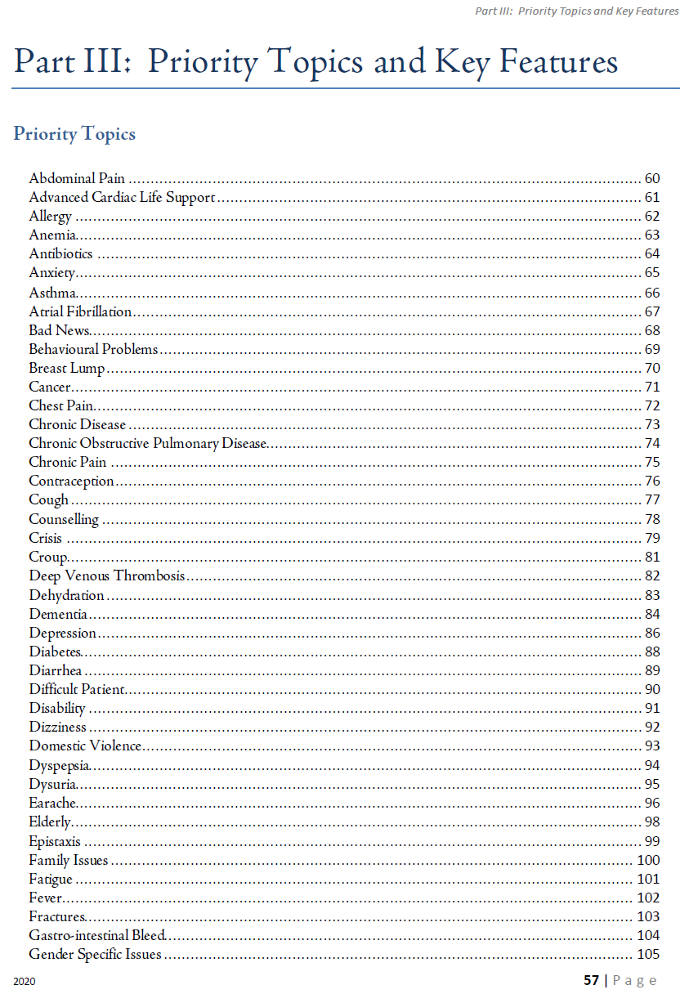
Priority topics

Slide 14
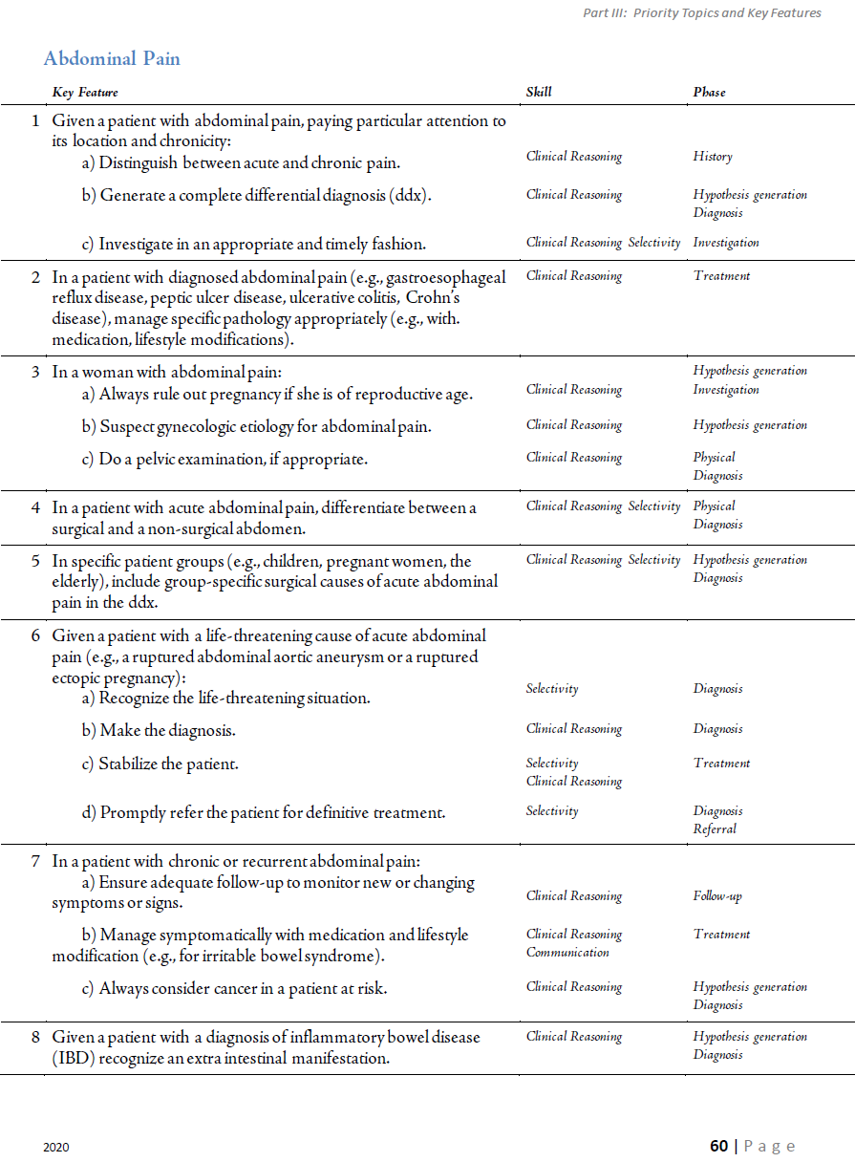
Key features

Slide 15
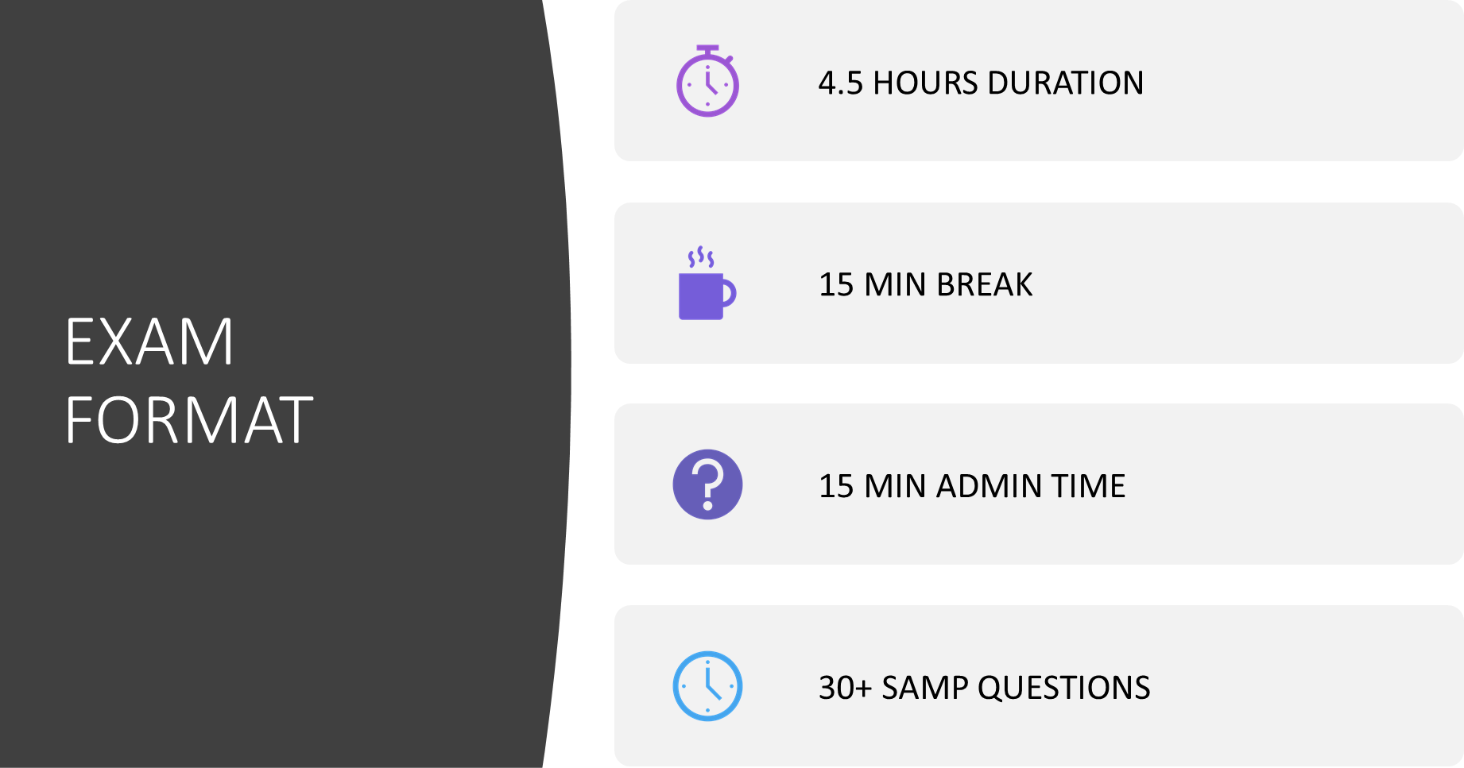

Slide 16
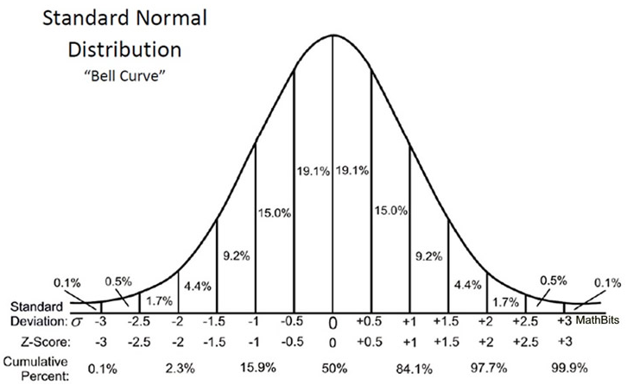
Determining a pass
Notes:
Z ≤ -2.001 = 2.3%

Slide 17
Useful resources…
U of M Family Medicine Toolkit
McMaster University PBSG modules
CFPC Self-Learning Modules
CFPC on-line SAMP practice exam
CFPC on-line SOO library & videos
Dr. Mike Kerlew Presents… (online podcasts)
https://99topics.drbouchard.ca/studynotes.pdf

Slide 18
And more…
Choosing Wisely Canada
Dash & Arnold; A guide to the Canadian Family Medicine Examination
O’Toole: Family Medicine Notes, preparing for the CCFP examination
Moseby’s Family Medicine
Rx Files

Slide 19
And more… journals
Canadian Family Physician (highlighted article list)
Review last 2-3 years for current articles
American Family Physician
Journal of the American Board of Family Practice
CMAJ
JAMA
Specialty journals by topic
NEJM

Slide 20
Preparation perspectives
REVIEW 105 priority topics and clinical features
FIND review articles and Canadian guidelines on the topic
CONSIDER setting (clinic, ER, ward, PCH etc)
MAINTAIN a pan-Canadian perspective

Slide 21
Consider age group – children, adolescent, adult, elderly.
What are the essential differences in management for these groups?
Consider vulnerable populations
How can you compensate for barriers to care?
What resources should you consider?

Slide 22
SAMPs are patient centered cases – age and gender specific
All questions relate directly to the case
Practice setting identified in the stem: answer question with setting in mind

Slide 23
A 65 year old male presents to your clinic with a three day history of chest pain
A 10 day old female was brought to the emergency room by her parents

Slide 24
Answering SAMPs
TEN WORDS OR LESS
When ordering laboratory investigations be SPECIFIC. For example, CBC, electrolytes, lipid profile and arterial blood gases are not acceptable; you must list the specific indices/test you would like for that question.
1. hemoglobin
2. white blood cell count
3. potassium
* Urinalysis is an acceptable answer

Slide 25
Answering SAMPs
When ordering other investigations, be SPECIFIC. For example, ultrasound is not acceptable, you must specify the body part to be examined.
When listing medications, the use of generic names or trade names will be accepted.
Give details about procedures ONLY IF DIRECTED TO DO SO.
When providing values or measures only SI units will be accepted.

Slide 26
Answering SAMPs
Avoid abbreviations which are not commonly used and which may not be clear to an examiner.
Put one answer per box, subsequent answers in the same box will not be considered.
If your answer to a question is “none”, please type “none”. Do not leave the answer box empty.
You won’t lose marks for a wrong answer.

