Slide 1
Opioid Agonist Therapy 101: An Introduction to Clinical Practice Workshop
Special Considerations: Acute, chronic and perioperative pain in the context of Opioid Agonist Treatment
Slide development - Kulvir Badesha MD, FRCPC
And Nicole Nakatsu B.Sc. Pharm, BCPS, EPPh

Slide 2
Faculty/Presenter Disclosure
Faculty: Nicole Nakatsu
Relationships with commercial interests: (list None if no disclosures)
Grants/Research Support: None
Speakers Bureau/Honoraria: Fresenius Kabi
Consulting Fees: None
Other: None
Mitigating potential bias: (delete this section if no disclosures above)
Fresenius Kabi at the time I gave the talk sold no narcotics. The talk was on Opioid Stewardship and they had no input on the content

Slide 3
Learning Objectives
Review definitions, pathophysiology, and classification of pain
Understand the epidemiology and management of chronic pain
Outline rational pharmaceutical options for pain management
Review current guidelines for pain with respect to patients with concurrent pain
Discuss management of pain for patients on OAT with acute and chronic pain through case-based learning

Slide 4
Case 1: Jim
52 year old male
Long standing history of alcohol use disorder
Introduced to opiates via his wife
Stabilized on buprenorphine/naloxone for a few years with a few minor relapses only
No other medical history or medications

Slide 5
Case 1: Jim
Jim’s wife leaves for 2 weeks to visit with family
Jim takes the opportunity to indulge in a few beer
Unfortunately, while on a ladder, Jim falls and has an acute navicular fracture for non operative management
He is having considerable pain, what do you do?

Slide 6
Case 2: Kathy
Kathy is a 33 year old female
She has a positive family history of substance abuse
She herself has a long standing history of an opiate use disorder for which she is on 120 mg of methadone
She also has known Crohn’s Disease which is currently in remission
She is transferred your clinic with the following….

Slide 7
Pyoderma Gangrenosum

Slide 8
Case 2: Kathy
Kathy presents in crisis
She is receiving Infliximab and prednisone and is being followed by a gastroenterologist as well as a dermatologist. She has had a poor response to therapy thus far
She is in pain. How do you proceed?

Slide 9
Pain Overview

Slide 10
Definitions
Nociception
The process by which information about a noxious stimuli is conveyed to the brain. It is the total sum of the neural activity that occurs prior to the cognitive processes that enable human to identify a sensation as pain
Pain
An unpleasant sensory or emotional experience associated with actual or potential tissue damage, or described in terms of such damage….it is always subjective.

Slide 11
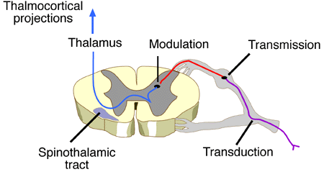
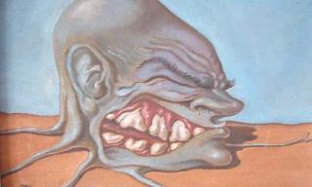
A picture is worth……
Nociception
Pain

Slide 12
Classification of Pain
Type: nociceptive, neuropathic pain
Temporal: acute pain, chronic pain
Location: soft tissue, bones/joints, visceral pain
Notes:
Nociceptive Pain
Pain that arises from actual or threatened damage to non-neuronal tissue due to the activation of nociceptors
Neuropathic Pain
Pain caused by a lesion within the somatosensory nervous system
Acute Pain
Generally agreement on pain lasting < 3-6 months
Pain that does not persist past normal tissue healing
Pain that has biological value
Chronic Pain
No universally accepted definition
Temporal definitions; vary from 3-6 months but don’t encapsulate the complete clinical picture
Pain without apparent biological value
Pain persisting beyond normal tissue healing time
persistent pain that is not amenable, as a rule, to treatments based on specific remedies

Slide 13
Pain Overview Treatment

Slide 14
Goals of Pain Management
Focus visits on function
Identify complex interactions that may be driving or enhancing the pain experience
Collaborative care models

Slide 15
Acute Nociceptive/Perioperative Pain

Slide 18
2017 Canadian Guidelines for Chronic Non Cancer Pain (CNPC)

Slide 19
2017 Canadian Guidelines for CNCP

Slide 20
2017 Canadian Guidelines for CNCP

Slide 21
But what about the methadone/buprenorphine?
Continue OAT
OAT dose is baseline for preventing withdrawal and once daily dosing will not provide significant pain relief
Split dosing may be an option for those eligible for carries
People on OAT may have a lower pain threshold, increase pain sensitivity
If using opioids start with dosing similar to that used for a person not on OAT
Caveat: may need to be larger and/or more frequent doses
Avoid using person’s abuse drug of choice if possible
Shared decision making should always be sought
Consideration of regional anaesthesia for perioperative pain

Slide 22
Buprenorphine hmmm…
Buprenorphine binds tightly to the mu-opioid receptor as a partial agonist

Slide 23
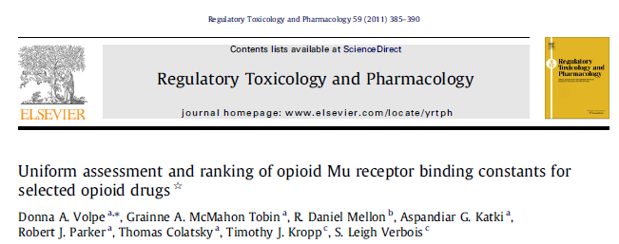

Slide 25
Other considerations
Referral to a reputable pain clinic regarding pharmacological non-opioid pain alternatives and non pharmacological alternatives
Employ non-opiate alternatives when possible
Ensure patient is aware of short term nature of opiate prescribing when necessary
Single prescriber
Limited dispensing
Close monitoring
Split dosing?
Notes:
Increasing the dose not mentioned

Slide 26
Clinical Application
Pain Overview Pharmaceutical Options What about my patient with acute pain on OAT?

Slide 27
Case 1: Jim
Jim’s wife leaves for 2 weeks to visit with family
Jim takes the opportunity to indulge in a few beer
Unfortunately, while on a ladder, Jim falls and has an acute navicular fracture for non operative management
He is having considerable pain, what do you do?

Slide 28
Case 2: Kathy
Kathy is a 33 year old female
She has a positive family history of substance abuse
She herself has a long standing history of an opiate use disorder for which she is on 120 mg of methadone
She also has known Crohn’s Disease which is currently in remission
She is transferred your clinic with the following….

Slide 29
Pyoderma Gangrenosum

Slide 30
Case 2: Kathy
Kathy presents in crisis
She is receiving Infliximab and prednisone and is being followed by a gastroenterologist as well as a dermatologist. She has had a poor response to therapy thus far
She is in pain. How do you proceed?

Slide 31
Take Home Messages
Appreciate the pain experience in the context of each individual patient
Manage expectations early and set realistic goals
Be aware of awakening the addiction circuitry and be ready to tighten treatment parameters for safety
More research is needed regarding sub-populations of patients with chronic pain
More research is needed regarding treatment of pain in patients with concurrent opiate use disorders
Return to first principles, understand the type (s) of pain that you are attempting to palliate, and then choose medications appropriately

Slide 32
References
http://www.iasp-pain.org/
College of Physicians and Surgeons of Manitoba 2015. Manitoba Methadone and Buprenorphine Maintenance: Recommended Practice.
College of Physicians and Surgeons of Ontario 2011. Methadone Maintenance and Treatment Program: Standards and Clinical Guidelines.
Center for Addictions and Mental Health 2011. Buprenorphine/Naloxone for Opioid Dependence: Clinical Practice Guidelines.
Greenwald MK et al. Buprenorphine maintenance and mu-opioid receptor availability in the treatment of opioid use disorder:implications for clinical use and policy. Drug Alcohol Depend. 2014 Nov 1; 0: 1-11.
National Opioid Use Guideline Group 2010. Canadian Guideline for Safe and Effective use of Opioids for Chronic Non Cancer Pain
Crewe K.R. et al. Clinical Pharmacogenetics Implementation Consortium guideline for cytochrome P450 2D6 genotype and codeine therapy; 2014 update. Clinical pharmacology and therapeutics. 2014; 95:376-382.
Rosenblum, A. et al. Prevalence and Characteristics of Chronic Pain among Chemically Dependent Patients in Methadone Maintenance and Residential Treatment Facilities. JAMA. 2003; 289: 2370-2378.
Katz, J. Chronic Pain, Psychopathology, and DSM-V Somatic Symptom Disorder. Can J Psych. 2015; 60 (4): 160-167.
Moulin, DE. Pharmacological management of chronic neuropathic pain: revised consensus statement from the Canadian Pain Society. Pain Res Manag; 2014: 328-335.
Moulin, DE. Chronic Pain in Canada – Prevalence, treatment, impact and the role of opioid analgesia . Pain Res and Manag; 2002: 179-184.
Turk D et al. Treatment of chronic non-cancer pain. Lancet. 2011; 377: 2265-35.
Volpe DA et al. Uniform assessment and ranking of opioid Mu receptor binding constants for selected opioid drugs. Regulatory Toxicology and Pharmacology 59 (2011) 385-390.

Slide 33
Questions ???

