Slide 1
Andexanet Alfa: Mechanism of Action and Clinical Pharmacology
This slide presentation may include evolving scientific information that has not been reviewed and approved by Health Canada
These slides are intended for educational purposes only
AstraZeneca Canada Inc. does not, under any circumstances, promote its products for off-label or unapproved uses

Slide 2
Andexanet Alfa
Mechanism of Action and Clinical Pharmacology

Slide 3
Native Factor Xa Structure
Native FXa
Native Factor Xa
FXa Inhibitor
S419
Binding site
GLA
    Catalytic Domain
S
S
Graphic adapted from: Lu G et al. EMJ Cardiol 2018;6[1]:47-51.
FXa, Factor Xa; GLA, γ-carboxyglutamic acid.
Lu G et al. Nat Med. 2013;19(4):446-451.
Notes:
Using FX as a template, modifications were made in three regions to generate
r-Antidote (andexanet alfa):
Removal of GLA domain to prevent anticoagulant effect
Replacement of the activation peptide with Arg-Lys-Arg to connect the light chain to the heavy chain
Mutation of the active-site serine to alanine to prevent thrombin generation
Reference
Lu G, DeGuzman FR, Hollenbach SJ, et al. A specific antidote for reversal of anticoagulation by direct and indirect inhibitors of coagulation factor Xa. Nat Med. 2013;19(4):446-453.

Slide 4
Andexanet Alfa: Recombinant, Modified Version of Native Factor Xa Produced in CHO Cells
Andexanet alfa acts as a Factor Xa (FXa) decoy
Andexanet alfa was rationally designed to reverse the anticoagulant effects of FXa inhibitors
Native FXa
Andexanet alfa
FXa Inhibitor
GLA domain removed to prevent anticoagulant effect
High affinity retained
A419
Binding site
GLA
    Catalytic Domain
S
S
    Activity eliminated to prevent thrombin generation
    N terminal residues retained to reduce immunogenicity
Graphic adapted from: Lu G et al. EMJ Cardiol 2018;6[1]:47-51.
CHO, Chinese hamster ovary; FXa, Factor Xa; GLA, γ-carboxyglutamic acid.
Lu G et al. Nat Med. 2013;19(4):446-451.
Notes:
Using FX as a template, modifications were made in three regions to generate
r-Antidote (andexanet alfa):
Removal of GLA domain to prevent anticoagulant effect
Replacement of the activation peptide with Arg-Lys-Arg to connect the light chain to the heavy chain
Mutation of the active-site serine to alanine to prevent thrombin generation
Reference
Lu G, DeGuzman FR, Hollenbach SJ, et al. A specific antidote for reversal of anticoagulation by direct and indirect inhibitors of coagulation factor Xa. Nat Med. 2013;19(4):446-453.
Please capitalize Native

Slide 5
Andexanet Alfa Binds to Three Entities:
Unbound
direct Factor Xa inhibitor¹
Unbound AT-III /
indirect Factor Xa inhibitor complex¹
Tissue Factor Pathway Inhibitor (TFPI) ²⁻³
Graphic adapted from: Lu G et al. EMJ Cardiol 2018;6[1]:47-51.
S
S
AT-III, antithrombin III.
1. Lu G et al. Nat Med. 2013;19(4):446-45. 2. Lu G et al. Blood. 2016;128(22):3831 [abstract]. 3. Lu G et al. EMJ Cardiol. 2018;6[1]:47-51.
Notes:
Because andexanet alfa resembles native FXa, it binds to everything that native FXa binds to: direct FXa inhibitors, indirect FXa inhibitors, and TFPI

Slide 6
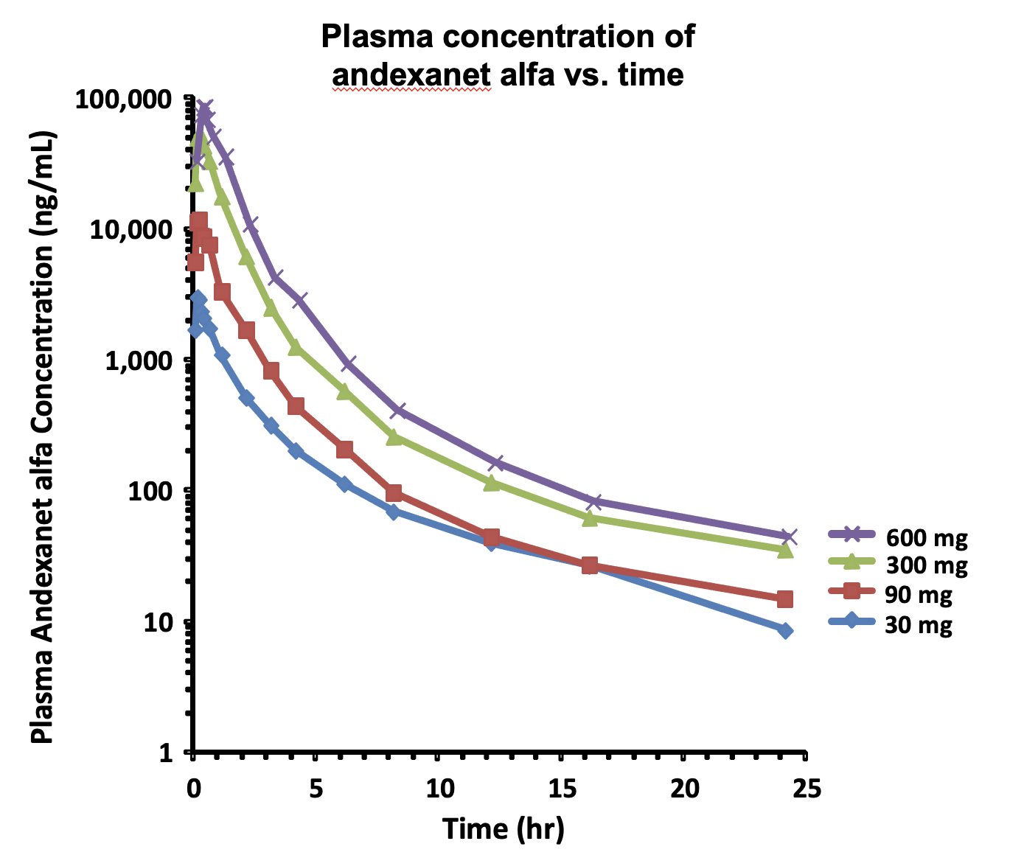
Pharmacokinetics of Andexanet Alfa
Rapid onset of action
  within 2-5 min after bolus administration¹⁻³
Pharmacokinetic (PK) half-life:
  Phase 1/2 studies: ~4-8 hours²⁻³
  Prescribing Information: ~ 3 hours⁴
Pharmacodynamic (PD)/effective half-life¹⁻³
  ~ 1 hour
Anticoagulants don’t affect PK of andexanet alfa (they clear separately)^{2,4}
PK in elderly same as in younger subjects⁴
Graphic adapted from: Siegal D et al. Blood Adv 2017;1(21):1827-1838
1. Siegal DM et al. N Engl J Med. 2015;373(25):2413-2424. 2. Siegal D et al. Blood Adv. 2017;1(21): 1827-1838. 3. Lu G et al. Blood Adv. 2020;4(4):728-739. 4. ANDEXXA® (coagulation factor Xa (recombinant), inactivated-zhzo) [Prescribing Information]. Alexion Pharmaceuticals, Inc., Boston, MA; 2021.
Notes:
Intravenous administration

Slide 7
Pharmacokinetics of Andexanet Alfa
Clearance/Metabolism:
No specific studies have been conducted to determine the precise method of elimination of andexanet alfa
It is believed, that like other large proteins, it is broken down by proteolytic cleavage mechanisms into small peptides¹
  and then clearance likely occurs via hepatic and renal mechanisms
  In clinical trials, no intact drug detected in urine²⁻³
1. Vugmeyester Y et al. World J Biol Chem. 2012;3(4):73-92. 2. Siegal D et al. Blood Adv. 2017;1(21): 1827-1838. 3. Lu G et al. Blood Adv. 2020;4(4):728-739.

Slide 8
Binding of Andexanet Alfa to Factor Xa Inhibitors
Reversible binding¹⁻²
  1:1 binding stoichiometry
  Need > 1:1 stoichiometric molar ratio of andexanet alfa : FXa inhibitor to shift binding equilibrium and reverse the effects of the FXa inhibitor
High affinity binding (subnanomolar range)³
  Relative potency of binding is in the same order of magnitude as the inhibition constants reported in the literature for FXa inhibitors against plasma-derived FXa
Competitive binding:¹⁻³
  Direct FXa inhibitors:
    Native FXa and andexanet alfa compete for binding to FXa inhibitors
  Indirect FXa inhibitors:
    Native FXa and andexanet alfa compete for binding to the AT-III/FXa inhibitor complex
andexanet alfa
FXa inhibitor
A419
S
S
Graphic adapted from: Lu G et al. EMJ Cardiol 2018;6[1]:47-51
Affinity of andexanet alfa for direct FXa inhibitors³
Inhibitor | r-Antidote K_{d} (nM) | FXa K_{i} (nM)
Rivaroxaban | 1.53 ± 0.22 | 0.400
Apixaban | 0.58 ± 0.02 | 0.100
AT-III, antithrombin III; FXa, Factor Xa; K_{d}; potency; K_{i}, inhibition constants; nM, nanomoles; r-antidote; recombinant antidote.
1. Siegal D et al. Blood Adv. 2017;1(21): 1827-1838. 2. Lu G et al. Blood Adv. 2020;4(4):728-739. 3. Lu G et al. Nat Med. 2013;19(4):446-451.
Notes:
Need > 1:1 stoichiometry to completely reverse FXa inhibition.
The FXa inhibitors bind to the same site on andexanet alfa as that on native FXa.
The lower Ki and Kd values indicate higher affinity binding.

Slide 9
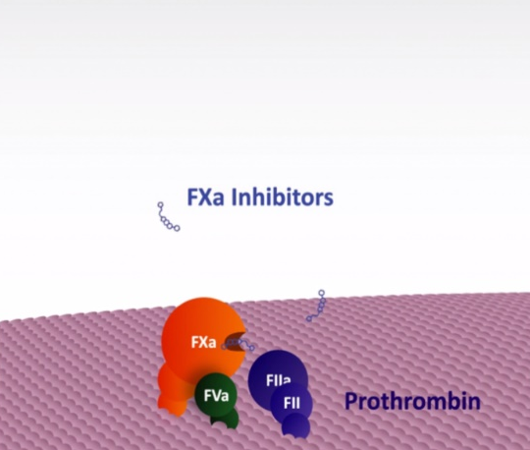
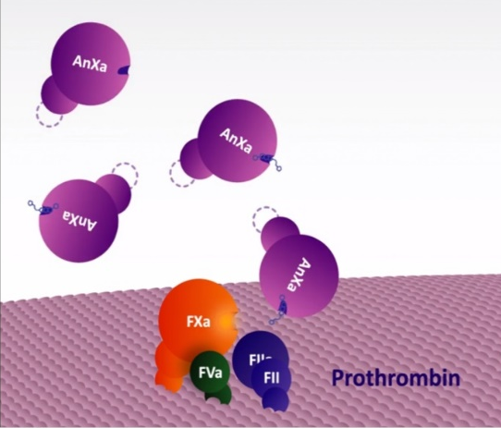
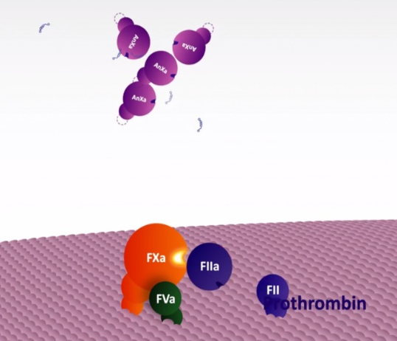
Andexanet Alfa Mechanism of Action – Direct Factor Xa Inhibitors
2
Andexanet alfa directly binds and sequesters unbound FXa inhibitors with high affinity
3
1
Absence of GLA domain prevents assembly into prothrombinase complex on platelet surface
FXa inhibitors block enzymatic activity of FXa
Without Andexanet alfa
With Andexanet alfa
4
Restoration of FXa activity and normal thrombin generation
AnXa, andexanet alfa; AT-III, antithrombin III; FII, Factor II; FIIa, factor IIa; FVa, Factor Va; FXa, factor Xa; GLA, γ-carboxyglutamic acid.
ANDEXXA® (coagulation factor Xa (recombinant), inactivated-zhzo) [Prescribing Information]. Alexion Pharmaceuticals, Inc., Boston, MA; 2021.
Graphics adapted from: Yeh CH et al. Circ Res. 2013; 113:954-957.
Notes:
FXa inhibitor binds to the active site of FXa. 3 amino acids that produce catalytic activity

Slide 10
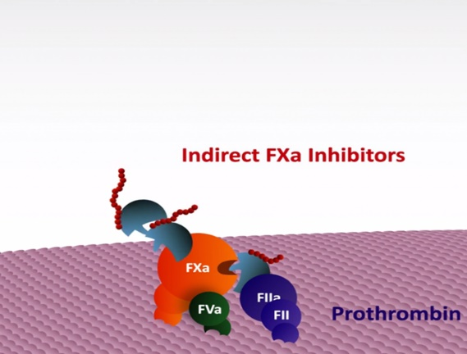
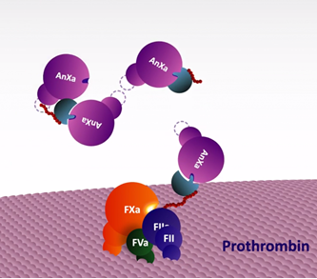
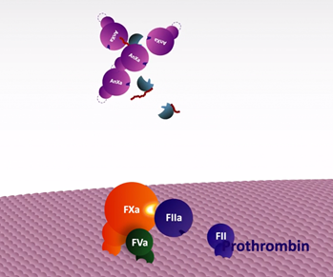
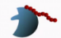
Andexanet Alfa Mechanism of Action – Indirect Factor Xa Inhibitors
2
Andexanet alfa binds to unbound AT-III/indirect FXa inhibitor complex sequestering it away from native FXa
3
Absence of GLA domain prevents assembly into prothrombinase complex on platelet surface
Without Andexanet alfa
With Andexanet alfa
1
4
LMWH-bound AT-III has high affinity for FXa and FIIa
Restoration of FXa and FIIa activity and normal thrombin generation
AnXa, andexanet alfa; AT-III, antithrombin III; FII, Factor II; FIIa, factor IIa; FVa, Factor Va; FXa, factor Xa; GLA, γ-carboxyglutamic acid; LMWH, low-molecular-weight heparin.
Graphics adapted from: Yeh CH et al. Circ Res. 2013; 113:954-957.

Slide 11
Select Direct Factor Xa Inhibitor Pharmacokinetics: Volume of Distribution
¹
¹
Select Pharmacokinetic Parameters of Factor Xa Inhibitors
 | Rivaroxaban² | Apixaban³ | Edoxaban⁴
T_{½} (hr) | 5-9* | 12 | 10-14
V_{D} (L) | 50 | 21 | 107
* 11-13 hours in elderly subjects aged 60-76 years
hr, hours; L, liters; T_{½,} half-life; V_{D}, volume of distribution
1. Le J. Drug Distribution to Tissues. In: Porter R, Kaplan J, Lynn R, Yeh E, et al, eds. Merck Manual Professional Version Online. Kenilworth, NJ;2020. https://www.merckmanuals.com/professional/clinical -pharmacology/pharmacokinetics/drug-distributionto-tissues#. Accessed November 17, 2020. 2. XARELTO® [prescribing information]. Titusivlle, NJ: Janssen Pharmaceuticals Inc.; 2020. 3. ELIQUIS® [prescribing information]. Princeton, NJ: Bristol-Myers Squibb Company and New York, NY: Pfizer Inc: 2019. 4. SAVAYSA® [prescribing information]. Basking Ridge, NJ: Daiichi Sankyo, Inc: 2020.

Slide 12
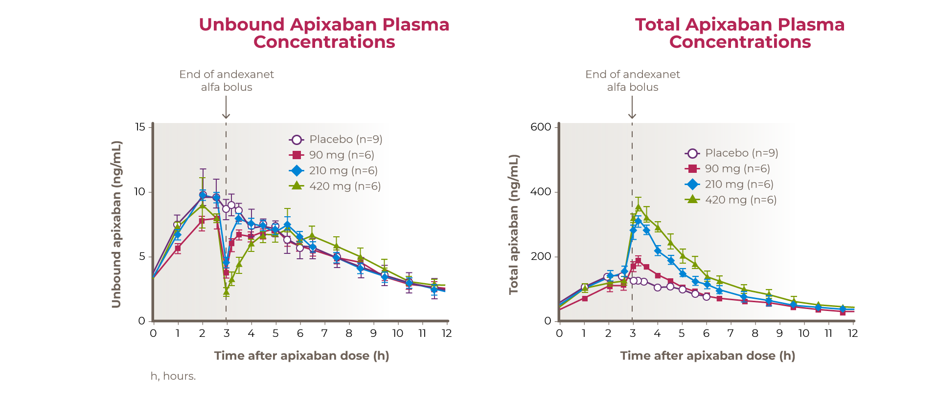
Effect of Andexanet Alfa on Direct Factor Xa Inhibitor Pharmacokinetics
Theoretical model to demonstrate initial V_{D} and redistribution of apixaban when andexanet alfa is administered
Measured unbound and total apixaban concentrations when andexanet alfa is administered
AnXa, andexanet alfa; FXa, Factor Xa; h; hour; V_{D,} volume of distribution.
Siegal D et al. Blood Adv. 2017;1(21): 1827-1838.

Slide 13
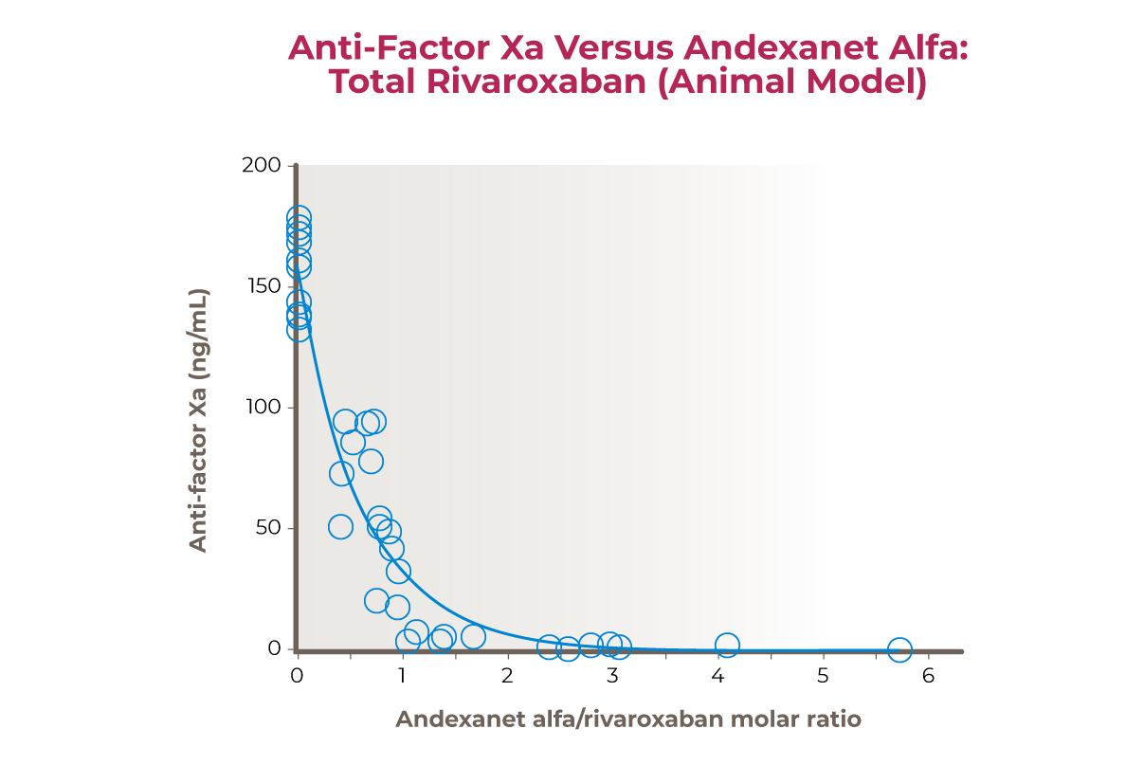
Ratio of Andexanet Alfa: Factor Xa Inhibitor Needed to Reverse Anti-FXa Activity
Phase 2 Healthy Volunteer Studies
Apixaban³
  A 420 mg bolus dose of andexanet alfa achieved > 90% reduction in anti-FXa activity, which equates to a stoichiometric molar ratio of andexanet alfa to total apixaban of ~ 2.3:1 to ~2.9:1
Rivaroxaban⁴
  Rapid reversal of anti-FXa activity (89% and 93% decrease) was achieved with a ~1.1:1 to 1.3:1 molar ratio of andexanet alfa : total plasma rivaroxaban
Graphic adapted from: Lu G et al. J Thromb Haemost 2017 (Suppl);15:1747-1756
≥ 90% inhibition of anti-FXa activity achieved with a
1.3:1 stoichiometric ratio of andexanet alfa to rivaroxaban concentration
FXa, Factor Xa.
1. Lu G et al. J Thromb Haemost. 2017;15:1747-1756. 2. Lu G et al. J Thromb Haemost. 2017 (Suppl);15:1747-1756. 3. Siegal D et al. Blood Adv. 2017;1(21): 1827-1838. 4. Lu G et al. Blood Adv. 2020;4(4):728-739.
Notes:
We need a 1.3:1 ratio of andexanet alfa: FXa inhibitor to reverse anti-FXa activity in order to drive the equilibrium from binding of FXai from FXa to andexanet alfa

Slide 14
Andexanet Alfa Dose Modeling Provided Dose Recommendations to Reverse Anti-FXa Activity
Reversal of rivaroxaban anti-FXa activity by 800 mg bolus + 8 mg/min over 120 min
Model simulations considered the following:
Concentration of FXa inhibitor
Volume of distribution of FXa inhibitor
Fraction of bound FXa inhibitor
Half-life of andexanet alfa and FXa inhibitor
Clearance of andexanet alfa and FXa inhibitor
BID, twice daily; FXa, Factor Xa; hrs, hours.
Adapted from: Leeds JM, et al. Blood. 2015; 126(23): 1135 [abstract]. Presented as a poster at the American Society of Hematology Annual Meeting 2015.
Notes:
Andexanet alfa dose-dependently reduced anti-FXa activity in the model. Complete reversal of anti-FXa activity was achieved with a 400 mg bolus of andexanet alfa.

Slide 15
Andexanet Alfa Dose Modeling Provided Dose Recommendations to Reverse Anti-FXa Activity
Two doses depending on FXa inhibitor, dose, and timing of last dose:¹
  Bolus immediately followed by continuous infusion
    High dose
    Low dose
Full reversal requires molar excess of andexanet alfa : FXa inhibitor; ratio>1:1²⁻³
Maintenance of anticoagulation reversal requires continuous infusion after bolus that keeps ratio greater than 1:1²⁻³
FXa Inhibitor | FXa Inhibitor Last Dose | Timing of FXa Inhibitor Last Dose Before Andexanet Alfa Initiation
FXa Inhibitor | FXa Inhibitor Last Dose | < 8 Hours or Unknown | ≥ 8 Hours
Rivaroxaban | ≤ 10 mg | Low Dose | Low Dose
 | > 10 mg / Unknown | High Dose
Apixaban | ≤ 5 mg | Low Dose
 | > 5 mg / Unknown | High Dose
Dose | Initial IV Bolus | Follow-on IV Infusion
Low Dose | 400 mg at 30 mg/min | 4 mg/min for 120 minutes (480 mg)
High Dose | 800 mg at 30 mg/min | 8 mg/min for 120 minutes (960 mg)
FXa, Factor Xa; IV, intravenous.
1. ANDEXXA® (coagulation factor Xa (recombinant), inactivated-zhzo) [Prescribing Information]. Alexion Pharmaceuticals, Inc., Boston, MA; 2021. 2. Siegal D et al. Blood Adv. 2017;1(21): 1827-1838. 3. Lu G et al. Blood Adv. 2020;4(4):728-739.

