Slide 1
Dr. Sora Ludwig
St. Boniface Hospital
December 9th/22
T2 Diabetes: Pharmacologic Update

Slide 2
Outline:
Glycemic targets
Monitoring
Oral anti-hyperglycemic agents (AHA)
Parenteral AHA
Insulin
Combinations

Slide 3
Targets
Glucose levels
 | A1C (%) | FPG Pre-prandial (mmol/L) | 2hr post prandial (mmol/L)
Target | ≤ 7.0 | 4.0-7.0 | 5.0-8.0 (10.0)
Normal range | ≤ 6.0 | 4.0-6.0 | 5.0-8.0

Slide 4
Monitoring
A1C:
  Every 3 months
SBGM/CGM:
  General benefit to monitoring
  Necessary when taking meds with risk of hypoglycemia
  Frequency:
    Dependent on treatment regimen

Slide 5
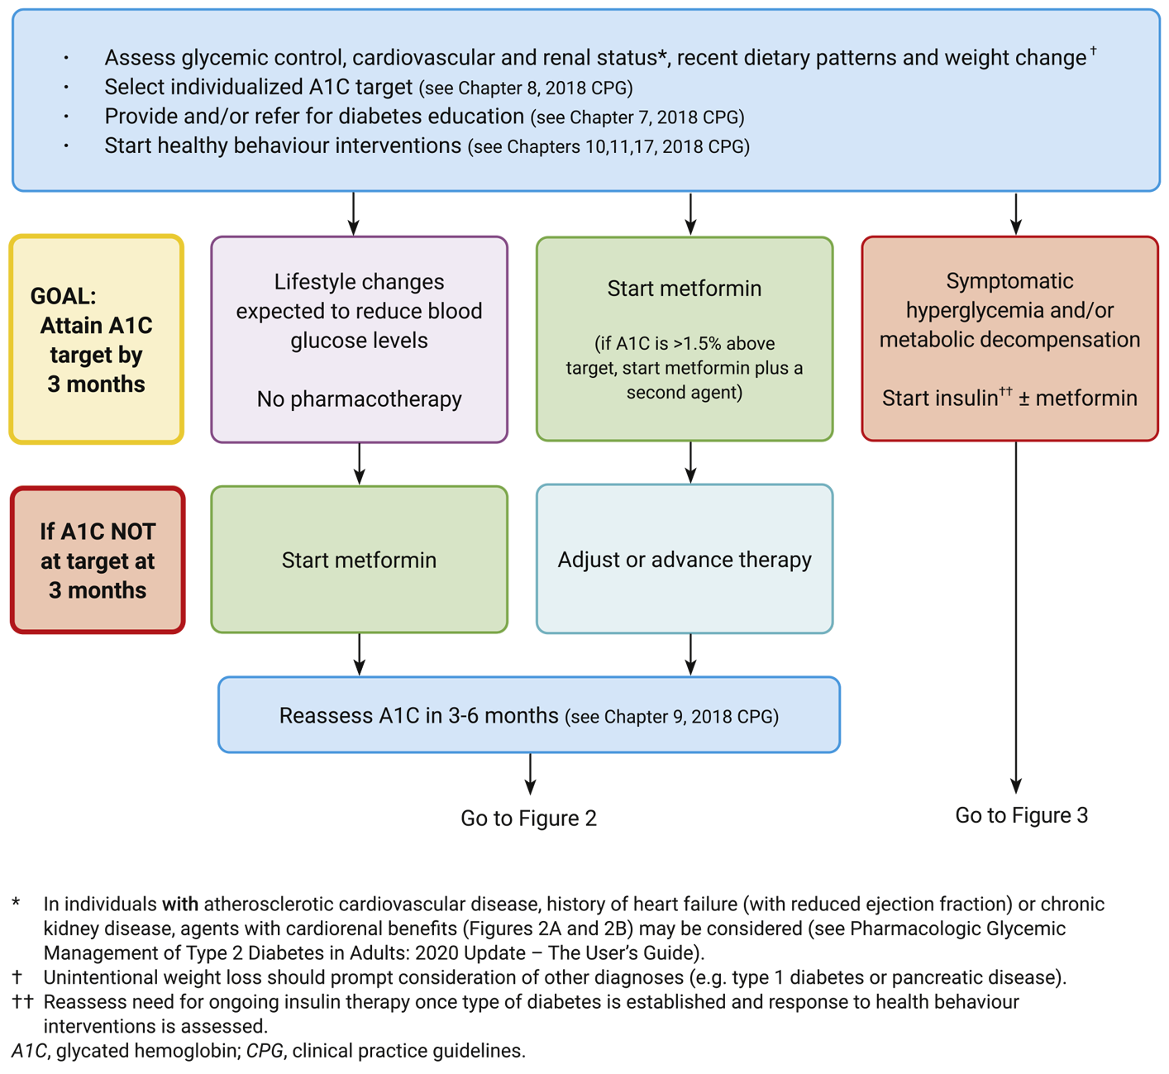
Diabetes Canada- 2021

Slide 6
Type 2 diabetes:
Anti- Diabetes agents
Principles
Combination therapy in sub-maximal dosages:
Monotherapy will lower A1C by 0.5-1.5 %
Combinations of agents with different mechanisms of action
In presence of “marked” hyperglycemia (A1C ≥ 1.5% above target i.e.8.5%) or evidence of metabolic decompensation:
Initial use of 2 or more agents with serious consideration of insulin

Slide 7
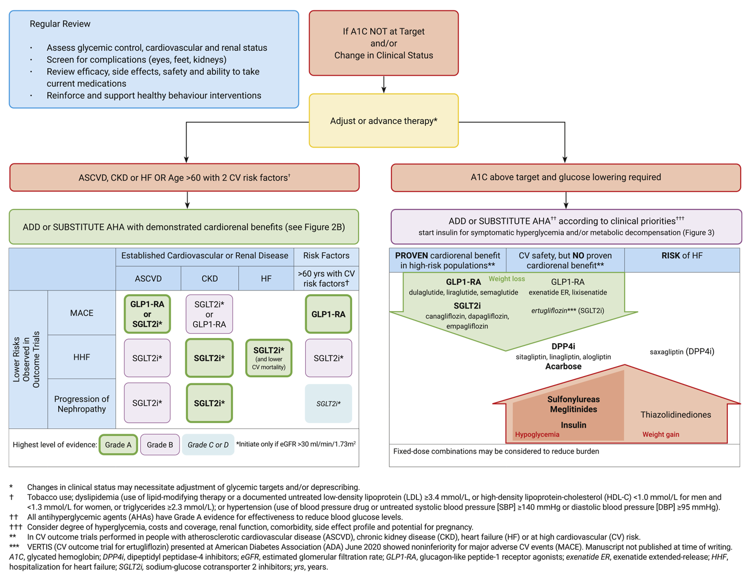
Diabetes Canada-
2021

Slide 8
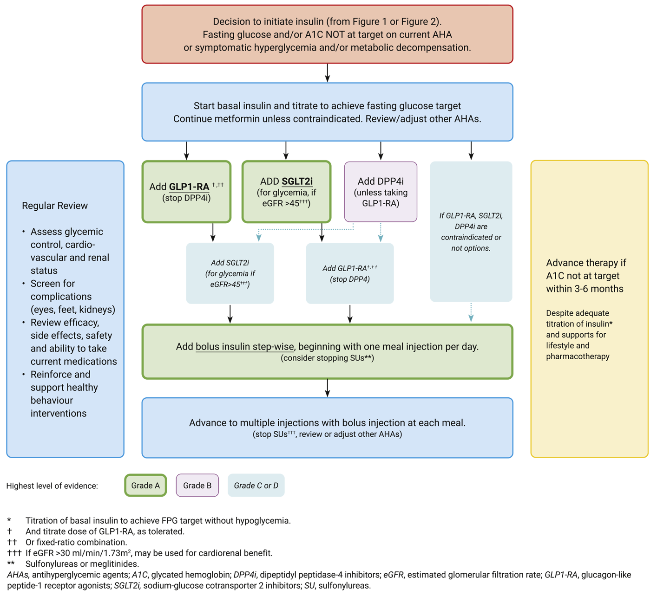
Diabetes Canada-
2021

Slide 9
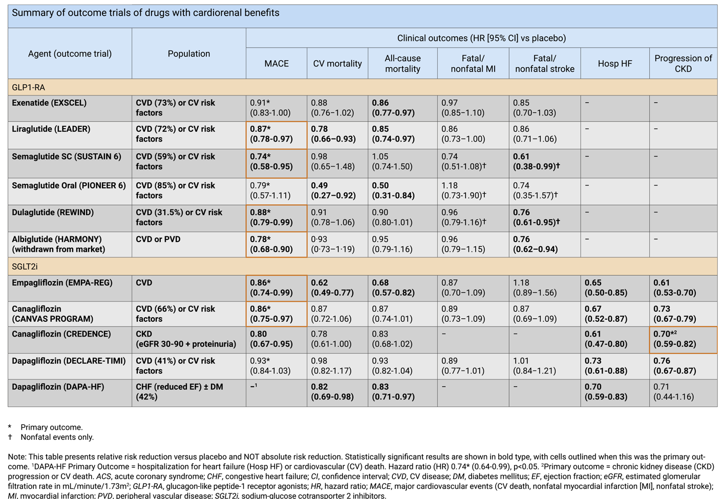
Diabetes Canada-
2021

Slide 10
Newer/More Effective Agents
Incretins
  DDP IV inhibitors GLP-I agonists
    Sitagliptin* - Semaglutide-weekly*
    Saxagliptin* - Exenetide BID/weekly*
    Linagliptin* - Albiglutide weekly
    Alogliptin - Lixisenatide OD
                - Dulaglutide weekly*
                - Liraglutide OD*
Sodium Glucose Co-Transporter-2s Inhibitors (SGLT2s):
  Canagliflozin*
  Dapagliflozin*
  Empagliflozin*
* Currently available

Slide 11
Sodium Glucose Co-transporters Inhibitors
SGLT-2s
Mechanism of action:
  Inhibit renal tubular reabsorption of glucose
CVD indication
Concerns:
  renal function, eGFR <30-60
    although Cana eGFR of 15
  Elderly- dehydration
  Risk of DKA at lower blood sugars

Slide 12
SGLT s Inhibitors
Dosing
Empapagliflozin:
  10, 25
Canagliflozin:
  100, 300
Dapagliflozin:
  5, 10

Slide 13
Newer/More Effective Agents
Incretins
  DDP IV inhibitors GLP-I agonists
    Sitagliptin* - Semaglutide-weekly*
    Saxagliptin* - Exenetide BID/weekly*
    Linagliptin* - Albiglutide weekly
    Alogliptin - Lixisenatide OD
                - Dulaglutide weekly*
                - Liraglutide OD*
Sodium Glucose Co-Transporter-2s Inhibitors (SGLT2s):
  Canagliflozin*
  Dapagliflozin*
  Empagliflozin*
* Currently available

Slide 14
New Agents:
Incretins: Family of GI hormones
-PO glucose elicits a greater insulin response than IV glucose
-Secreted in response to glucose load and augment insulin response
-Preserved response in DM2
GLP-1: GI hormone
  Stimulates insulin secretion
  Suppresses glucagon secretion
  Inhibits gastric empting
  Inhibits food intake/weight gain (central effect)
  Hypoglycemia unlikely as response occurs in presence of hyperglycemia only

Slide 15
GLP-I
Dosing
Semaglutide:
  0.25 mg subcut weekly x 4 weeks
  0.5 mg subcut weekly
  1.0 mg subcut- for weight loss
  coming-
    2 mg – FDA approved- for weight loss
  2.4 ( Wegovy )

Slide 16
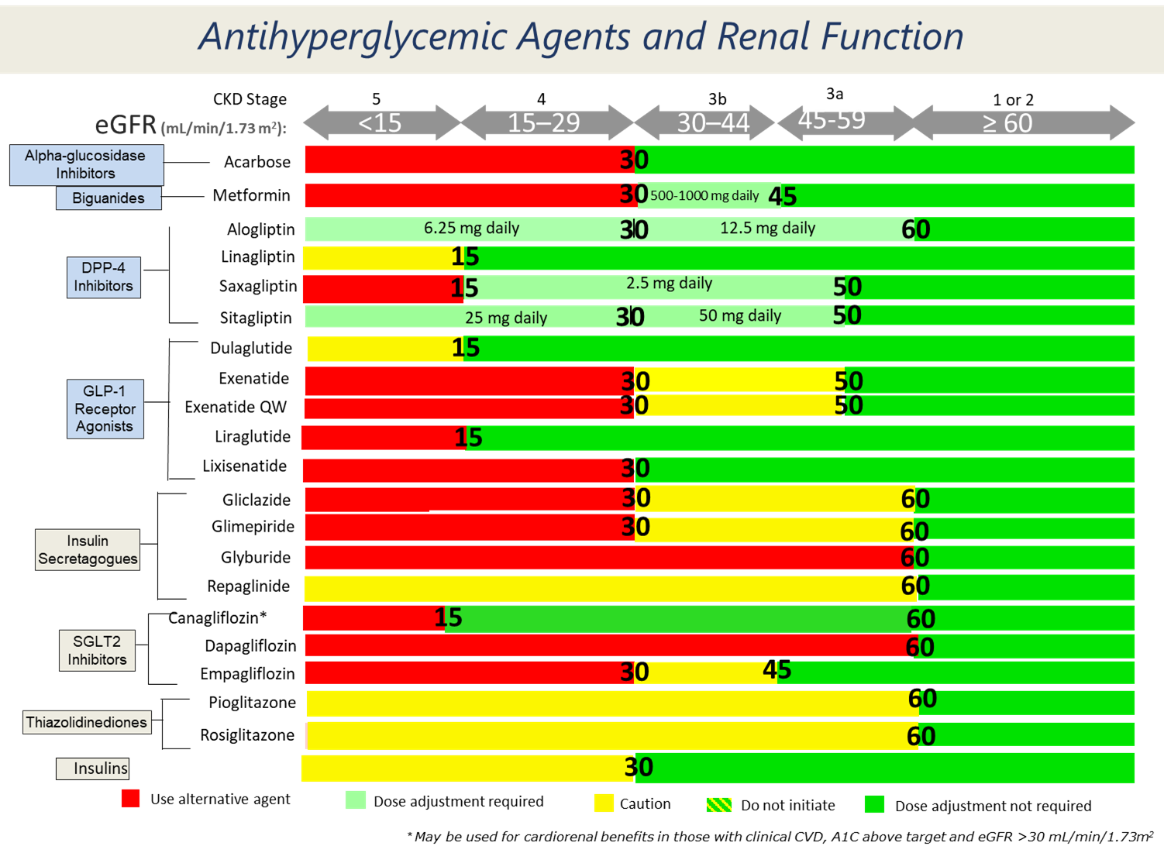

Slide 17
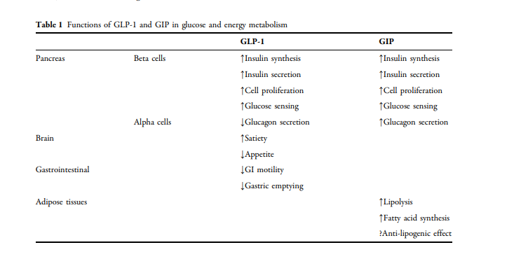
New Anti- hyperglycemic Agents on the Horizon:
Incretin Family
Tirzepatide- Combination GIP/ GLP1

Slide 18
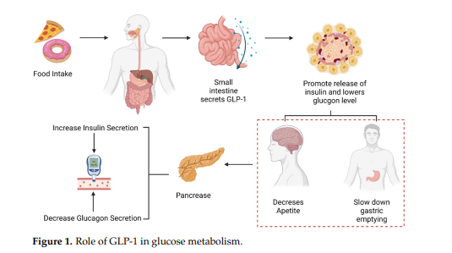
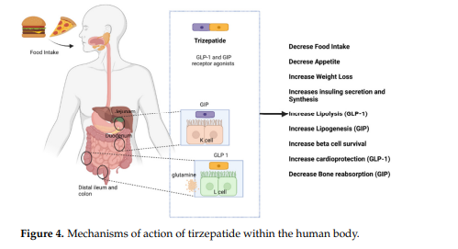
New Anti- hyperglycemic Agents on the Horizon
Incretin Family
GLP-1- Mechanism of Action
Tirzepatide: GIP & GLP-1- Mechanism of Action

Slide 19
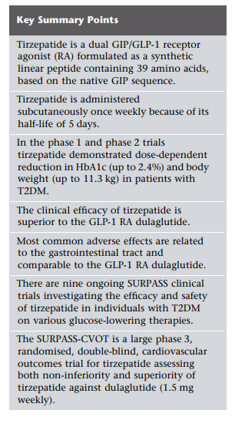
Tirzepatide- Combination GIP/ GLP1

Slide 20
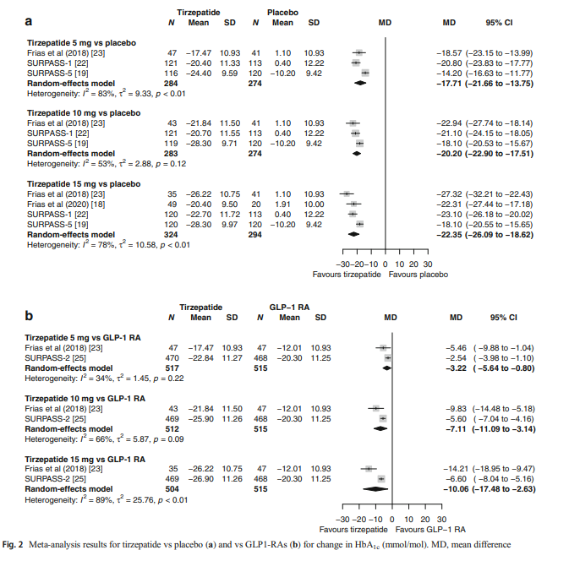
Meta-analysis:
Tirzepatide vs GLP1 re: A1C

Slide 21
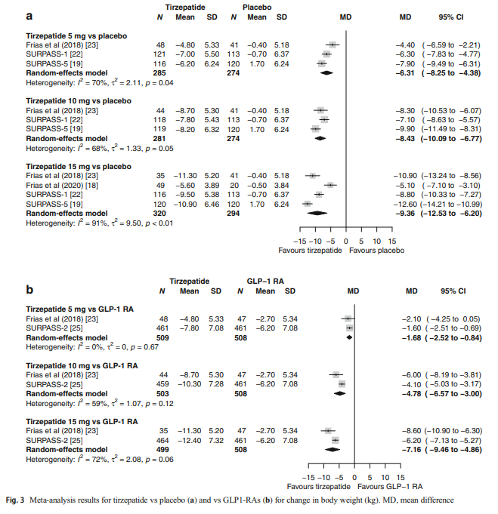
Meta-analysis:
Tirzepatide vs GLP1 re: Weight Reduction

Slide 22
Insulin: Classification
“Rapid rapid”: Fiasp
Rapid-acting:
Lispro = Humalog
Lispro= Admelog
Aspart = Novo-rapid
Glulisine = Apidra
Short-acting: Regular
Intermediate-acting: NPH
Long-acting:
Glargine = Lantus, Basaglar
Detemir = Levemir
Degludec = Tresiba
Pre-mix- analogue:
      Mix 25
      NovoMix 30

Slide 23
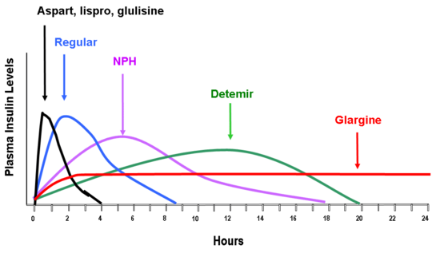
Insulin Action Curves
, Admelog
Fiasp
Degludec

Slide 24
Insulin /Oral Combinations:
Basal( HS or BID) insulin with most daytime oral meds
Insulin: Daytime
Basal (long-acting) /Bolus (Rapid-acting)
  With metformin, DPP IV, GLP-1, SGLT 2

Slide 25
Insulin: How to Start
Basal/Bolus:
  Basal: By Size:
    Lean- 5u hs, Insulin-resistant- 10u hs
    Titrate by 2 units q3 days until FBS in target
  Bolus:
    CHO Counting (rapid-acting insulin only):
    Start 1 unit / 15 gm CHO
    Flat dose
    Blood glucose correction ( CF) Rapid pre-meal insulin ONLY
    (1 extra unit q3 mmol >7)

Slide 26
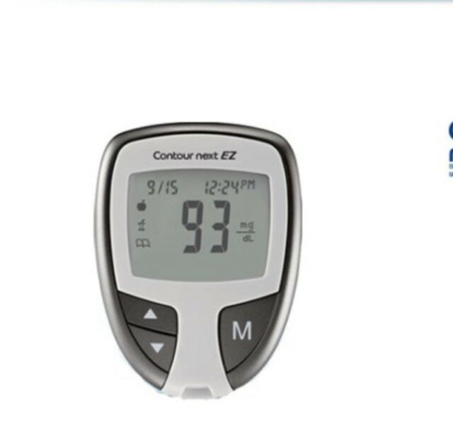
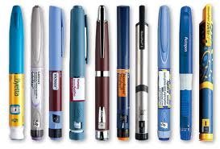
Diabetes Technology
The Old

Slide 27
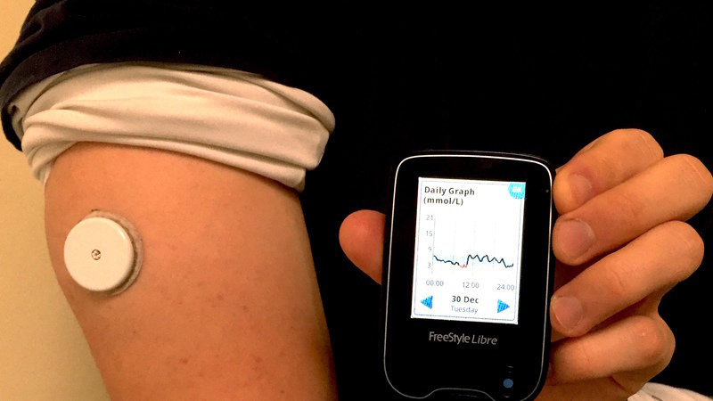
Diabetes Technology
The New

Slide 28
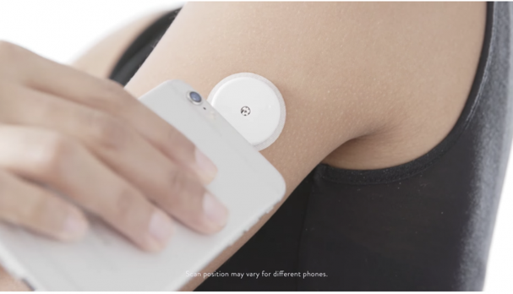
Apps for phones including voice-over

Slide 29
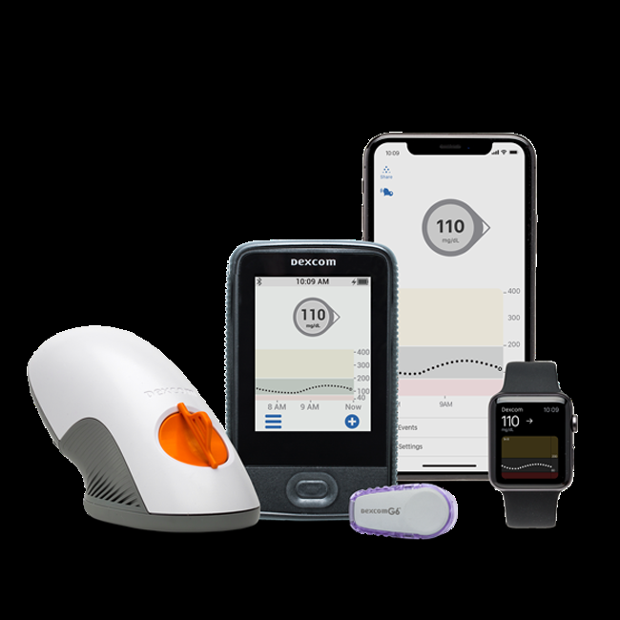
CGM, Dex Com G6

Slide 30
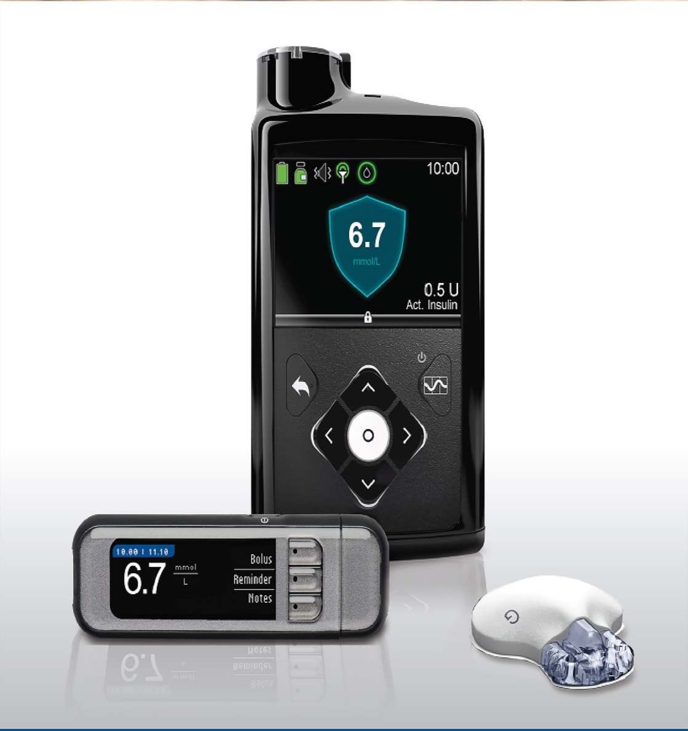
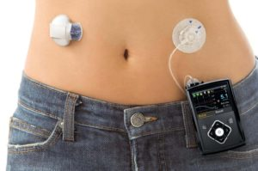
Insulin Pumps-The Future (is here)
Almost a Closed Loop System/Artificial Pancreas

Slide 31
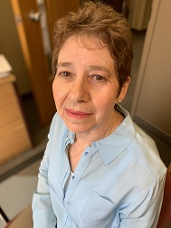
Now available:
Usual retail outlets
Amazon
Elsevier.com in print and electronic format.
It is also available in html and pdf format on ScienceDirect

