Slide 1
Delivering Effective Feedback
Auditor Training Workshop
Joanne Hamilton, RD, EdD

Slide 2
No conflicts of interest to declare
This Photo by Unknown author is licensed under CC BY-SA.

Slide 3
Treaty Territory
The University of Manitoba campuses are located on original lands of Anishinaabe, Cree, Oji-Cree, Dakota, Inuit and Dene peoples, and on the homeland of the Métis Nation.
We respect the Treaties that were made on these territories, we acknowledge the harms of the past and present, and we dedicate ourselves to move forward in partnership with Indigenous communities in a spirit of reconciliation and collaboration.
Notes:
The University of Manitoba campuses are located on original lands of Anishinaabe, Cree, Oji-Cree, Dakota, Inuit and Dene peoples, and on the homeland of the Métis Nation.
We respect the Treaties that were made on these territories, we acknowledge the harms of the past and present and we dedicate ourselves to move forward in partnership with Indigenous communities in a spirit of reconciliation and collaboration.

Slide 4
Acknowledgements
Anita Ens
Teresa Cavett
Office of Innovation & Scholarship in Medical Education, UM
Marilyn Singer, CPSM

Slide 5
Objectives
By the end of the session participants will be able to
Describe 4 basic steps for delivering feedback
Identify effective strategies to overcome barriers to giving feedback
Describe how to manage reactions to difficult feedback

Slide 6
Feedback - Definition
Information communicated to a learner about their performance in order to enhance learning: develop skills or improve performance with a goal of guiding and improving future efforts.
(Telio, Ajjawi, & Regehr, 2015).
Notes:
There are a lot of definitions in use and in the literature.
Feedback is: 'Specific information about the comparison between a trainee's observed performance and a standard, given with the intent to improve the trainee's performance.’
Van de Ridder, Stokking, McGaghie, & ten Cate (2008)
Feedback to learners in the clinical setting may be defined as the ongoing provision of information to learners about their performance in a given clinical activity, with the goal of guiding and improving future efforts. It is important to distinguish between feedback and evaluation; the latter is information given to the learner which is a judgment on overall performance. While feedback can, and perhaps should, be included in an evaluation, the purpose of feedback is essentially formative rather than summative.

Slide 7
Feedback works!
Improves clinical performance
Reinforces positive behaviours
Corrects undesirable behaviours
Decreases anxiety about performance
Without feedback, formal tests become overly important
Improves self-assessment
(Telio, Ajjawi, & Regehr, 2015).
Notes:
Critical to learning and improvement
From feedback we learn, compare what we do to some standard, adjust what we do and learn to do better. It motivates participants by telling them how far they are from a goal and how fast they are progressing towards that goal.
(Stillman, 1976; Maguire et. al., 1978; Wington et. al. 1986 and Scheidt et. al., 1986)

Slide 8
Feedback – Your Experiences
What was the most helpful feedback you ever received?
Why was it helpful?
What did you learn from it?
Did you change as a result?

Slide 9
Feedback Barriers
What barriers have you experienced to giving feedback?

Slide 10
Common Feedback Barriers
Giving | Receiving
Limited time Haven’t observed receiver of feedback Relationship (or lack of) with receiver Incomplete data on performance Conflicting data on performance Communication factors (tone, word choice etc.) Emotion Not well thought out; not focused Respect | Limited time Potential consequences of judgement Saving face / Identity Defensiveness Lack of trust Misunderstanding e.g., differing views on expectations Weak self assessment skills Respect
(Telio, Ajjawi, & Regehr, 2015).
Notes:
We won’t spend a lot of time on this and previous slide – it’s more to acknowledge the barriers and then bring them up as we talk about the feedback framework/process and how these barriers can be addressed using the framework
Common Barriers to Receiving Feedback:
Weak self-assessment skills (significant "blind spot")
Lack of perceived bond or investment from the provider of feedback
Workplace culture or environment does not support feedback
Emotional response to feedback (fear of exposing weaknesses, feeling vulnerable or defensive)
Poor quality or content of feedback (not based on observations, vague, delayed, comments on personal qualities rather than behaviours)
We don’t have control of many of these, but we can influence the quality and content of feedback

Slide 11
Culture & Feedback
Feedback is influenced by culture, values, expectations, personal history, relationships and power.
Figure: How different cultures view feedback
Lionel LaRoche, 2013, presentation at UofM Bannatyne Campus
Notes:
The neutral box refers to taking feedback (receiving feedback) as neither good nor bad..it just is feedback. So for people in Canada, East Asia, and Mexico (according to Laroche’s research), we tend to see feedback as either positive or negative, with very little being viewed as neutral. It is an evaluation or a judgement on us rather than just feedback.
“If you can’t say anything nice, don’t say anything at all.” Is this a Canadian value?
We could spend a lot of time on these factors, again, we’ll just refer to these influences and move on

Slide 12
Strategies to Address Barriers
Use feedback framework – particularly ask for self assessment
“What are your areas of strength ?”
“What are areas for improvement or would like suggestions for improvement?”
Use nonjudgmental/descriptive language – helps diffuse defensiveness
Be clear / direct – minimize misunderstanding
Check for understanding
This Photo by Unknown Author is licensed under CC BY-SA-NC
(Telio, Ajjawi, & Regehr, 2015).
Notes:
This is a recap of some of the main points in the session that can be pulled out as strategies to address the barriers
Use feedback framework – particularly ask for learner self assessment
Ask for learner perspective/self assessment – may be cultural/personal reasons; may shine light on missing data or misunderstood data or differing expectations. Allow learner to reflect.
Use non judgmental/descriptive language – helps diffuse defensiveness
Be clear / direct – minimize misunderstanding
Ask for learner understanding

Slide 13
Four Steps to Giving Feedback
Lay the groundwork for effective feedback
Use a feedback framework
Identify the performance issues
Understand the individual’s perspective and respond
(Telio, Ajjawi, & Regehr, 2015).

Slide 14
Lay the Groundwork
Establish your credibility and role
Build an environment of trust
Rapport building
Elicit their ideas on the areas
Use collaborative questioning
Be constructive
Include areas they are doing well
Offer suggestions to help with improvement
(Ende, 1983, Sargeant,et al., 2017, Telio, Ajjawi, & Regehr, 2015)
Notes:
Key features of effective feedback
Timely and expected
Based on observations – descriptive and non judgemental
Based on changeable behaviours
Related to learning goals
Limited in quantity – 2-3 areas
Build an environment of support and
Role model asking for and using feedback
Role model an acceptance of personal gaps in knowledge and skill
Convey an awareness that mistakes are inevitable
Actively encourage asking for advice and help
Plan ahead and negotiate
Feedback shouldn’t come as a surprise
Clarify the difference between feedback (coaching) and evaluation (judgement)
Seek out opportunities to observe
Elicit self assessment
Helps in understanding learners thinking
Can determine the most useful points for feedback
Helps in gauging the appropriate level of sophistication
Often the learner will do most of the work!
Choose appropriate time and place
As close in time as possible
Quickie feedback followed by a later discussion if necessary
Privacy may be necessary
Emotions may need to settle!!
Focus on the positive, not just the negative
Teachers tend to be quicker to correct than to reinforce
Change is more likely if positive feelings are engendered
Frame message in positive terms (coaching)
Indicate impact of behaviour
Select specific changeable behaviours
Tendency to give TOO MANY learning points – pick 2 or 3
Describe observations: be specific
Pick those the person can change
Focus on previously identified learning needs
Include follow-up plans
New behaviours need reinforcement
Implementation is not easy
Include strategies for putting it into practice
Follow-up helps reinforce change
AND highlights successes

Slide 15
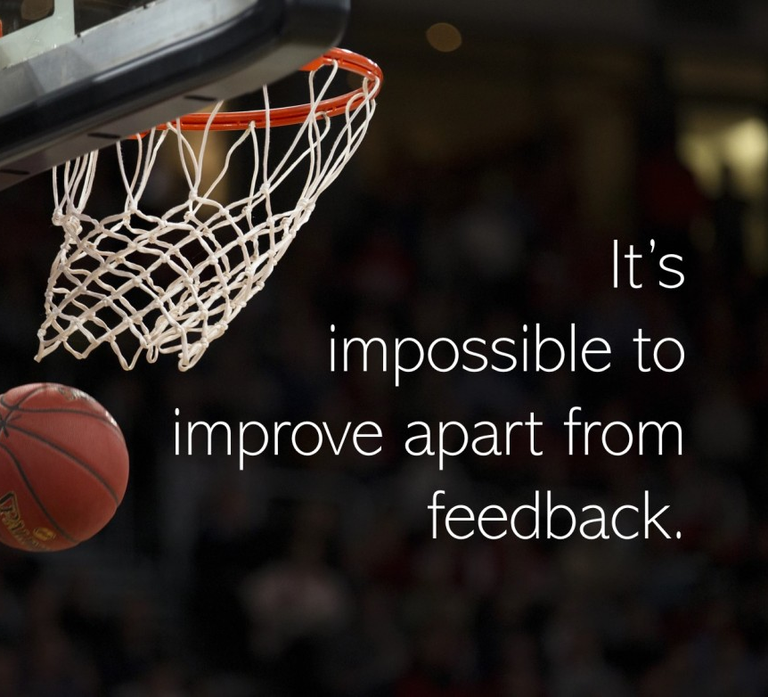
Use a Feedback Framework
A framework helps ensure good feedback practices
Guides the conversation
Focuses on constructive feedback
Includes some form of self assessment
Includes a plan for improvement
This Photo by Unknown Author is licensed under CC BY

Slide 16
Constructive Feedback
Formative
Keep doing that - reinforcing
Improvement needed - corrective
Guidance
How to improve
Elaborative
Why that was good
Why improve
(Sargent, et al., 2017)

Slide 17
A bit more about feedback
Good feedback is:
Descriptive and non-judgmental
Given at mutually agreed time and place
Timely
Specific in nature
On changeable behaviors
Limited to 2-3 areas
(Ende, 1983)

Slide 18
Descriptive and Non-judgmental
Judgmental: “You are sloppy.”
Descriptive: “There were some omissions in the charts that I’d like to discuss.”
Judgmental: “You must not value patient input.”
Descriptive: “Your documentation of the patient’s story seems to be limited.”
Vague/Judgmental: “The differential was inadequate.”
Descriptive/Non-judgmental: “The differential you documented did not include the possibility of disease X.”
Vague/Evaluative: “You did a great job on this note.”
Descriptive/Non-judgmental: “Your charts are appropriately detailed in terms of your treatment decisions, current prescriptions, allergies, and follow-up activities. They provide confidence in good patient care.”
Notes:
Vague/Evaluative: “You did a great job.”
Descriptive/Non-evaluative: “Your history was well-organized and really helped to rule out red flag concerns.”
The more neutral or descriptive/non evaluative comments are part of “laying the groundwork” or establishing rapport in R2C2 model.

Slide 19
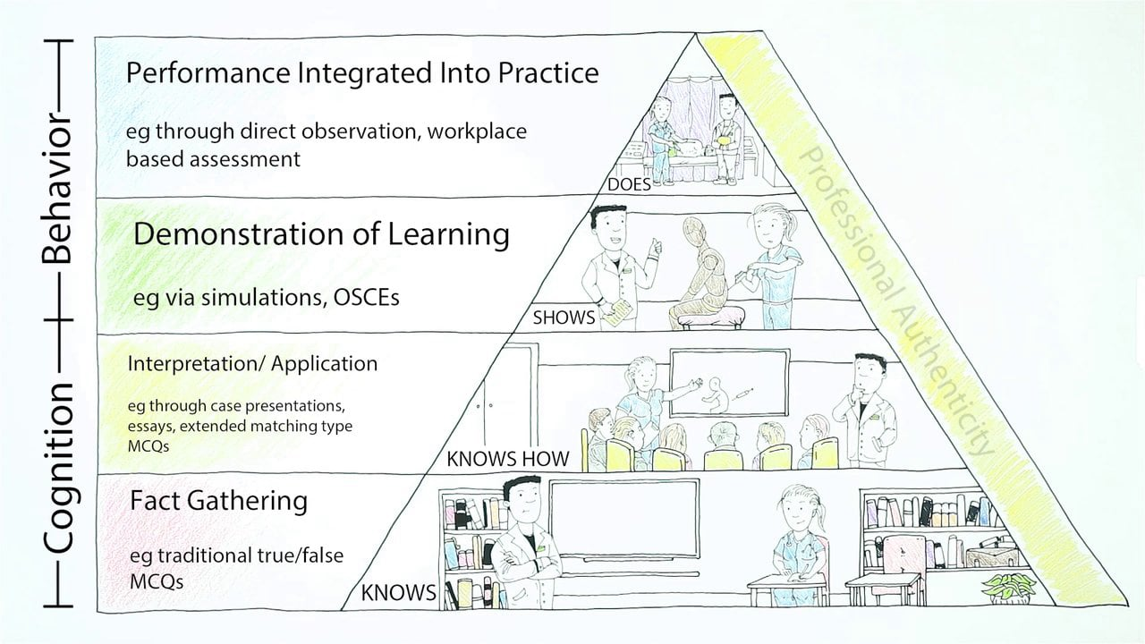
RX-OCR
Chart audit
RAPPORT
EXPECTATIONS
OBSERVE
COACH (ARCH/BAYER/PNP)
RECORD
This Photo by Unknown Author is licensed under CC BY-SA-NC
Notes:
This is the Royal College’s coaching in the moment framework; it’s described below.
Coaching in the Moment follows a process, and when done well there is tremendous value in the information given and its utility for the resident’s learning.
This process has been coined as the RX-OCR coaching process. It occurs between the clinician teacher, who we now refer to as “clinician coach”, and the resident.
The steps in the process are:
1) R: Establishing educational “Rapport” between the resident and the clinician; an educational alliance or partnership;
2) X: Setting “eXpectations” for the particular clinical time period;
These initial 2 steps need not take longer than a few minutes.
3) O: “Observing” some type of work that the resident does;
4) C: Engaging in a “Coaching” conversation for the purpose of improvement of that work;
5) R: “Record” a summary of the dialogue that occurred so that the resident can build a portfolio of observations demonstrating progress and areas to be improved.

Slide 20
ARCH Framework for Feedback
A: Ask for self assessment
R: Reinforcement of what was done well
C: Correct / Coach for improvement
H: Help the person with a plan for improvement

Slide 21
Bayer Model of Feedback
Continue… Comment on aspects of performance that were effective. Be specific and describe impact. Highlight things you would like to see done in the future. | Start, or do more… Identify behaviour the learner knows how to do and should do, or do more often.
Consider… Highlight a point of growth for the learner, a “doable” challenge for future interactions. | Stop, or do less… Point out actions that were not helpful, or could be harmful. Be specific and indicate potential impact.

Slide 22
PNP Sandwich
Positive
Negative
Positive
Use with Care!!

Slide 23
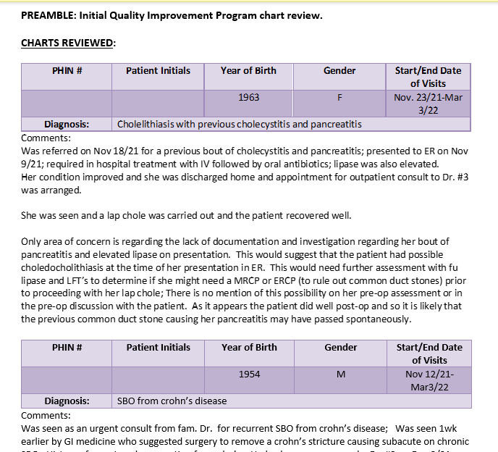
Identify the Performance Issue(s)
What patterns or area for discussion have you identified in the chart audit?
Data collection (Hx/Px)
Diagnosis
Reasoning?
Treatment planning
Treatment practices
Referrals
Prescribing
Follow-up
General documentation
Other
This Photo by Unknown Author is licensed under CC BY

Slide 24
Time for Practice: Case 1
In your groups: Role Play
Use Case scenario 1
All read chart audit report
Two Volunteers – Auditor role – Auditee role
Auditor discuss/provide feedback with auditee
Rest of group observe / provide coaching
What worked?
Debrief with Group
Notes:
Same groups from earlier in the morning…
Note: Auditors have to document the feedback process. This is covered in another session about that – chart stimulated recall.
Everybody does case 1
Second 1 – choose any of the other three: Gen surg or OBGYN or medicine.

Slide 25
Case 1: Debrief
What feedback did you give?
What was the performance issue?
What did you reinforce (keep doing)
What did you ‘correct’ (start doing or change)
Elaboration (Did you add a Why?)
What went well?
What didn’t go well?

Slide 26
Reinforcing Feedback
“The cumulative profile that you compile for patients in the chart is helpful. As is the documentation you provide in the notes about the reports you receive about your patients. Those are great.“
(specific and reinforcing)
“The cumulative profile is especially helpful for keeping track of chronic problems.”
(elaborative - nonjudgmental and reinforcing)
”The next step for you is to improve the charting so that other care providers can be equally responsive to the patients.”
Notes:
I tried to make up an example based on one of the audit reports. I’ve kept the slide hidden but moved it incase this is helpful for debriefing the scenario.

Slide 27
Corrective Feedback
“I noticed you didn’t follow the SOAP format in your charting. In one case very little subjective information was documented. Can you tell me about this?”
(specific, encourages self assessment)
“It’s important to use a framework, like SOAP, as it helps ensure that all the relevant information from an encounter is documented.”
(elaborative - nonjudgmental, forces self evaluation)
“What could you do to remember this next time for a similar situation?”
Notes:
I tried to make up an example based on one of the audit reports. I’ve kept the slide hidden but moved it in case this is helpful for debriefing the scenario.

Slide 28
Four Steps to Giving Feedback
Lay the groundwork for effective feedback
Identify the performance issues
Use a feedback framework
Understand the individual’s perspective and respond (managing reactions to feedback)
(Telio, Ajjawi, & Regehr, 2015).

Slide 29
Offering Difficult Feedback
Come right to the point
Give feedback directly and compassionately
Describe benefits of making change
Allow time to respond
Notes:
1. Identify the problem behavior.
2. Describe it in the opposite, positive terms.
E.g., if the person makes frequent mistakes you would talk about developing more accuracy.
3. Be specific
E.g. what do you mean by “more accuracy”?
4. Check for Understanding

Slide 30
Common Reactions to feedback
Blaming - "It's not my fault. What can you expect when the patient won't listen?"
Denial - "I can't see any problem with that"
Rationalisation - "I was really busy that day“ "Doesn't everyone do this?"
Anger - "I've had enough of this"
This Photo by Unknown Author is licensed under CC BY
Notes:
Marilyn, Is this and the next two helpful for this group? What would be relevant examples for auditors? This is all good. I have made a minor change on the last point of the next slide.
Interpreting Feedback
What does it mean?
Language (verbal / non-verbal/other cues)
Culture
Context
What are the consequences?
Informal feedback
In the moment
At the end of the day
For auditors Formal feedback (ITER)
In-progress / Formative
Final / Summative
Example – say “that’s Great”
Also hierarchies

Slide 31
Power & perceived threats

Slide 32
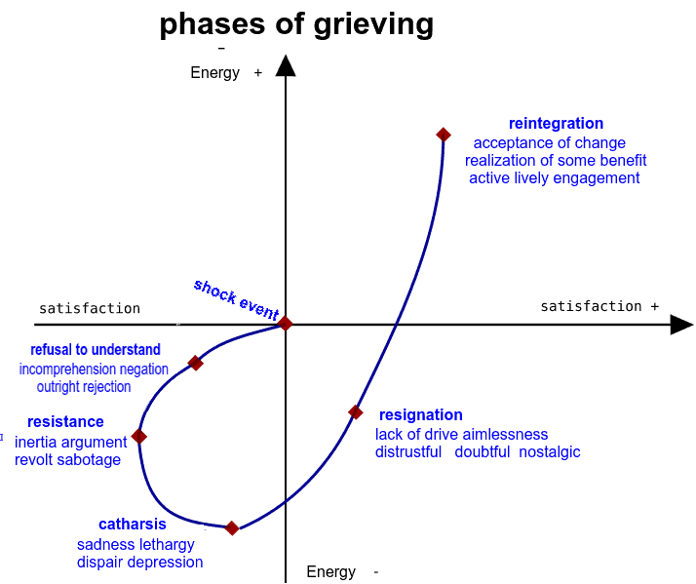
Understanding Reactions
Denial
Anger
Depression
Bargaining
Acceptance
Bertrand GRONDIN - Wikimedia image in French relabeled in English, CC BY-SA 4., https://commons.wikimedia.org/w/index.php?curid=64179142

Slide 33
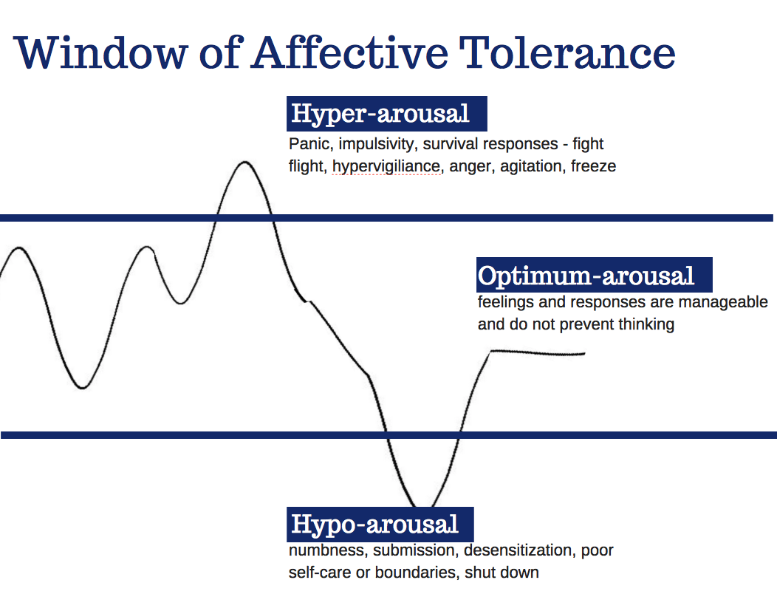
The affective impact might make it more difficult to hear feedback…
Image by Siegel, D.J., used with permission
Notes:
Jackie/Joanne
This slide goes over the window of affective tolerance which visually can help the audience think about where one may be during a situation where one experiences or sees a microaggressions/discriminatory act. The concept is that those in the optimal range are the ones who are best able to in that moment manage and address the situation. Presenters should talk about the three possible places one could be on this window. Additionally, this is a good slide to talk about how depending on the situation, one who witnesses a micro-aggression versus experiences one could more likely be in the optimum-arousal portion and thus can show allyship by being the one to address the situation. However, it is important to have the audience understand that it is key to develop an understanding of self to be able to realize where one is on the window and how that may affect whether or not they are able to address the situation.

Slide 34
What to do?
Name and explore the resistance - "You seem bothered by this. Help me understand why"
Keep the focus positive - "Let's recap your strengths and see if we can build on any of these to help address this problem"
Try to convince the person to own one part of the problem - "So you would accept that on that occasion you didn’t chart enough detail?"
Negotiate
"I can help you with this issue, but first I need you to commit to ..."
Allow time out
"Do you need some time to think about this?"
Keep the responsibility where it belongs
“This is an issue that needs addressing. What could you do to address this next time?“
Get Help

Slide 35
Time for Practice: Case 2
In your groups: Role Play
Choose either OG, Gen Surg, or FM doctor #2
All read chart audit report
Two Volunteers – Auditor role – Auditee role
Read related Chart review form and script scenario
Auditor discuss findings/provide feedback with auditee
Rest of group observe / provide coaching
What worked?
Debrief with Group
Notes:
Do this case if time. (i.e. if not a lot of discussion in the first bit of the workshop)
Note: Auditors have to document the feedback process. This is covered in another session about that – chart stimulated recall.

Slide 36
Case 2: Debrief
What feedback did you give?
What was the performance issue?
What did you reinforce (keep doing)
What did you ‘correct’ (start doing or change)
Elaboration (Did you add a Why?)
What went well?
What didn’t go well?

Slide 37
Reinforcing Feedback
“It looks like you are managing coronary heart disease and hypertension well. That’s great.“
(specific and reinforcing)
“These are common conditions in geriatric populations, so keeping on top of the guidelines for management is important.”
(elaborative - nonjudgmental and reinforcing)
”The next step for you is to improve the charting so that other care providers can be equally responsive to the patients.”
Notes:
I tried to make up an example based on one of the audit reports. I’ve kept the slide hidden but moved it incase this is helpful for debriefing the scenario.

Slide 38
Corrective Feedback
“I noted that you were using Benzodiazepines in 2 of the 3 geriatric charts I reviewed, and there wasn’t any documentation of discussion of risks or tapering. Can you tell me about that?”
(specific, encourages self assessment)
“It’s important explore the risks of these drugs with patients and have plans for tapering in place when starting the prescription, as the benefit of these drugs in this population decreases over time when compared to the risk of overdose and addiction.”
(elaborative - nonjudgmental, forces self evaluation)
“What could you do to remember this next time for a similar situation?” “You should consider reviewing the CPSM guidance”

Slide 39
Questions?

Slide 40
Summary
Feedback is a dynamic conversation
Using a framework can help ensure we incorporate all components
Feedback is a skill, it gets easier with practice

Slide 41
Thank you
What do you need to do to orient your leaners and manage expectations?
What are your organization's remediation and probation policies?
Do you have an organized approach to assessing learners’ performance and catching difficulties early?

Slide 42
References
Ende J. Feedback in clinical medical education. JAMA. 1983;250:777-781
Sargeant, J., Mann, K., Manos, S., Epstein, I., Warren, A., Shearer, C., & Boudreau, M. (2017). R2C2 in action: testing an evidence-based model to facilitate feedback and coaching in residency. Journal of Graduate Medical Education, 9(2), 165-170.
Telio, S., Ajjawi, R., & Regehr, G. (2015). The “educational alliance” as a framework for reconceptualizing feedback in medical education. Academic Medicine, 90(5), 609-614.
Notes:
Add and check all references

