Slide 1
Medical Record Keeping
WHAT TO LOOK FOR AS AN AUDITOR

Slide 2
Disclosure
I have no conflict of interest to disclose.

Slide 3
Learning Outcomes
By the end of this presentation, participants should be able to
Identify the basic requirements of good charting
Identify tools that may enable charting improvements

Slide 4
SOAP Note Charting
Accurate charting is a legal necessity
Most of the clinical work we do is problem focused
The SOAP note is the basis of the problem oriented medical record
SOAP notes provide communication among multiple providers & over multiple visits

Slide 5
SOAP Notes
Consist of 4 parts:
S – Subjective
O – Objective
A – Assessment
P – Plan
Should be concise and clear
Reflect your thinking process

Slide 6
Subjective
Chief complaint - may include direct quotes from patient
Chronologic account of events including current status of symptoms
Should include pertinent positives & negatives
Should indicate effect on level of function, if applicable

Slide 7
Objective
Physical exam including vital signs
Should include pertinent positives (abnormal findings) and negatives (normal findings)
Available lab data
Available X-ray & other diagnostic tests

Slide 8
Assessment
Interpretation of the patient’s problem(s) – listed individually
Differential diagnosis of the problem(s)
Update on current status

Slide 9
Plan
Treatment for each of the problems listed in the assessment
Should include tests, prescriptions, recommendations
Should also include when to return & what to do if symptoms worsen

Slide 10
Cumulative Information and Forms
Cumulative Patient Summary
Problem List
Medication List
Past Medical/Surgical History
Family History
Social History
Allergies
Preventive Care Checklist/Primary Care Quality Indicators
Results Flow Sheet
Prenatal Form
Rourke Baby Record
Growth Chart/Percentiles
Immunization

Slide 11
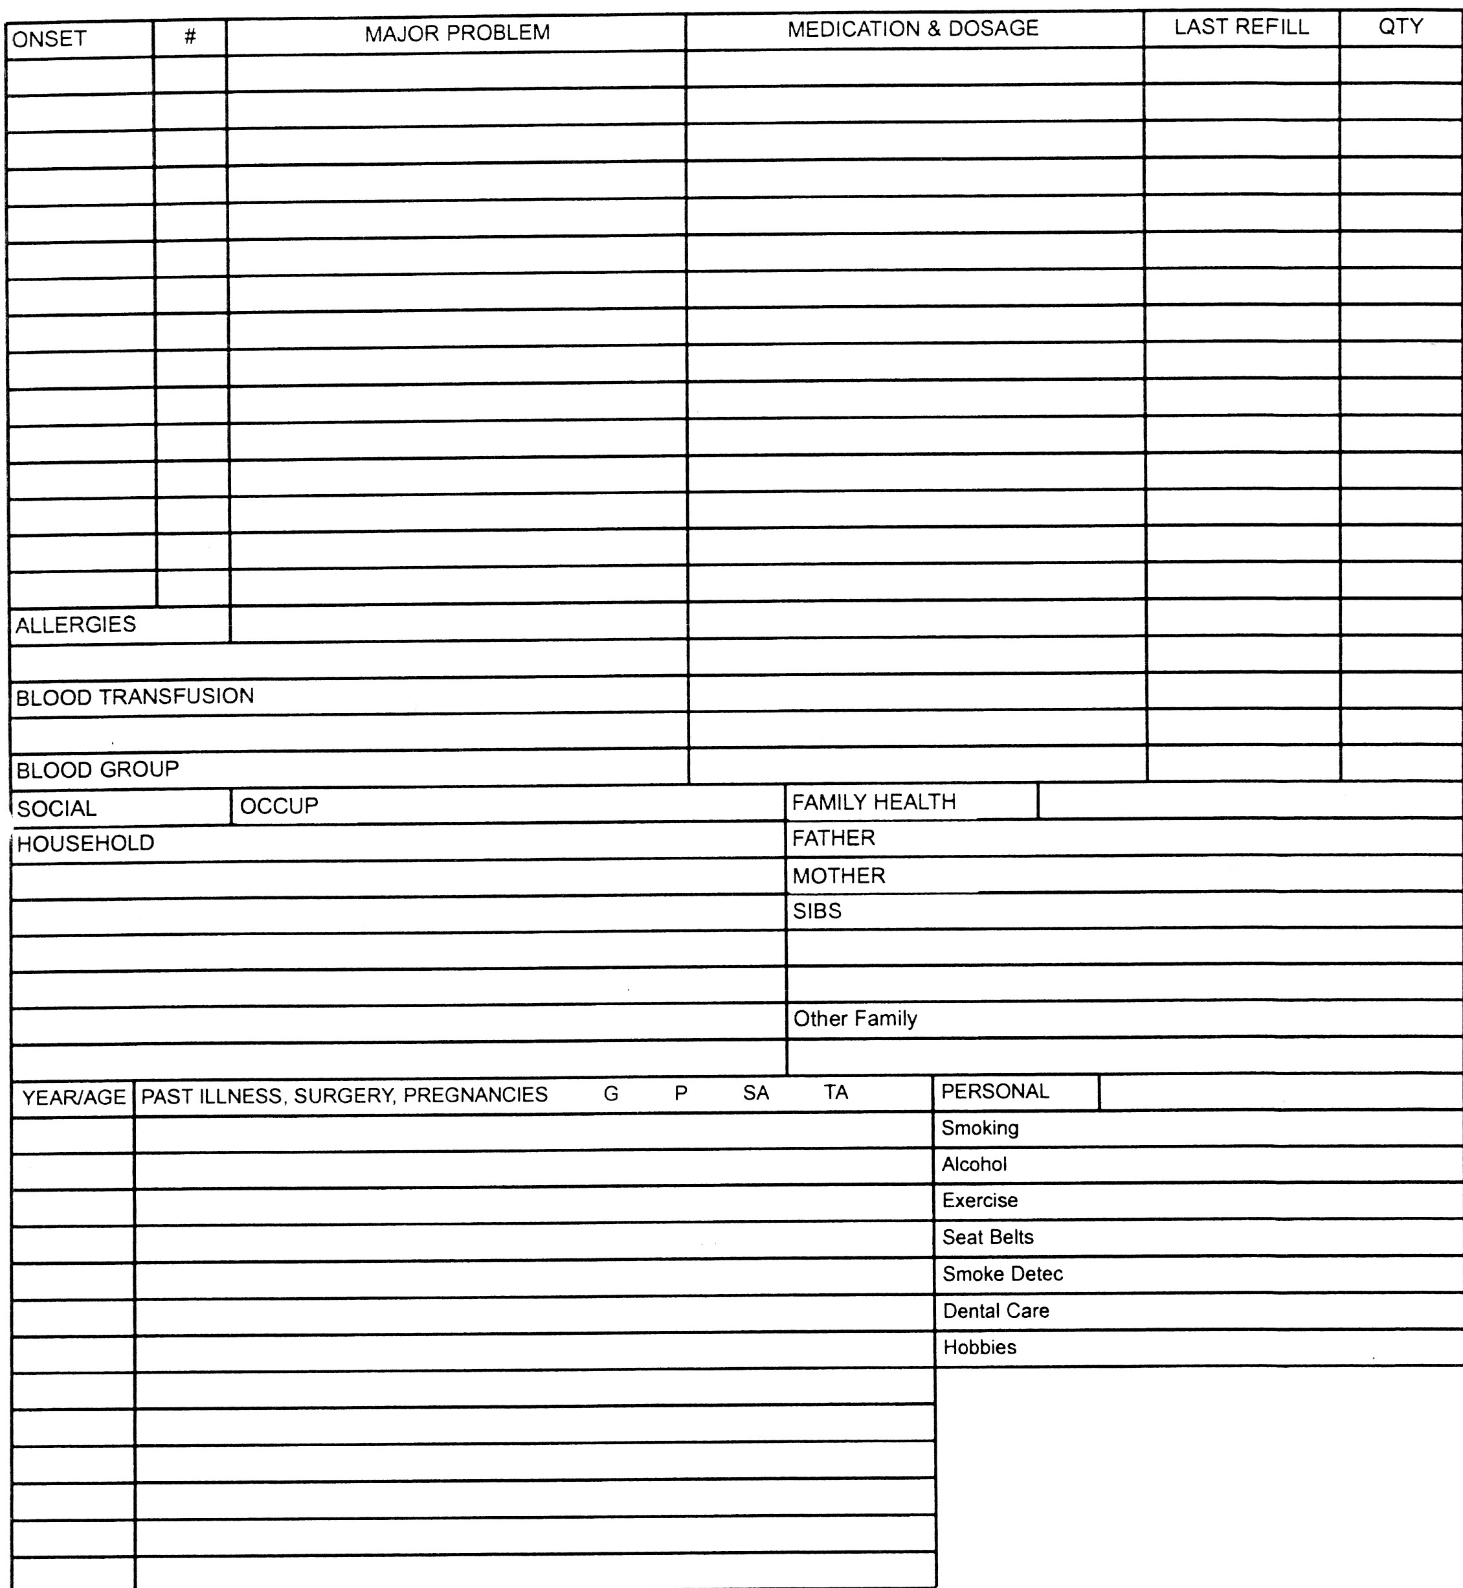
Cumulative Health Record

Slide 12
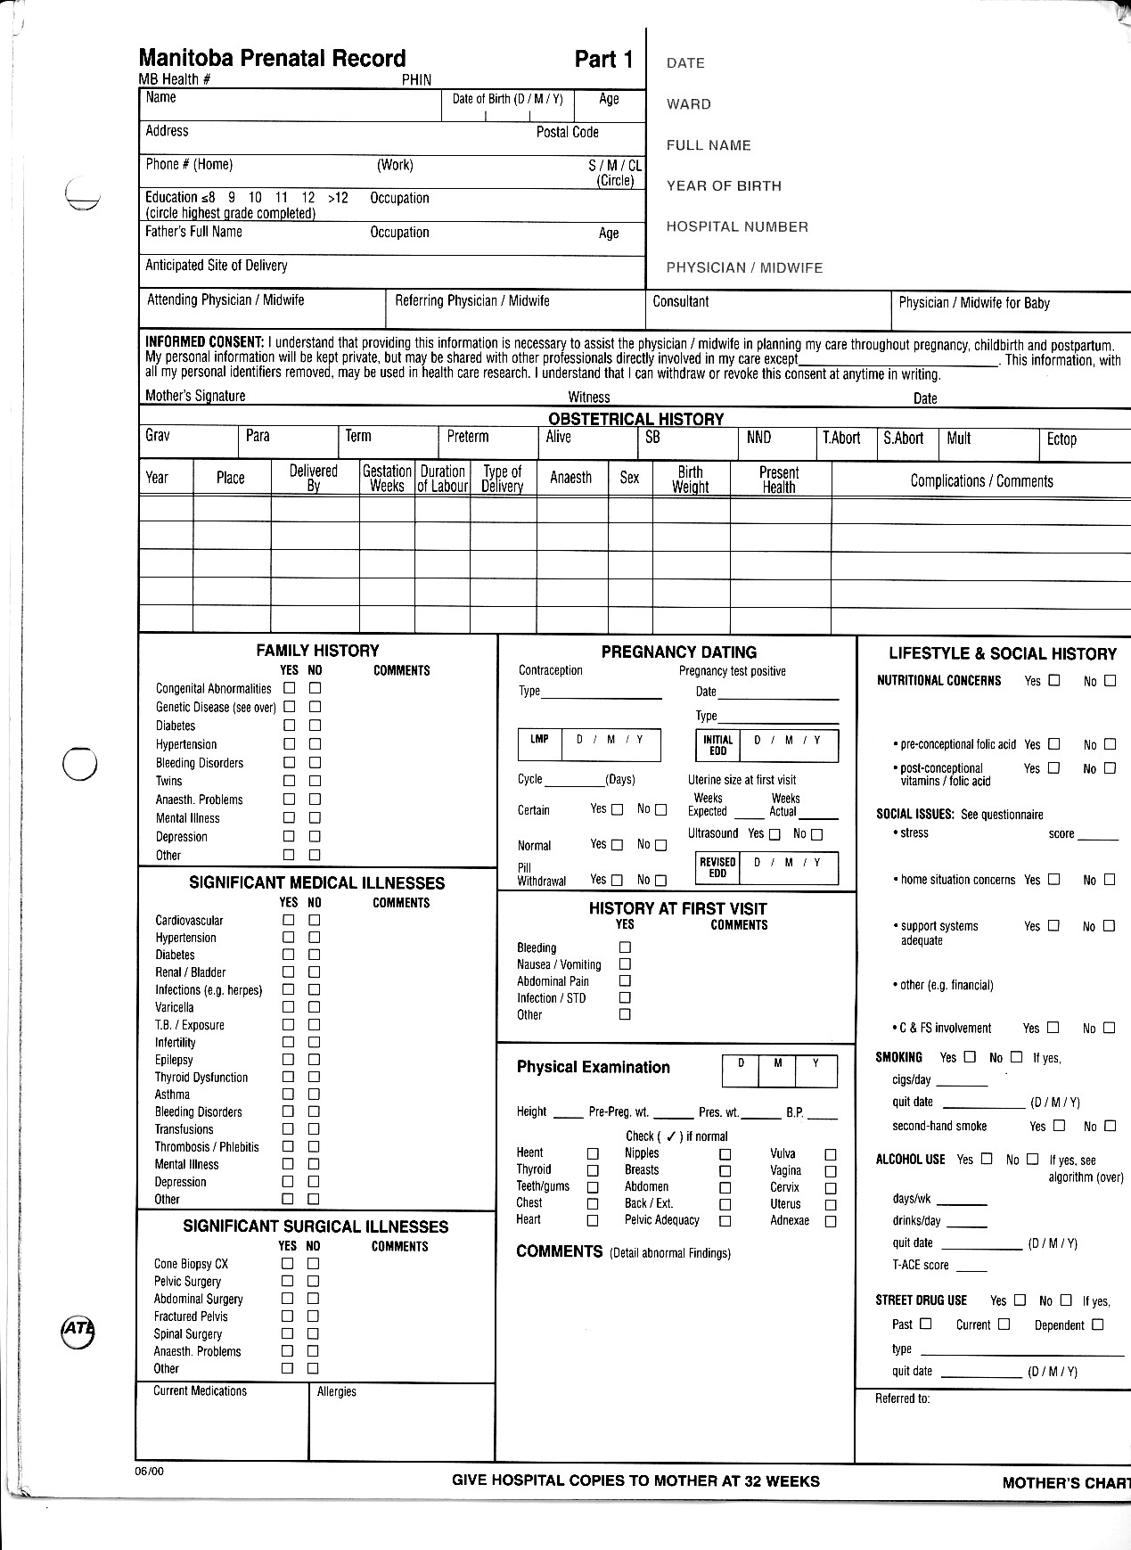
Prenatal Forms

Slide 13
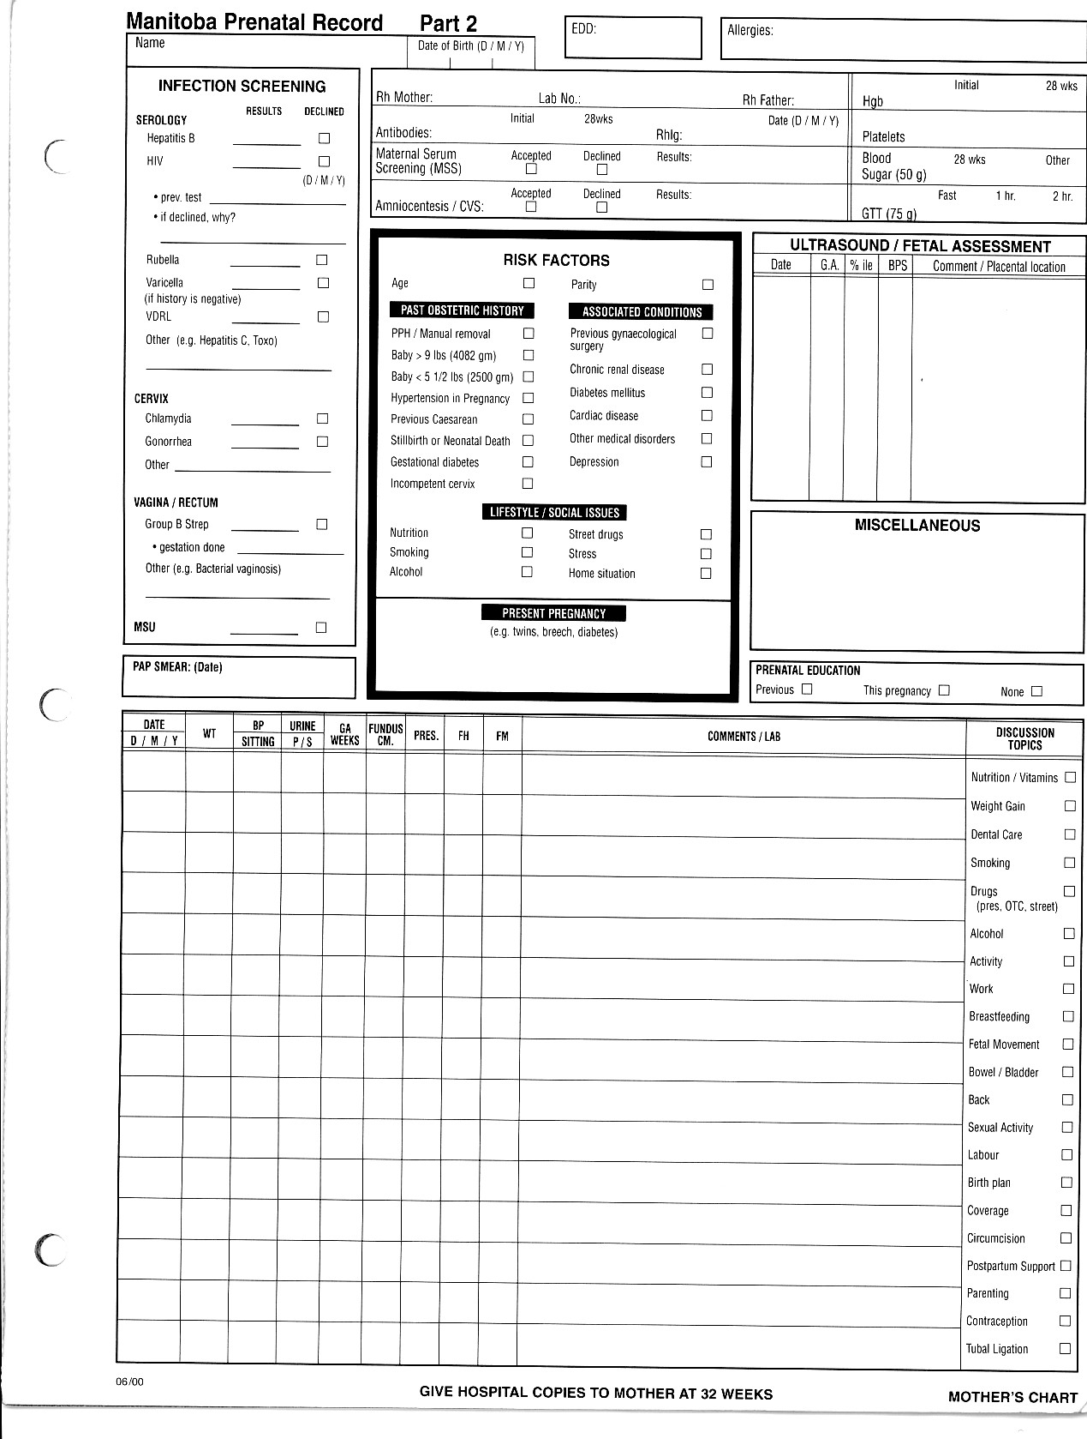
Prenatal Forms

Slide 14
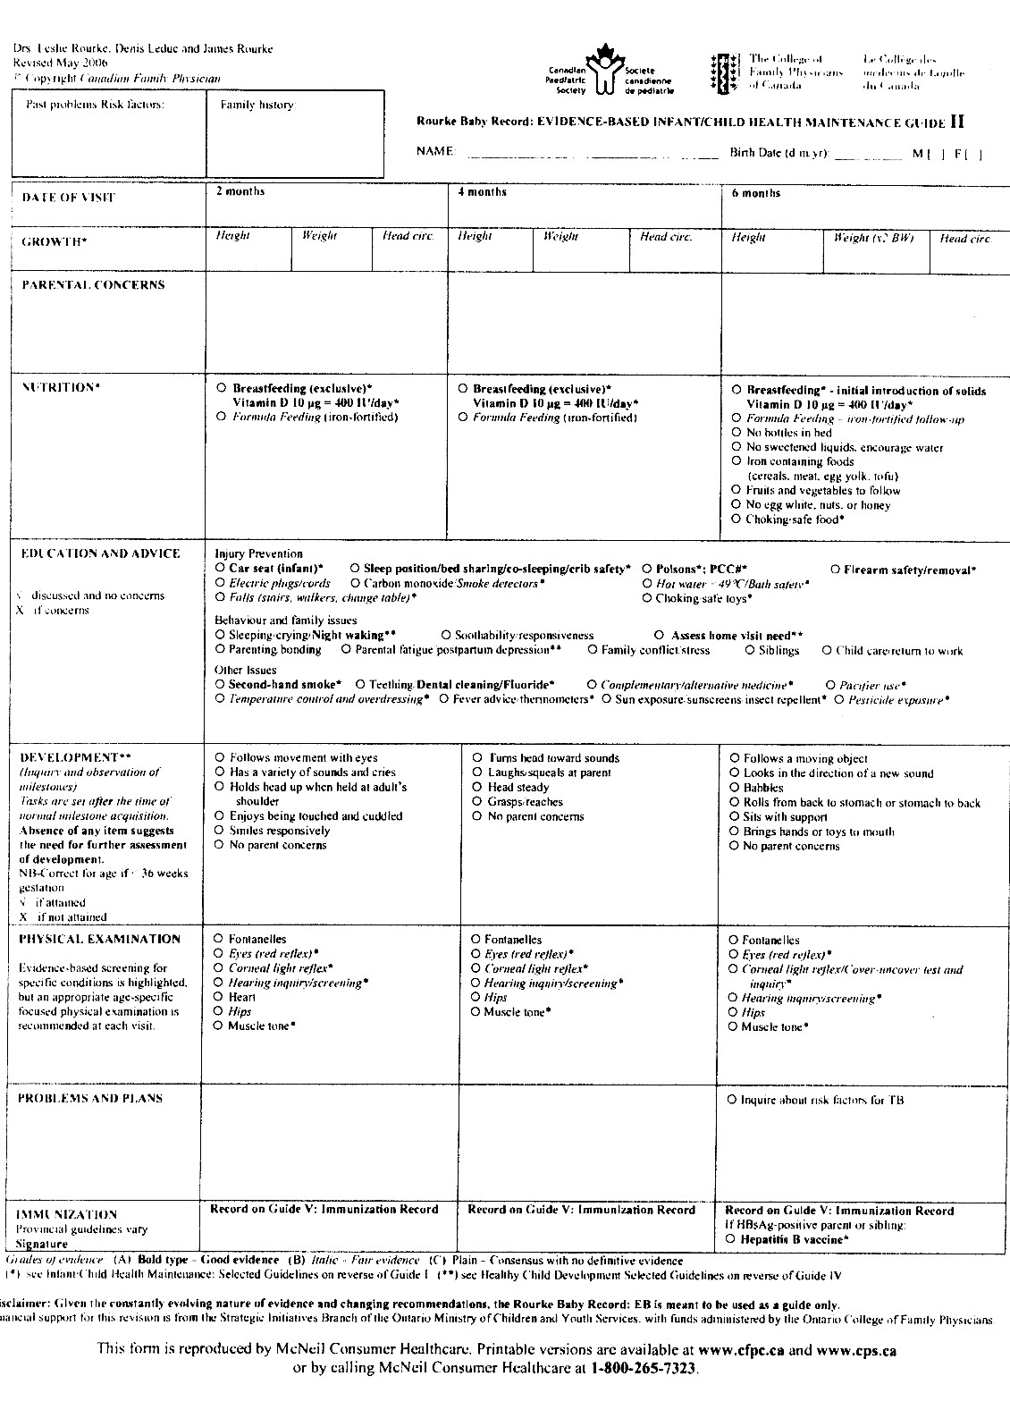
Rourke Baby Record

Slide 15
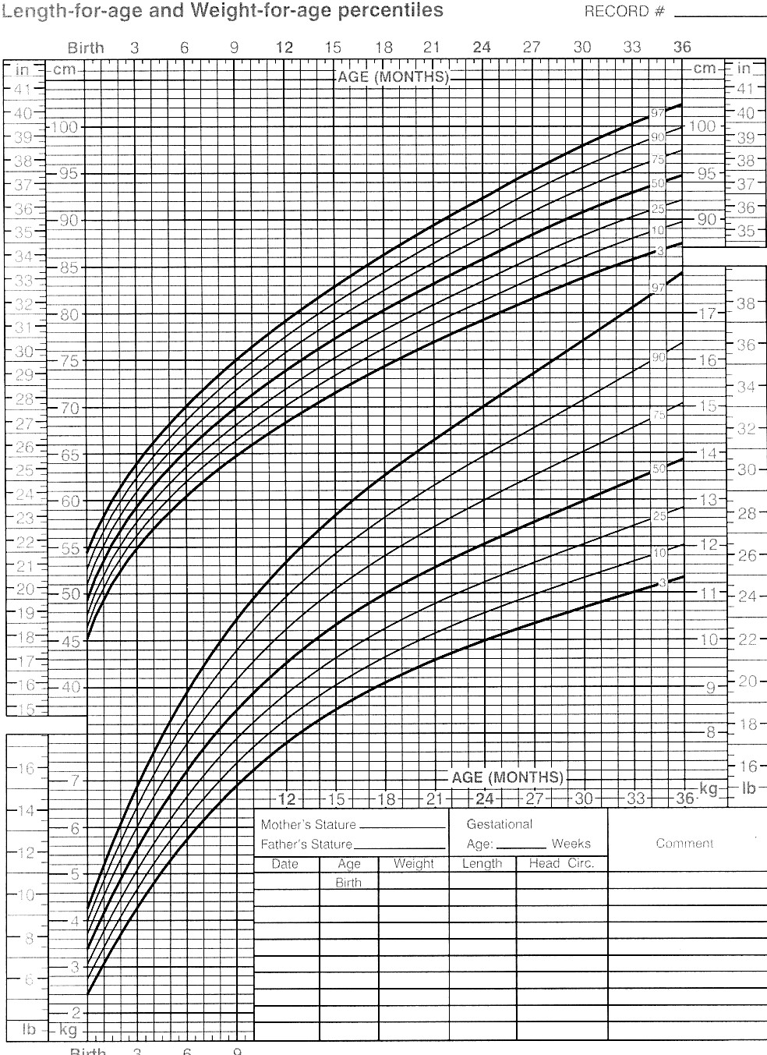
Growth Chart

Slide 16
Referral Letter

Slide 17
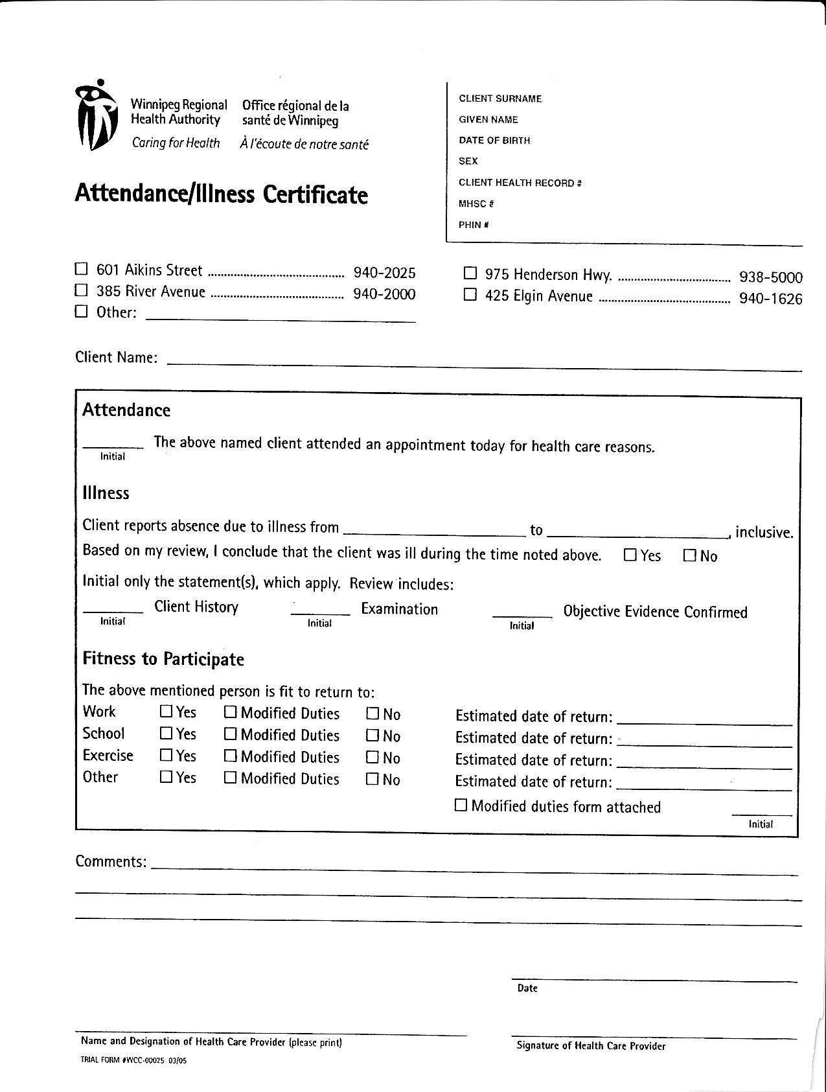
Sick Note

Slide 18
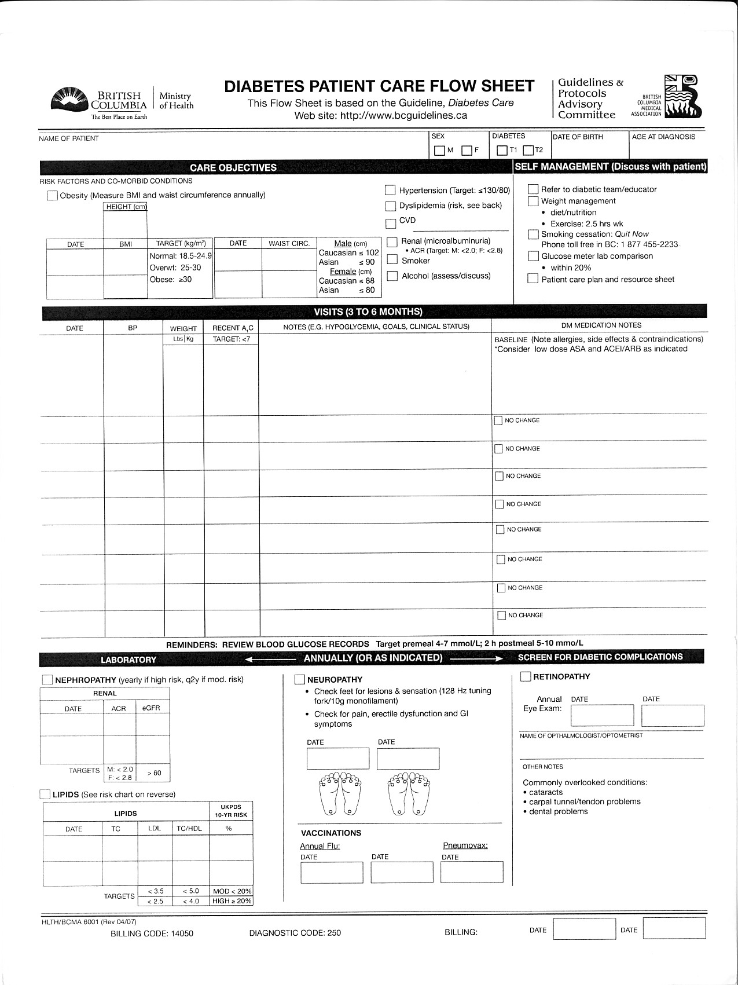
Diabetes Flow Sheet Flow sheets also available for other chronic conditions

Slide 19
Pearls
As an auditor, look for cohesive information – can you tell what is going on with the patient?
Adequate history and physical exam
Recording of prescriptions
Completion of problem lists, past history, social and family history
Use/overuse of templates or macros

Slide 20
Questions?
msinger@cpsm.mb.ca

