Slide 1
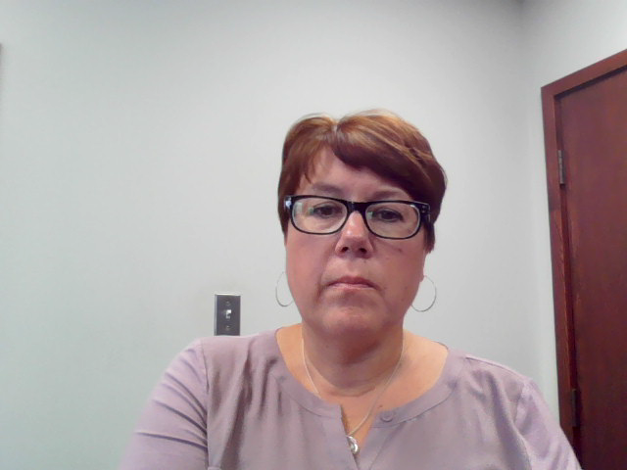
Roles, Responsibilities and Reporting Requirements of a
Practice Supervisor
October 2020

Slide 2
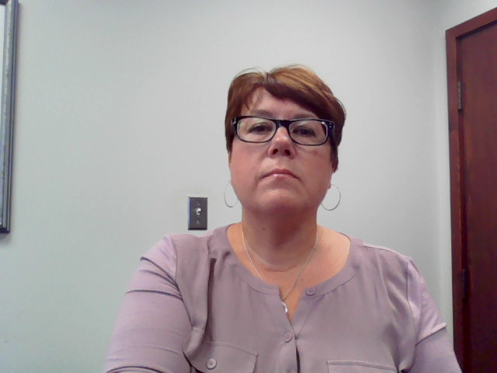
Qualifications and Criteria of a Practice Supervisor
Must not currently be the subject of any disciplinary proceedings
Must have a certificate of practice and registration to practice independently in the province
Must be in practice a minimum of 2 years
Notes:
In order to be approved as a PS, a physician must be practising in MB for 2 consecutive years and be practising in a similar scope of practice in the same geographic location (if possible). Consideration may be given should a physician be in the same specialty but is not available in the same region.
Although the supervisor should not be the subject of any disciplinary proceedings at the time that they are appointed as a practice supervisor, if they have previously been the subject of a disciplinary action, depending on the nature of the discipline, this may not always preclude them from acting as a practice supervisor.

Slide 3
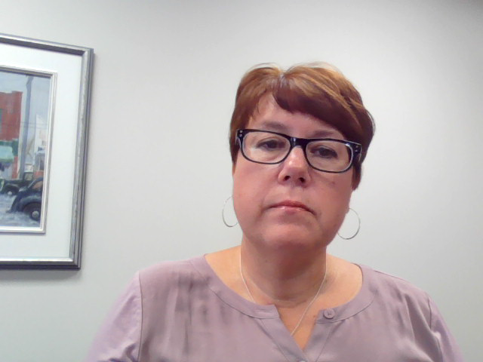
Roles and Responsibilities of a Practice Supervisor
To review the provisionally registered physician’s practice at regular intervals
      Is the physician practising safely?
      Does the physician meet the expected clinical standards of care?*
Maintain appropriate boundaries
Must be an unbiased reporter of observations
Must provide written reports
Must relay information to the College should the requirement for additional monitoring be identified
Must provide feedback to the provisional registrant which could help identify physician enhancement opportunities and/or assist in learning about community resources to help meet patient needs
The supervisor should have a similar scope of practice and be in the same geographic location as the provisional registrant
    *Medical standards of care defined as the level at which the average, prudent provider in a given community would practice. It is how similarly qualified practitioners would have managed the patient’s care under the same or similar circumstances.
Notes:
The primary responsibility is to review the physician’s practice at regular intervals for the first 2 years that they are in practice:
Is the physician practising safely?
Do they meet the expected clinical standards of care?
Remember, your role is a “friend to the College”
You will:
- provide written reports to the College and will share these reports with the physician
- provide feedback to the physician to identify strong and weak points in their practice

Slide 4
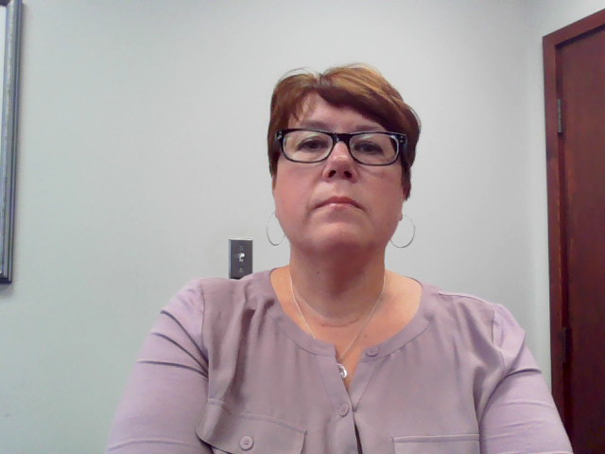
Agreements
An undertaking is signed by the provisional registrant for the entire duration of provisional registration
The practice supervisor must also sign an undertaking
The supervision phase of practice is clearly defined
If the practice supervisor resigns or ceases practice in Manitoba, the provisional registrant must stop practice until a new practice supervisor is appointed and approved by the College
Notes:
Undertakings must be signed by the physician being supervised and the practice supervisor prior to registration being granted.
The agreement clearly outlines the expectations of both and when reports are due.
If the PS ceases practice, a new PS must be appointed immediately and approved by the College. The College can provide assistance and should be contacted as soon as you know that you will be leaving.
Should you be away from practice either for vacation or an LOA, contact the College to make alternate arrangements for that time. A new PS may or may not need to be appointed.

Slide 5
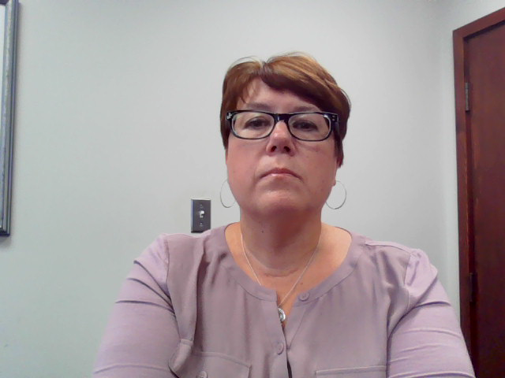
What is a Provisional Registrant?
A physician who does not yet meet the requirements for Full (Practising) Class Registration
Under the College’s current regulation, Provisional Registrants are given a specific time frame to meet the requirements for Full (Practising) Class Registration
Notes:
A phyisician who does not meet the requirements for full practising class registration, may meet the requirements for provisional class registration. Registration would be for a maximum of 5 years. Therefore, you may be a PS for a physician for up to 5 years, although the reporting requirements will end at the end of the 2nd year.

Slide 6
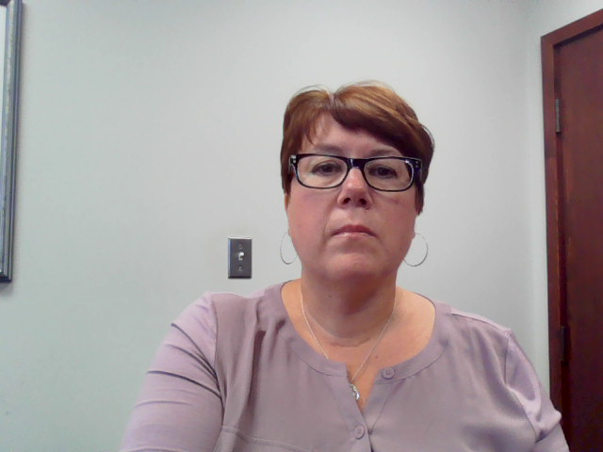
Requirements for Full (Practising) Class Registration
Family Medicine
  must obtain the Licentiate of the Medical Council of Canada (LMCC) and College of Family Physicians Certification Examination (CCFP) within 5 years of the initial date of provisional registration; OR
  Successfully complete the Manitoba Practice Assessment Program (MPAP)
Specialty Area of Practice
  must obtain the Licentiate of the Medical Council of Canada (LMCC) and Royal College Certification within 5 years of the initial date of provisional registration; OR
  Successfully complete the Manitoba Practice Assessment Program (MPAP)
Notes:
The requirements for FR for family practice are LMCC and CCFP (or MPAP) and for specialty practice the LMCC and RC (or MPAP)

Slide 7
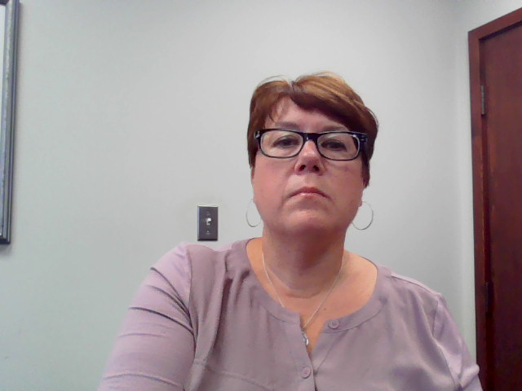
Length of Period of Supervision
Supervision is one component of a progressive path to Full (Practising) Class Registration
Some components remain in place until the physician obtains Full (Practising) Class Registration
Components and frequency of reporting are determined by the College
Supervision, for most provisional registrants, will gradually reduce throughout the duration of Provisional Registration
Notes:
As indicated earlier, a provisional registrant has 5 years to meet the requirements of full practising class.
Monitoring and reporting is scheduled for the first 2 years in practise. Should you feel that the physician is practising at an acceptable level after two years, you would not be requird to submit further reports or have scheduled meetings (unless you have a special arrangement with the physician).
However, you should always be available to the physician you are supervising until the physician is no longer provisionally registered.

Slide 8
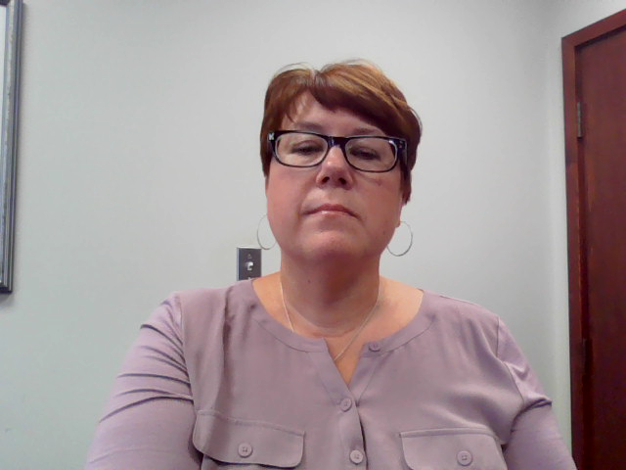
Frequency of Reporting
Although a reporting structure will be provided, should there be concerns about competence at any time, more frequent reporting may be required
Reports are shared with provisional registrant to identify personal areas for continuing professional development
Report must be signed by provisional registrant and shared with the Mentor (if applicable)
Report will be held on file by College
Notes:
Reporting intervals are outlined in the signed undertaking:
After month 1, 2, 3
External chart audit at month 6
After month 9
360 review after 1 year
After month 18 and 24
Additional reports (if required)
Reports should be shared with the physician, signed by both and also shared with the mentor
Reports must be submitted to the College (on the timeline provided)

Slide 9
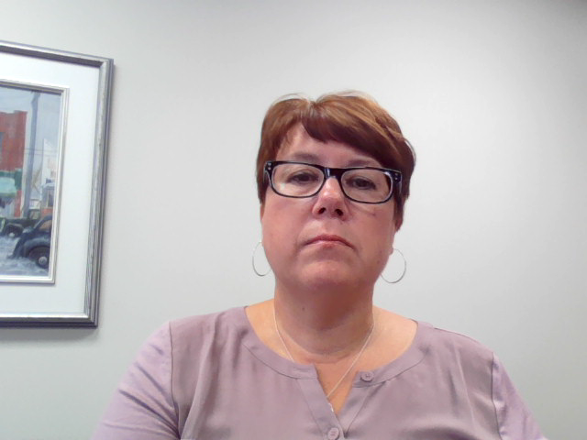
Reporting Requirements for the Practice Supervisor
A reporting structure is provided by the College, prior to supervision commencing
A formal documented report (template provided by the College) is required
The report must include the tools used by the practice supervisor for the chart review (stimulated chart recall, interviews with other health professionals/staff, direct observation – if required - and communication skills assessment)
Specific areas where professional development or upgrading are highlighted
Notes:
A monitoring report template is provided to the PS
The report will consist of reviewing charts individually and then discussing with the provisional registrant in the areas of strengths and weaknesses
If there are areas of improvement, suggestions should be given with respect t how to improve and resources provided. These areas should be noted on the following report to note whether or not improvements have been made. If not, this should be addressed with the physician and with the College (if required)

Slide 10
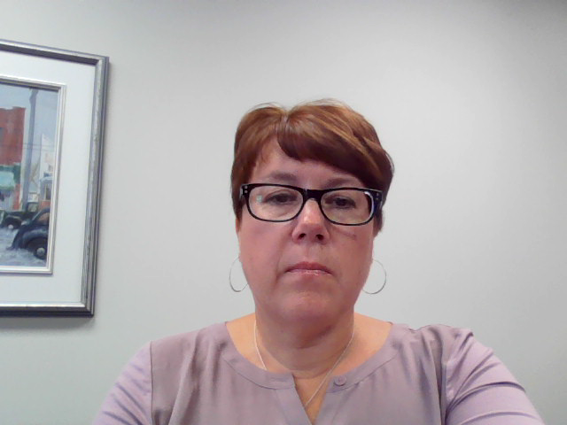
Reporting Schedules
Practice Ready Assessment (PRA’s) Registrants, MLPIMG’s and Exam Eligible Physicians
    Monitor Reports:
        Every month for first 3 months
        9, 18 and 24 months
        Immediately if there is a breach of responsibilities or patient safety concerns
        Anytime as deemed necessary by the Registrar
  External Chart Audit – 6 months
  360 review between 9 and 12 months
Notes:
This was outlined under Frequency of Reporting

Slide 11
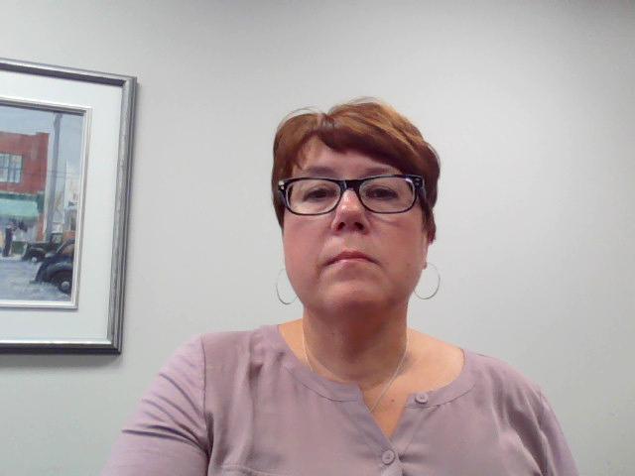
Basis of Immediate Reporting to the College
Supervised physician’s practice may expose patients to risk/injury
Supervised physician’s conduct presents a concern
Supervised physician is practising below standard
Supervised physician fails to comply with the terms of the undertaking (which includes missing an appointment with the supervisor without sound reason or being uncooperative)
Supervisor is unable to continue the role on a timely or temporary basis (ie. Illness, vacation, etc.)
Supervisor becomes the subject of an investigation by the regulator
Notes:
Immediate reporting is required if:
- there are patient or physician safety concerns
- If the physician is practising below standard or noncompliant.
Or If you are unable to fulfil your role
As noted previously if you are the subject of an investigation, it may be deemed that it may not be in your best interest (or the interest of the physician) for you to continue as a PS until the matter is resolved.

Slide 12
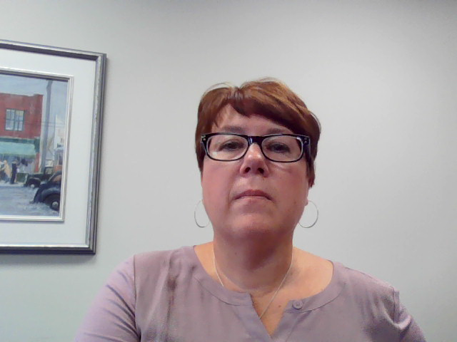
Meetings – Responsibility & Format
Make it as stress free as possible
Somewhere private and quiet
Ensure they know specifically where and when
Who will arrange the meeting?
When will first point of contact be? Before physician starts? Telephone? Email? In person?
Will the physician be in the room with you while charts are reviewed?
How much time will you need?
How much time should the physician schedule for the meeting?
Notes:
Meetings between the PS and physician set the tone for the relationship
Who will arrange the meetings? Will it be you or your assistant?
Who will be responsible for pulling the charts? Are the charts paper or do you require access to the EMR?
Will you require the physician to make note of charts they wish to discuss with you?
How many charts?
Will you review the charts first, then meet with the physician?
Do you want them in the room with you while you review the charts?
Will the meeting be face-to-face? By Zoom? By Email?
Should they book time off and how much time should they book?
These are all scenarios that you may want to determine or discuss with the physician ahead of time

Slide 13
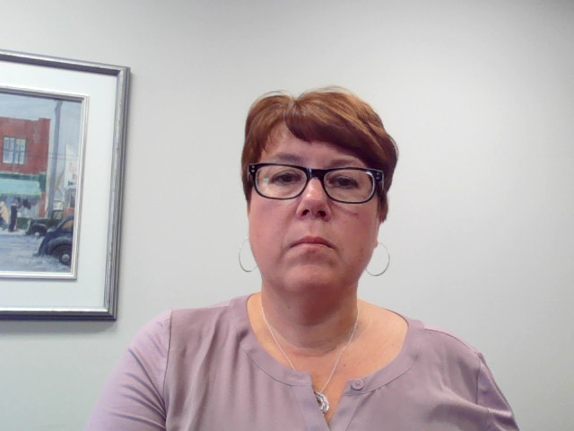
Feedback
Explain how you will provide feedback
Finding and improving on weaknesses
Evaluating and improving knowledge of system
Evaluating and assessing and addressing conflicts, eg. MAID, abortion
Be clear as it is educational – not punitive
Explain there may be deficiencies to address
  How you will deliver suggestions for improvement & how these will be reviewed at next meeting
Notes:
When you first meet with the physician, explain clearly how you will provide feedback.
Indicate that there may be deficiencies and weaknesses uncovered and how you will address these at each meeting.
Remember…your role as PS is educational and not punitive. Should issues arise that are beyond your scope as a PS, these should be relayed to the Regisrtar and will be dealt with by the Registrar.

Slide 14
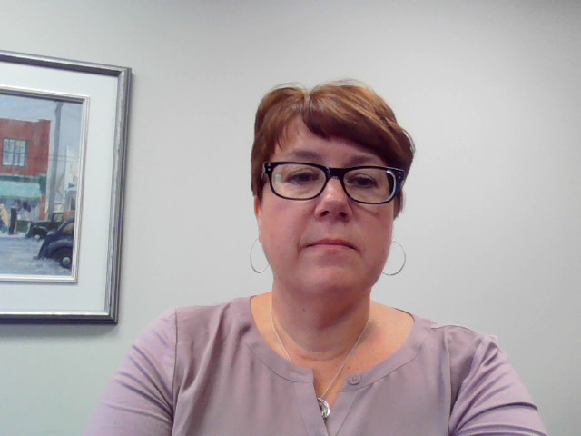
QUESTIONS?
Any questions regarding payments can be made to:
Sean Brygidyr Sean.Brygidyr@gov.mb.ca
Executive Director, Workforce
Manitoba Health, Seniors and Active Living
300 Carlton Street, Wpg MB, R3C 3M9
(204) 788-6767

